Slide 1
WELCOME TO Literacy/Content AREAS & Technology Training!
Be sure to sign in. ☺
Please choose a table for your collaboration team according to the table signs.
Notes:
Sign in = payroll reporting (YOU MUST SIGN IN TO GET PAID).
Sit with your team or those at your grade level. June 11/12- have table tents for grade levels, August 11/12 – have table tents for grade levels. June 16-25- have 2 table tents for K-2, 3-5

Slide 2
Agenda
2014-2015 Literacy Curriculum Guides & Assessment Plan
Technology and Literacy
Teacher-Created/CUTEE Resources
Think Central Resources
Smart Exchange Resources
12:00pm Lunch
VI. Social Studies Curriculum Guides & Resources
Science Curriculum Guides & Resources
Health Curriculum Guides & Resource
4:30pm Dismissal
Notes:
Full agenda with lots of time for collaboration around each resource.
You have agenda at your table to review times as well. ☺

Slide 3
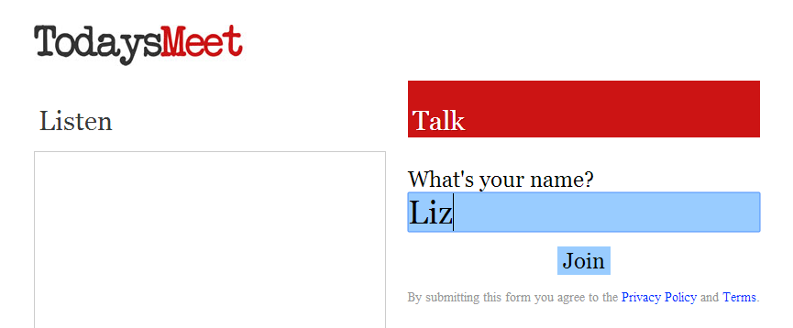
todaysmeet.com/summerpd
Questions or comments during today’s sessions can be posted at todaysmeet.com/summerpd
Notes:
Enter name, click join

Slide 4
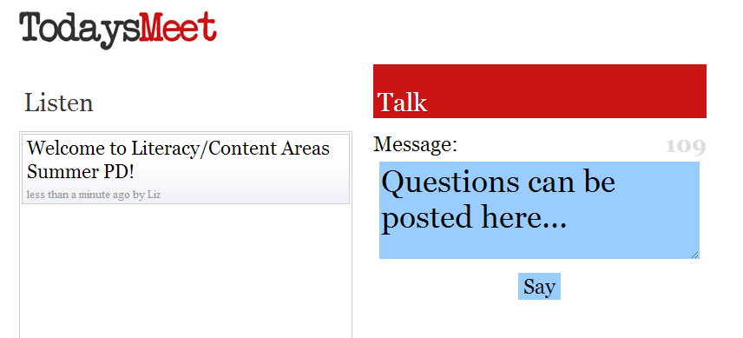
todaysmeet.com/summerpd
Type your question or comment
Click “Say”
Feel free to respond to each other. We will also try to get on and respond as much as possible during the session so check back!

Slide 5
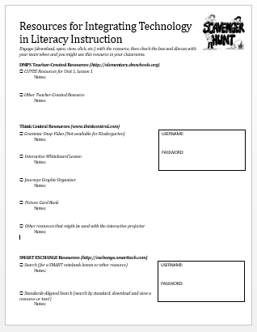
Resources for Today’s PD
Agenda & Scavenger Hunt
Use this document during collaborative planning time to help you explore each resource.
Notes:
The handout you picked up as you signed in
If you take a look at the agenda, you will see we have lots of time planned for collaboration around each resource that we showcase here for you.
Additionally, on the back of the handout, you will find a scavenger hunt that offers a spot for you to take notes how to access the resource or things you want to remember about the resource. It’s a long way to the start of the year and we want you to be able to take what you’ve learned today and apply it when school starts again.
You will want to make sure you check out each resource during the collaborative planning time and if applicable, write down the username and password so you don’t forget when Fall comes.

Slide 6
Resources for Today’s PD
elementary.dmschools.org
Notes:
We have a new website for elementary teachers. We recognize that you teach it all in most cases so we wanted to have everything in one spot. On this website, you will find literacy and math resources, as well as science, social studies, and health resources.
Assessments, Curriculum Guides, and Teacher created resources are all in this one spot.
Along with some resources from today’s PD under the PD heading, on the Summer PD 2014 page.

Slide 7
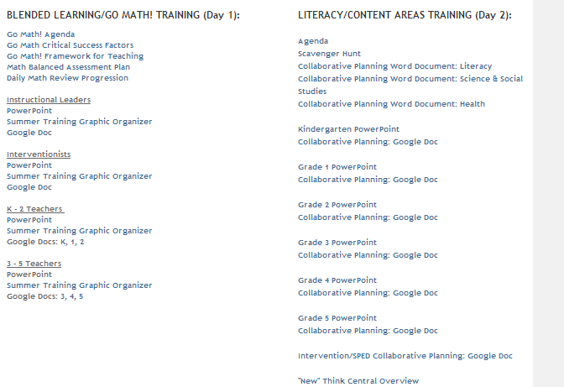
Resources for Today’s PD
elementary.dmschools.org
Notes:
When you go this page, everything we talk about or use today is outlined and available under “Literacy/Content Areas Training (Day 2)”

Slide 8
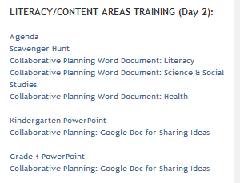
Resources for Today’s PD
*Same documents as today’s handouts
Notes:
There you will find electronic versions of the Agenda and Scavenger Hunt, in case you prefer to fill out the scavenger hunt electronically and save it on your computer for next year

Slide 9
Resources for Today’s PD
*Documents that can be used during collaborative planning time
*A planning document MUST be used for AEA/Drake credit
Notes:
Also, you will find some documents to help guide your thinking during the collaborative planning time. You will find a hard copy at your table of these documents, but they are probably best used electronically so we can save them to our computers (and not use them).
This document simply gives you space to plan for how you will integrate technology into each unit for literacy, science/social studies, and health.
If you or your building already have a document that you use for planning, feel free to use that instead. If you are wanting AEA/Drake credit, you MUST fill out a planning document with your ideas from today. It doesn’t have to be this one.

Slide 10
Resources for Today’s PD
*Today’s PowerPoint (follow along if you want!)
Notes:
Since we all learn at a different pace, I wanted to make sure you had access to the PowerPoint that we are using today so that you can review at your own pace during our PD time. There are some links in the PowerPoint too that you might find helpful.
Be sure to click on your own grade level’s PowerPoint so that you can view the grade level classroom examples that are embedded as well.

Slide 11
Resources for Today’s PD
*During today’s collaborative planning time, feel free to share ideas via the Google Docs
Notes:
Lastly, each grade level also has a google document, along with one for intervention/ELL/Sped support.
One of the biggest benefits of having teachers from many schools come together is to learn and grow from each other. These documents will allow us to collect our ideas and share them with each other. Since we have teachers at all grade levels present, be sure to use the appropriate google doc. Intervention/ELL/SPED might find it more applicable to add to the specific grade level with which the resource would work, but I put a separate document there for you guys as well- just in case. You will find a spot to record technology integration ideas for literacy, science, social studies, and health on each googledoc.
I am requesting that one person per table take a few minutes to record that table’s best technology integration ideas on this document during each collaborative planning time. As we host PD sessions for the next two weeks, these documents will continue to be edited and added to. You can access the document at any time for ideas.

Slide 12
Norms
Active Listening:
Self-monitor use of electronics
Feel free to follow along on your computer during explanation and demonstration portions and take notes if desired (We have some WIFI devices that can be used if needed- Let us know!)
Raise hand or flag me down for individual assistance
Stay focused on the topic at hand- avoid working on other tasks
Exploration: Scavenger Hunt & Collaborative Planning:
Collaborate with your team
Explore the resource by using the Scavenger Hunt to make sure you are finding all the important pieces and features
Plan for instruction using structured Collaborative Planning document or your own document
Share ideas with other teams using the Collaborative Planning googledocs
Notes:
All that being said, know that Norms must look different because we really want you out there exploring these resources while we are explaining and demonstrating.

Slide 13
Tablets
Notes:
Hide slides until Tablets are available.

Slide 14
Tablet Introduction
Notebook, tablet, and everything in between
Not only can you twist and fold the notebook’s display into a tablet and back again, the software was made for touch.

Slide 15
Tablet Introduction
Designed for durability
The HP EliteBook Revolve meets military standards 810G testing³¹ for drop, vibration, functional shock, dust, altitude, and high and low temperature.
Premium materials like scratch-resistant Corning® Gorilla® Glass 3 and an all-magnesium chassis are designed to excel in the field.

Slide 16
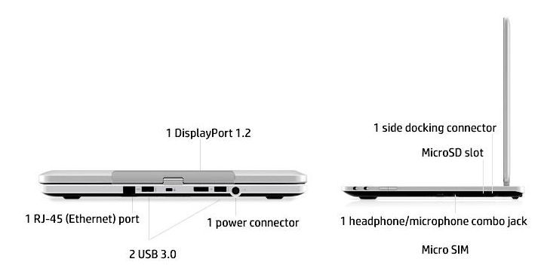
Tablet Introduction
Connect to displays, projectors, and accessories through USB and DisplayPort:

Slide 17
Tablet Introduction
Battery Life- UP TO 8.25 hours
Battery life will vary depending on the product model, configuration, loaded applications, features, use, wireless functionality, and power management settings. The maximum capacity of the battery will naturally decrease with time and usage.
Notes:
Apple lists the battery life of an iPad as up to 10 hours on wifi
2.5 hours to get full charge back if turned off while charging, 3-5 hours if turned on

Slide 18
Tablet Introduction
Use them today during exploration time or during the presentation to access the resources so you become familiar with how they work.
During exploration time today, discuss and plan how you will have students use the tablets in your classroom with the resources discussed

Slide 19
2014-2015 Literacy
Curriculum Guides & Assessment Plan

Slide 20
New Website
elementary.dmschools.org
Math, Literacy, Content Areas Guides (with links)
Assessment information
Teacher Created Resources
Links to SharePoint folders by unit
Review during Summer PD
Grades 2-5 Literacy CFA Resources
Resources
Increased/Decreased Needs
Common Core
T & L
PLC
2013-2014 Resources
PD
Blended Learning
Close Reading
Balanced Math
Kite Project
Summer PD 2014

Slide 21
Literacy Guides
Standards for each unit will remain the same for the 2014-2015 school year
Formatting of the guides has changed slightly.
Additional information about Journeys materials (titles/genre) have been added to each lesson
Guides will be printed as part of Teaching and Learning documents and delivered to buildings in the fall (similar to last year)
2014-2015 guides are available NOW at:
elementary.dmschools.org
Notes:
Changes were based on feedback collected though the form on the Elementary Literacy website.

Slide 22
Literacy Guides
Notes:
Only change is the addition of Main Selection & Genre to each unit’s guide

Slide 23
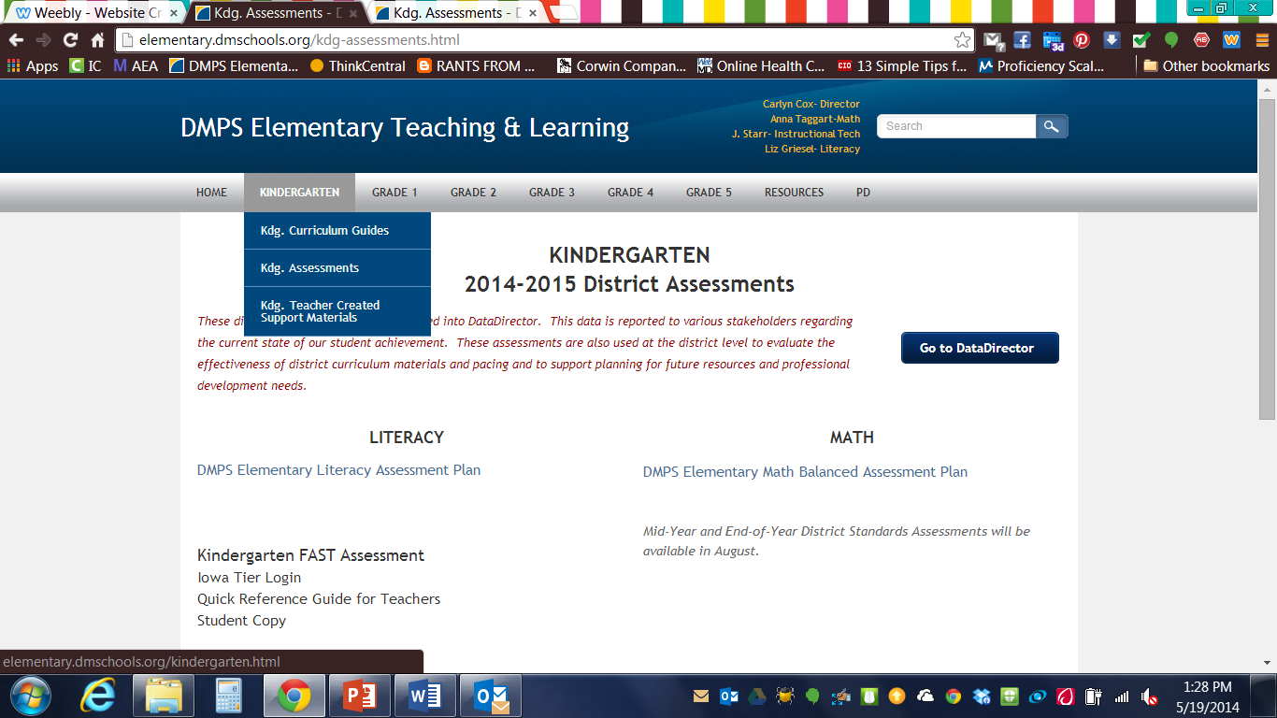
2014-2015 Literacy Assessment Plan
elementary.dmschools.org
Notes:
Change- At kindergarten ELS is replaced with earlyReading Assessment in Fall, Winter, and Spring.
At first grade, PA profile in Fall and BRI in Winter are replaced with earlyReading Assessment

Slide 24
New Infinite Campus
Data Director will be available (and required for district assessment) through 2015
Fall 2014 = “new” Infinite Campus
Training for all on district-directed pre-service day
Building IC skill set in 2014
Use IC with SRG understanding in 2015
Fall 2015 = NO Data Director

Slide 25
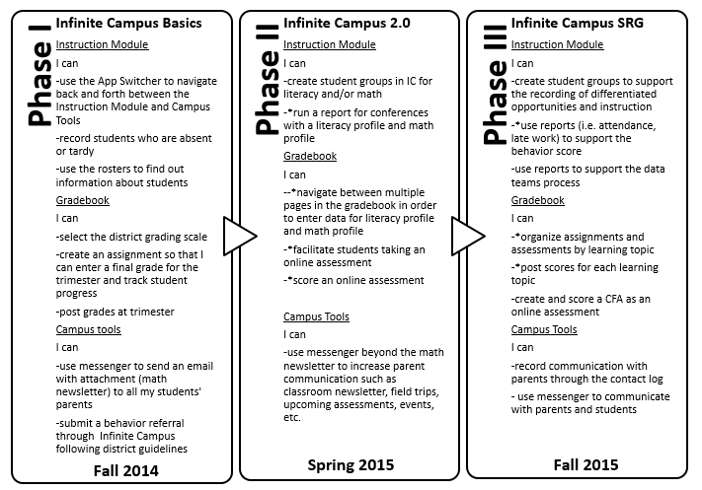
New Infinite Campus: 3 Phase Plan
Training Fall 2014 at your school:
Continuous- July 14
Extended August 11
Traditional- August 18
Date and Time of Training
Continuous Calendar Schools | Extended Calendar Schools | Traditional Calendar Schools
Morning of July 14, 2014 (led by District IC Experts) | Morning of August 11, 2014 | Morning of August 18, 2014

Slide 26
New IC: Teacher Training
Teachers will be trained by their School IC Support Team.
Expectations:
Teachers will accurately record attendance in IC.
Teachers will accurately report and communicate student progress through IC using the gradebook.
Teachers will utilize Campus Messenger to increase communication with parents.
Teachers will submit behavior referrals in IC following district guidelines.
Training Fall 2014 at your school:
Continuous- July 14
Extended August 11
Traditional- August 18

Slide 27
Introduction to Technology & Literacy

Slide 28
What is “Literacy?”
Literacy is tied inherently to technology because technology profoundly affects how we communicate.
“Literacy”
A basic definition: the skills needed to read and write
A more complex definition: the skills necessary to communicate effectively within a particular cultural context
As technology advances, “literacy” instruction must advance too.

Slide 29
When do students use “literacy skills?”
Students learn about reading from experiences in text in various media:
Computerized Story Books/eBooks
Games
Music
Film
Television
Search Engines
Instant Messaging
Email
Social media (Facebook, Twitter, etc)
As technology advances, “literacy” instruction must advance too.

Slide 30
What skills are involved in “literacy?”
Skill areas related to literacy instruction:
Collaborating with others
Communicating with others
Finding and evaluating information
Solving problems by creating and communicating solutions
Quick Write:
How does technology influence what students need to learn and how students learn these skills?
Notes:
Share QW with a partner

Slide 31
Expectations for Technology Integration into DMPS Literacy Instruction
Try new things to grow as a teacher!
Be open-minded
Use available technology in your classroom to enhance your current literacy instruction
No district requirement at this time on when or how to use a specific technological resource in literacy.
Notes:
Knowing that literacy is communication and communication in 2014 often means the use of technology, we have to embrace some changes to the way we teach literacy.

Slide 32
Saving your summer PD information
Notes:
With that being said, we are going to explore a lot of technology resources today, and you may want to have a consistent place to save them. During the math training, if you attended, J talked through saving to OneDrive. Here’s a quick review on how to do that.

Slide 33
OneDrive Saving
Cloud-based storage
Tied directly to your email address and district login
Accessible from anywhere with internet access
Available across multiple platforms

Slide 34
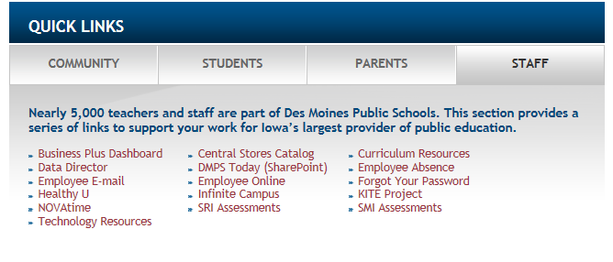
Accessing OneDrive
Click on the Employee Email link from the DMPS homepage

Slide 35
Accessing OneDrive
Once logged in to your Office 365 account, you will see a link for OneDrive in the upper right hand corner

Slide 36
Accessing OneDrive
This will take you to a “My Documents” folder in the cloud
This is not tied to anything else that you have ever saved documents to (This is NOT the “My Documents” on your hard drive)
You can sync this folder to other locations, but we will not be discussing that today.
This is housed in the cloud and available anywhere you can log in to your email account

Slide 37
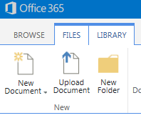
Accessing OneDrive
Click the “File” tab, and then “New Folder” icon

Slide 38
Accessing OneDrive for Business
Name your new folder “SummerPD2014”

Slide 39
Accessing OneDrive for Business
After clicking “Save,” you will see that folder show up in your document list.
Click the “SummerPD2014” folder to open.

Slide 40
Accessing OneDrive for Business
Drag and drop any files from your desktop or downloads folders to this location for future use
The file will be COPIED into the OneDrive folder. You need to access the item through OneDrive when you make changes, not through the original source (your desktop, downloads, etc).
Since you will receive a lot of resources during these PD sessions, please save anything you feel may be valuable in the future to this location for easy access.

Slide 41
CUTEE Resources & Teacher Created Materials

Slide 42
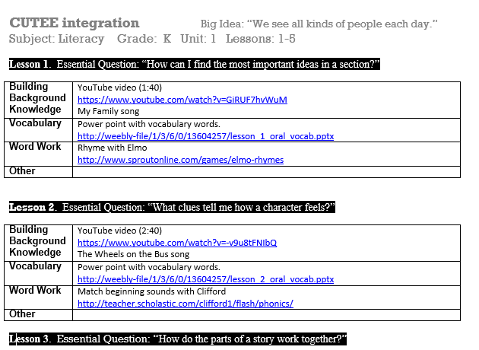
CUTEE Resources
Compiled by the CUTEE group (Curriculum Using Technology to Engage & Enhance)
Live Links
ONE document with all lessons for EVERY unit in EVERY grade level

Slide 43
Accessing CUTEE Resources
“Teacher-Created Support Materials”

Slide 44
Accessing CUTEE Resources
“Literacy”

Slide 45
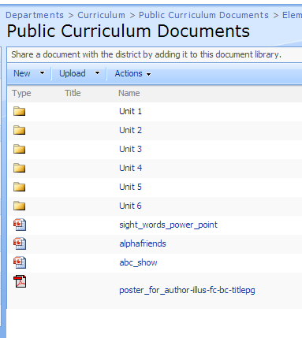
Accessing CUTEE Resources
Choose Unit
OR
Generic Items listed below folders

Slide 46
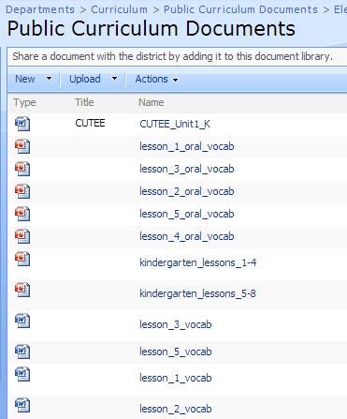
Accessing CUTEE Resources
The CUTEE document is titled “CUTTEE” and saved as name “CUTEE_Unit#_Grade” with description of “CUTEE”

Slide 47
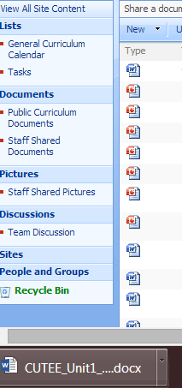
Where did it go?
Click to download:
OR
Notes:
1- appears at bottom
2- appears in downloads

Slide 48
Save it where you want it!
Click “Save As” once in the presentation/document and choose a location where you want to save the resource
Cloud accounts (onedrive, googledrive, dropbox) will keep your computer running quicker by keeping huge files off your harddrive
Save it to a spot that makes sense so you can find it later!

Slide 49
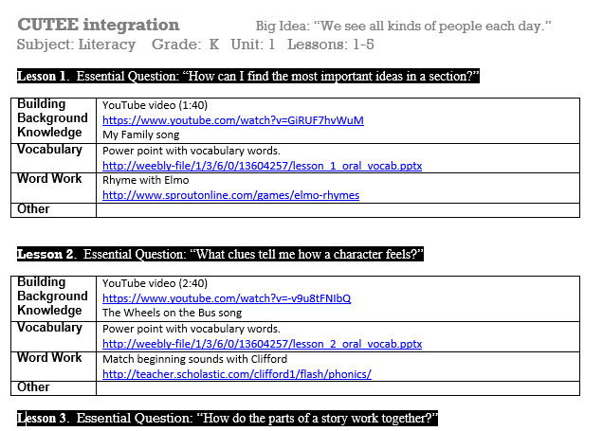
Accessing CUTEE Resources
+
Notes:
Once in the CUTEE document:

Slide 50
Accessing Teacher-Created Materials
MANY documents and presentations submitted by teachers across DMPS
Submit your own resources by emailing it to Liz (Elizabeth.Griesel@dmschools.org

Slide 51
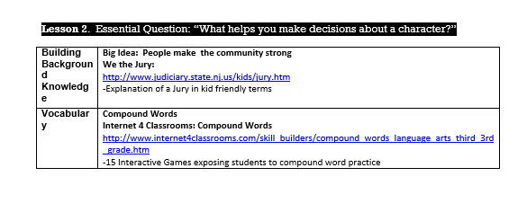
3rd Grade Classroom Example
The following example could be used to build background knowledge before reading The Trial of Cardigan Jones (Grade 3, Lesson 2)
Locate CUTTEE Resource for current unit, browse options by clicking on links

Slide 52
3rd Grade Classroom Example
The website offers an explanation courtroom procedures in student-friend terms and includes a quiz at the bottom.
http://www.judiciary.state.nj.us/kids/jury.htm

Slide 53
*Classroom Example*
Vocabulary Introduction- Animoto Video
Word Work Websites
Notes:
Esther will quickly review how to access and then play lesson 26 video.
Then will show lesson 26 & 27 examples for word work- emphasizing not all lessons come from the same website

Slide 54
Exploration: Scavenger Hunt & Collaborative Planning

Slide 55
Reminder of Norms
Exploration: Scavenger Hunt & Collaborative Planning:
Work with your team
Explore the resource by using the scavenger hunt (handout) to make sure you are finding all important pieces and features
Plan for instruction using structured “Collaborative Planning” document (available on website) or other document
Share ideas with other teams using the google doc

Slide 56
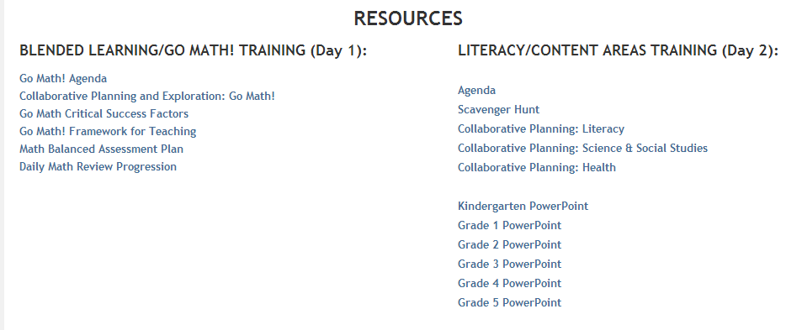
elementary.dmschools.org
PD> Summer PD

Slide 57
Exploration: Scavenger Hunt & Collaborative Planning
Take a break, too!

Slide 58
Share Out
Share an idea or “aha! moment” your team discussed during Exploration time using the googledoc on the website.
Check out the google doc posted on the website for cool ideas that YOU might want to use, too!

Slide 59
*Brain Break*
Body Spell
From Go Noodle
https://www.gonoodle.com/
Notes:
Esther

Slide 60
Think Central

Slide 61
Think Central
Thinkcentral.com

Slide 62
Think Central
Thinkcentral.com

Slide 63
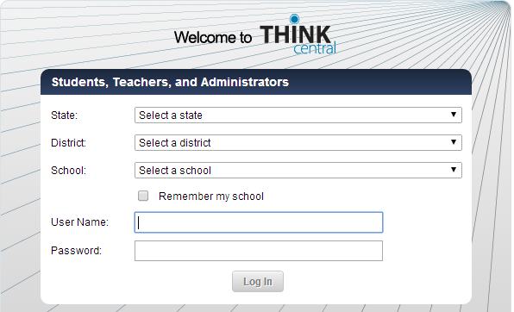
Think Central
Thinkcentral.com
User Name: district username (grieselel)
Password: your district password
Email Elizabeth.Griesel@dmschools.org for User Name or Password reset

Slide 64
Think Central
Thinkcentral.com
TEMPORARY LOGIN (if needed):
School: Adams Elementary
User Name: summerpd
Password: summerpd

Slide 65
Think Central
Thinkcentral.com

Slide 66
Think Central
Thinkcentral.com
Use dropdown menus to select subject, grade level, and language

Slide 67
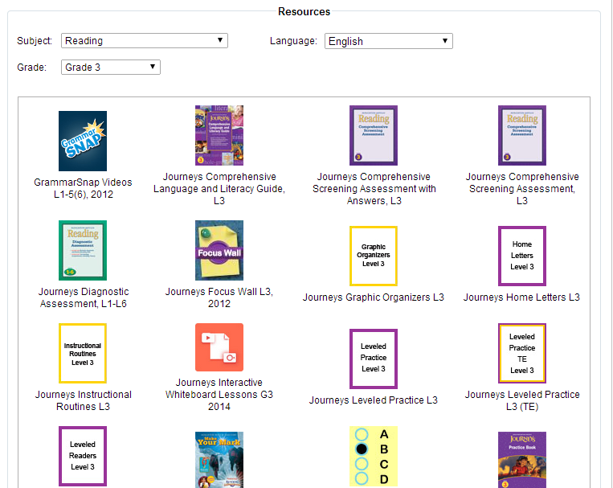
Think Central

Slide 68
Think Central: New Look Coming July 2014

Slide 69
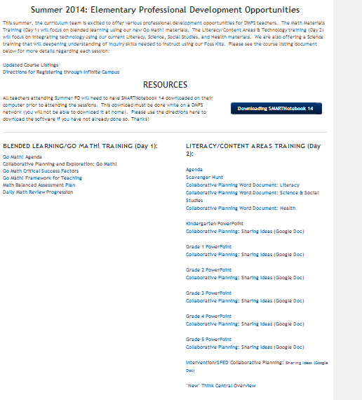
Think Central: New Look Coming July 2014
Visit “Summer PD” page for New Think Central Overview document which contains videos and support resources

Slide 70
Think Central

Slide 71
Graphic Organizers

Slide 72
Graphic Organizers

Slide 73
Graphic Organizers
http://www-k6.thinkcentral.com/content/hsp/reading/journeys/na/gr3/graphic_organizers_9780547810591_/launch.html
Notes:
Whiteboard View
Zoom
Use interactive markers to write on graphic organizer

Slide 74
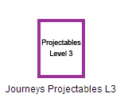
Projectables

Slide 75
Projectables

Slide 76
Projectables
http://www-k6.thinkcentral.com/content/hsp/reading/journeys/na/gr3/Online_Journeys_projectables_9780547356723_/launch.html?page=i

Slide 77
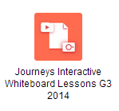
Interactive Whiteboard Lessons
*Uses SmartNotebook Software*
(directions or downloading available on elementary.dmschools.org)

Slide 78
Interactive Whiteboard Lessons

Slide 79
How to Download SMARTNotebook 14

Slide 80
SMART Notebook 14
SMART Notebook is available immediately for download on your teacher station.
It is currently housed in the district’s “Software Center”.
If you have questions about how to download the software, contact the customer service desk, X8161, or follow the link to Technology Resources.
Notes:
The software is immediately available.
You can get help from either the customer service desk, or technology resources documents. (Link Provided in PPT)
https://sharepoint.dmps.k12.ia.us/sites/divisions/tech/TechnologyResources/Equipment/Imaging%20Process_InstallingSoftware.aspx

Slide 81
SMART Notebook 14
Click on your “Start” Icon
Type “Software Center” into the search bar
Click on Software Center
Notes:
Here is a brief walk through of how to download Smart Notebook 14:
Click your “Start” Icon
Type “Software Center” into the search bar
Click on Software Center

Slide 82
SMART Notebook 14
Click on the “Find additional applications from the Application Catalog” link.
Notes:
The Software Center window will open.
Click on “Find additional applications from the Application Catalog”

Slide 83
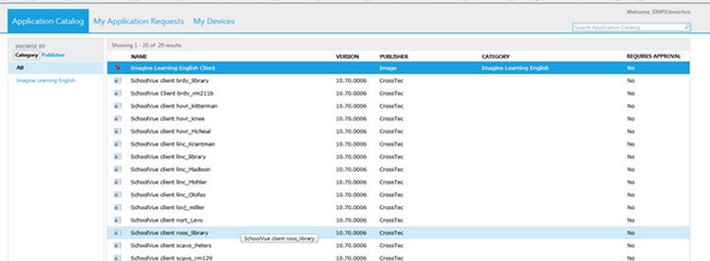
SMART Notebook 14
Find SMART Notebook software and click
Notes:
A new window will open.
SMART Notebook will now be listed as one of the options of additional software. Simply click on the software and it will download automatically.
This will take approximately ______ minutes to download, so please plan accordingly.

Slide 84
SMART Notebook 14
The SMART Notebook software has the ability to enhance the interactive projector.
You must have the SMART Notebook software in order to run the interactive lessons provided with the Go Math materials next year.
Notes:
The software enhances the projector. You projector can run and be interactive with your computer/laptop without the software. It is essentially a REALLY BIG MOUSE.
The SMART Software will allow us to use and create interactively engaging content to add to our already great teaching practices.
You must have the software to run the interactive lesson next year.

Slide 85
SMART Notebook 14
Please feel free to explore and create with the SMART Notebook 14 software.
We will be providing some very basic templates for you on the Elementary Literacy website between now and the end of the year.
Notes:
Even without the interactive projectors in place you can begin to become familiar with the software and it’s capabilities between now and the end of the school year. You will need to rely on your mouse and keyboard as a way to interact at this time.
We will be providing some basic templates between now and the end of the school year on the Elementary Literacy site. Feel free to download them and change them to meet your needs as you see fit.

Slide 86
Interactive Whiteboard Lessons
Notes:
At least 2 per lessons, optional
Already tied directly to Journeys content for that lesson

Slide 87
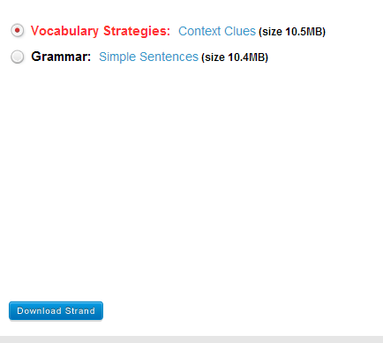
Interactive Whiteboard Lessons

Slide 88
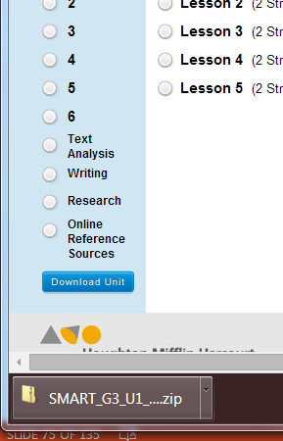
Where did it go?
Click to download:
OR
Notes:
1- appears at bottom
2- appears in downloads

Slide 89
Save it where you want it!
Click “Save As” once in the presentation/document and choose a location where you want to save the resource
Cloud accounts (onedrive, googledrive, dropbox) will keep your computer running quicker by keeping huge files off your harddrive
Save it to a spot that makes sense so you can find it later!

Slide 90
Interactive Whiteboard Lesson

Slide 91
Interactive Whiteboard Lesson
Once the presentation is open, choose “full screen” to change the view so that students/teacher can manipulate using the interactive projector:

Slide 92
Interactive Whiteboard Lesson

Slide 93
Interactive Whiteboard Lesson
Notes:
Each lesson has different activities available

Slide 94
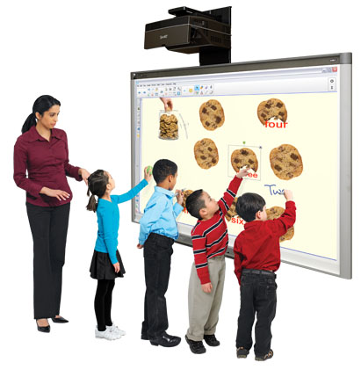
Interactive Whiteboard Lesson
REMEMBER: anything you do with your mouse (click, dragging, etc.), you will be able to do with your finger using the interactive projector.

Slide 95
Kindergarten Classroom Example
Unit 1/Lesson 1: Vocabulary Strategies: Classify and Categorize Words
Notes:
Teacher tip box-
Tap words to hear them, tap little lights to get category names, drag into machine, tap wheel to make it pop out

Slide 96
*1st Grade Classroom Example*
Interactive Whiteboard show lesson 26
Download before the lesson
Filter through to determine what pieces will be best for your students
Typically the same format for each lesson
Notes:
Esther

Slide 97
Exploration: Scavenger Hunt & Collaborative Planning

Slide 98
Reminder of Norms
Exploration: Scavenger Hunt & Collaborative Planning:
Work with your team
Explore the resource by using the scavenger hunt (handout) to make sure you are finding all important pieces and features
Plan for instruction using structured “Collaborative Planning” document (available on website) or other document
Share ideas with other teams using the google doc

Slide 99
Exploration: Scavenger Hunt & Collaborative Planning

Slide 100
Share Out
Share an idea or “aha! moment” your team discussed during Exploration time using the googledoc on the website.
Check out the google doc posted on the website for cool ideas that YOU might want to use, too!

Slide 101
Smart Exchange
Notes:
-Downloading the smart software so that interactive presentations can run on your computer
-VERY BASIC introduction to downloading and using SMART interactive presentations
-Much, much more training will be coming from our smart certified trainers

Slide 102
Purpose of Smart Exchange
“Training, Content, and Community”
Teacher-created and shared SMART lessons, practice, & activities
ALREADY MADE AND READY TO USE!
Search by standard, grade level, and/or subject
Much, much more training on SMART software coming soon

Slide 103
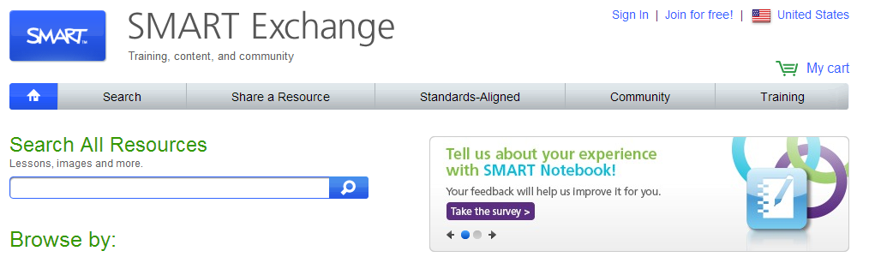
Smart Exchange
STEP 1:
www.exchange.smarttech.com

Slide 104
Smart Exchange
STEP 2:
To download SMART presentations, you will need to “join for free.”

Slide 105
Smart Exchange
STEP 3:
Fill in your information.
Choose “SMART Board interactive white board” under SMART products.

Slide 106
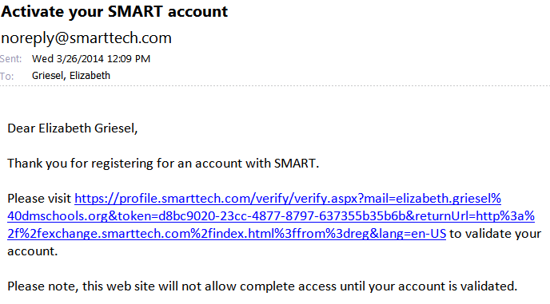
Smart Exchange
STEP 4:
Check your email to activate your account.

Slide 107
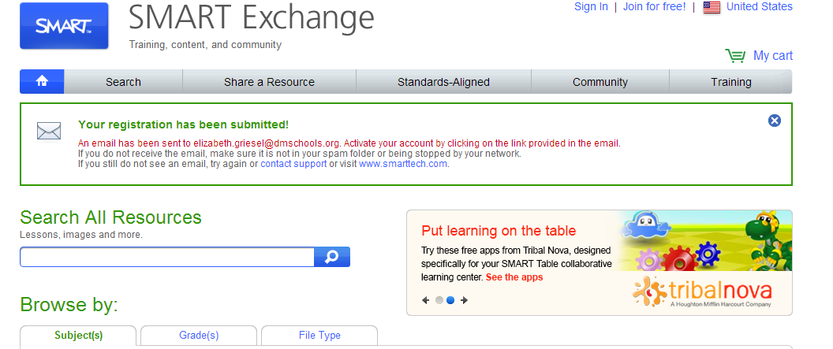
Smart Exchange
STEP 5:
Search for resources!

Slide 108
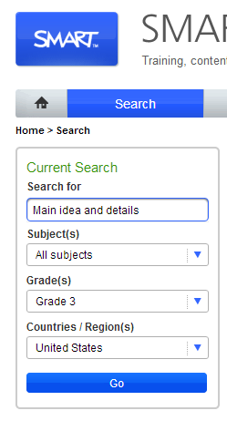
Smart Exchange
Topic/Grade level search
*Consider your literacy, science, social studies, health, & math curriculum when searching.
*Consider presentations that you could use whole group with students or that students could use independently in small groups

Slide 109
Smart Exchange
Standards-aligned presentation search:

Slide 110
Smart Exchange
Choose “Common Core State Standards”

Slide 111
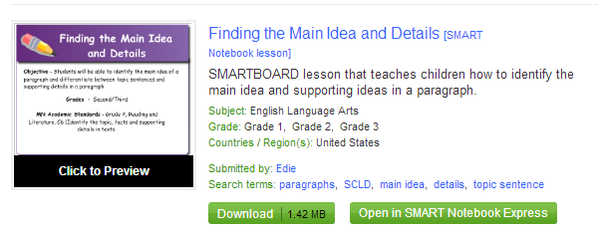
Smart Exchange
1- Click to preview
2- Click to download

Slide 112
Where did it go?
Click to download:
OR
Notes:
1- appears at bottom
2- appears in downloads

Slide 113
Save it where you want it!
Click “Save As” once in the presentation/document and choose a location where you want to save the resource
Cloud accounts (onedrive, googledrive, dropbox) will keep your computer running quicker by keeping huge files off your harddrive
Save it to a spot that makes sense so you can find it later!

Slide 114
Smart Notebook Lesson
Once the presentation is open, choose “full screen” to change the view so that students/teacher can manipulate using the interactive projector:

Slide 115
SMART Toolbar
Advance or Go Back a page
Add a page or delete a page

Slide 116
SMART Toolbar
Undo last action or Redo last action
Open a file or Save a file

Slide 117
SMART Toolbar
View Screens
Zooming in and out or making your presentation full screen
Click on the button to see options

Slide 118
SMART Toolbar
Screen Capture
SMART Document Camera
Measurement Tool
Paste
Delete
SMART Exchange
Show/Hide Screen Shade
Table

Slide 119
SMART Toolbar
Shapes
Regular Polygons
Select
Fill
Eraser
Pens
Text
Lines

Slide 120
SMART Toolbar
Show SMART Response Buttons
Add - Ons

Slide 121
Smart Notebook Lesson
Click/TOUCH arrows on lower left side of screen (when projected, touch arrows) to move between screens (slides) of the presentation.

Slide 122
Smart Notebook Lesson
REMEMBER: anything you do with your mouse (click, dragging, etc.), you will be able to do with your finger using the interactive projector.

Slide 123
Basic Editing
Double click in area so that text box appears, and edit as you would in Microsoft Word

Slide 124
Editing Smart Notebook Lessons
*Much, much more training on changing, adding, and creating presentations coming soon to your building!
SMART Training Resources:
https://smarttech.com/Resources/Training/Training+Search?Products=SMART%20Notebook&Audience=All%20audiences&Budget=All%20budgets&Training%20Type=Free%20Resources
Introduction to SMART Notebook Part I: Software Basics http://downloads01.smarttech.com/media/trainingcenter/videos/webinar/nb_11_part_1.html
Introduction to SMART Notebook Part II: Enhanced Skills
http://downloads01.smarttech.com/media/trainingcenter/videos/webinar/nb_11_part_2.html
Notes:
Smart Trainers across the district
Increased number of technology coordinators, can come deliver PD at your building on anything technology-related (including SMART Notebook)

Slide 125
4th Grade Classroom Example
Lit 1: CCSS.ELA-LITERACY.RL.4.1 Refer to details and examples in a text when explaining what the text says explicitly and when drawing inferences from the text.

Slide 126
*1st Grade Classroom Example*
Plants Activity
Whole Group Science
Vowel Sort
Center Activity
Koosh Ball Sight words
Transition Activity as students come to the carpet
Notes:
Ashley

Slide 127
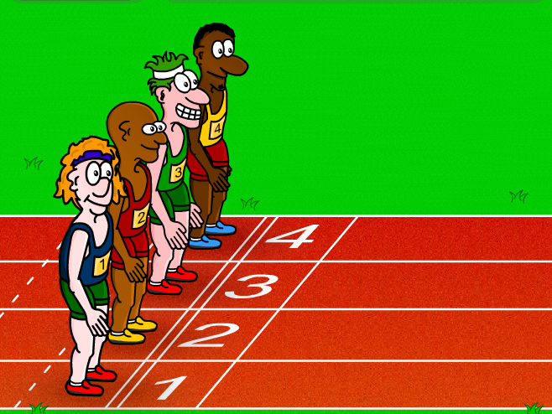
Exploration: Scavenger Hunt & Collaborative Planning

Slide 128
Share Out
Share an idea or “aha! moment” your team discussed during Exploration time using the googledoc on the website.
Check out the google doc posted on the website for cool ideas that YOU might want to use, too!

Slide 129
Exit Survey
Before you leave, please visit the following link to take a survey regarding your PD experiences this morning:
https://www.surveymonkey.com/s/elementarysummerpd
From the dropdown menu at the top, choose:
“Literacy and Technology”

Slide 130
Lunch
12:00-1:00*
*If you wish to earn AEA/Drake EDEX Credit for today as part of the 2 day course, please continue to engage in collaborative planning.

Slide 131
Course Credit information and links on elementary.dmschools.org
To receive credit:
Attend a Math Session (Day 1) and a Literacy Session (Day 2)
Complete 30 minutes of onsite structured collaboration during our 1 hour lunch break during both sessions.
Send Liz (Elizabeth.Griesel@dmschools.org) your Collaborative Planning documents (Literacy, Science-Social Studies, Health) AND assignment from Day 1 training (with J & Anna).
Complete registration using the instruction on the Summer PD page of the website by June 30th.
Notes:
Joanna

Slide 132
Content Areas & Technology Summer Training
1:00-4:30

Slide 133
Agenda
Social Studies Curriculum Guides & Resources (Amber Graeber)
Exploration: Collaborative Planning
Science Curriculum Guides & Resources (Kim O’Donnell)
Exploration: Collaborative Planning
Health Curriculum Guides & Resource (Connie Sievers)
Exploration: Collaborative Planning
Exit Survey & Dismissal

Slide 134
Social Studies

Slide 135
Science and Social Studies Unit Organization 14-15
 | K | 1st | 2nd | 3rd | 4th | 5th
Unit 1 | Social Studies: Learning about Myself and My Classroom Community | Social Studies: Families in our Community | Social Studies: Our Community | Social Studies: Cultures in our Community | Social Studies: Regions of the United States | Science: Our Solar System: Delta Solar System Kit
Unit 2 | Science: The 5 Senses: Delta 5 Senses Kit | Social Studies: Families in Other Places | Science: Air and Weather Foss Kit | Science: Structures of Life Foss Kit | Science: The Human Body Foss Kit | Social Studies: The Story We Tell: Native Americans and Slavery
Unit 3 | Science: Weather and Seasons: (Trees Kit, Observing Weather Section only) | Science: Balance and Motion Foss Kit | Social Studies: Communities Needs and Wants | Science: Scientific Experimentation: Water Foss Kit | Science: Earth Materials Foss Kit | Social Studies: US Independence
Unit 4 | Social Studies: Learning About Myself and Others | Social Studies: Exploring New Places | Social Studies: Participating in Community | Social Studies: Working in Our Community | Social Studies: Our Regions, Geography and History | Science: Food and Nutrition Foss Kit
Unit 5 | Social Studies: Responsibilities to Myself and Others | Science: Pebbles, Sand and Silt Foss Kit | Science: Solids and Liquids Foss Kit | Social Studies: Going Places | Social Studies: Our Regions, Economy and Government | Social Studies: From Sea to Shining Sea: The Movement West
Unit 6 | Science: Plants and Trees: Trees Foss Kit | Science: New Plants: New Plants Foss Kit | Science: Insects Foss Kit | Science: Great Discoveries: Magnetism and Electricity Foss Kit | Science: Environments Foss Kit | Science: Variables in Science: Variables Foss Kit

Slide 136
Social Studies Guides Unit Calendar/Guides
elementary.dmschools.org
Grade level dropdown menu> “Curriculum Guides” Page

Slide 137
2014-2015:ADDITIONAL SUPPORT IN SOCIAL STUDIES
Curriculum guide format is aligned to that of literacy
“I Can” Statements are detailed week by week for use by teacher teams
A live link is embedded to a folder on SharePoint with resources to support instruction
Writing integration options in each unit

Slide 138
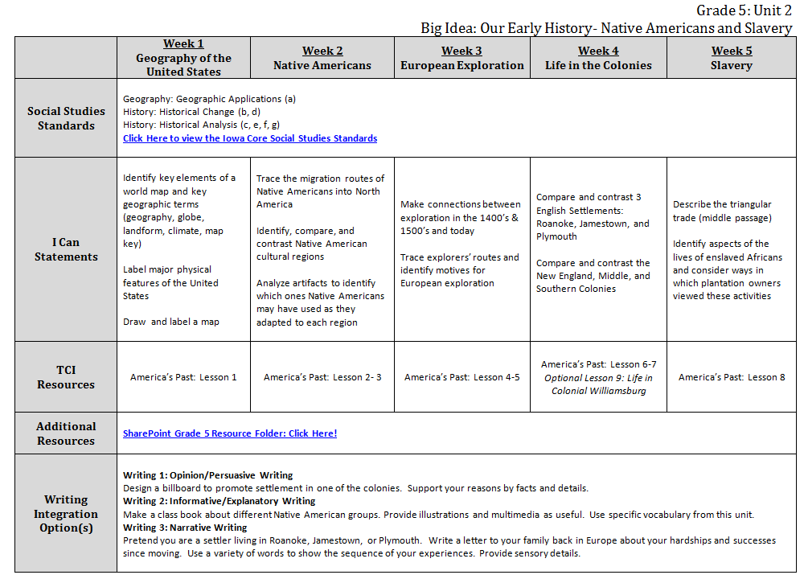

Slide 139
Social Studies Guides Unit Calendar/Guides
elementary.dmschools.org
Grade level dropdown menu> “Curriculum Guides” Page

Slide 140
Notes:
Standards
Live link to standards

Slide 141
Notes:
I Can Statements – week by week and aligned to resources

Slide 142
Notes:
TCI Resources
Free account + many resources (PDFs) are available via our live link . . .
In most cases, you will do 1-2 lessons each week (if you choose)

Slide 144
ADDITIONAL RESOURCES: SOCIAL STUDIES

Slide 145
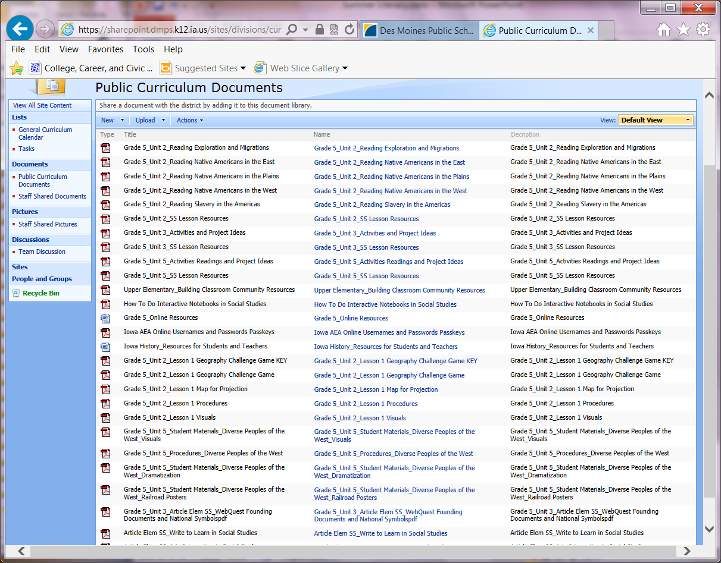
ADDITIONAL RESOURCES: SOCIAL STUDIES
Notes:
Lots of materials available to you!

Slide 146
Online Resources

Slide 148
*1st Grade Classroom Example*
Community Example from SMART Exchange
Adjusted example to make it more interactive and aligned with I can statements.
Notes:
Ashley will show on Smartboard

Slide 149
Exploration: Collaborative Planning
(Use Social Studies & Science Collaborative Planning document or other structured document for planning in your teams.)

Slide 150
Science

Slide 151
Science and Social Studies Unit Organization 14-15
 | K | 1st | 2nd | 3rd | 4th | 5th
Unit 1 | Social Studies: Learning about Myself and My Classroom Community | Social Studies: Families in our Community | Social Studies: Our Community | Social Studies: Cultures in our Community | Social Studies: Regions of the United States | Science: Our Solar System: Delta Solar System Kit
Unit 2 | Science: The 5 Senses: Delta 5 Senses Kit | Social Studies: Families in Other Places | Science: Air and Weather Foss Kit | Science: Structures of Life Foss Kit | Science: The Human Body Foss Kit | Social Studies: The Story We Tell: Native Americans and Slavery
Unit 3 | Science: Weather and Seasons: (Trees Kit, Observing Weather Section only) | Science: Balance and Motion Foss Kit | Social Studies: Communities Needs and Wants | Science: Scientific Experimentation: Water Foss Kit | Science: Earth Materials Foss Kit | Social Studies: US Independence
Unit 4 | Social Studies: Learning About Myself and Others | Social Studies: Exploring New Places | Social Studies: Participating in Community | Social Studies: Working in Our Community | Social Studies: Our Regions, Geography and History | Science: Food and Nutrition Foss Kit
Unit 5 | Social Studies: Responsibilities to Myself and Others | Science: Pebbles, Sand and Silt Foss Kit | Science: Solids and Liquids Foss Kit | Social Studies: Going Places | Social Studies: Our Regions, Economy and Government | Social Studies: From Sea to Shining Sea: The Movement West
Unit 6 | Science: Plants and Trees: Trees Foss Kit | Science: New Plants: New Plants Foss Kit | Science: Insects Foss Kit | Science: Great Discoveries: Magnetism and Electricity Foss Kit | Science: Environments Foss Kit | Science: Variables in Science: Variables Foss Kit

Slide 152
Science Unit Changes for 14-15
 | K | 1st | 2nd | 3rd | 4th | 5th
Unit 1 | Social Studies: Learning about Myself and My Classroom Community | Social Studies: Families in our Community | Social Studies: Our Community | Social Studies: Cultures in our Community | Social Studies: Regions of the United States | Science: Our Solar System: Delta Solar System Kit
Unit 2 | Science: The 5 Senses: Delta 5 Senses Kit | Social Studies: Families in Other Places | Science: Air and Weather Foss Kit | Science: Structures of Life Foss Kit | Science: The Human Body Foss Kit | Social Studies: The Story We Tell: Native Americans and Slavery
Unit 3 | Science: Weather and Seasons: (Trees Kit, Observing Weather Section only) | Science: Balance and Motion Foss Kit (NEW) | Social Studies: Communities Needs and Wants | Science: Scientific Experimentation: Water Foss Kit | Science: Earth Materials Foss Kit | Social Studies: US Independence
Unit 4 | Social Studies: Learning About Myself and Others | Social Studies: Exploring New Places | Social Studies: Participating in Community | Social Studies: Working in Our Community | Social Studies: Our Regions, Geography and History | Science: Food and Nutrition Foss Kit
Unit 5 | Social Studies: Responsibilities to Myself and Others | Science: Pebbles, Sand and Silt Foss Kit | Science: Solids and Liquids Foss Kit | Social Studies: Going Places | Social Studies: Our Regions, Economy and Government | Social Studies: From Sea to Shining Sea: The Movement West
Unit 6 | Science: Plants and Trees: Trees Foss Kit | Science: New Plants: New Plants Foss Kit | Science: Insects Foss Kit | Science: Great Discoveries: Magnetism and Electricity Foss Kit | Science: Environments Foss Kit | Science: Variables in Science: Variables Foss Kit
*All changes were made based on teacher feedback.
Notes:
Changes made (click one at a time and the arrows appear)
Kindergarten: Pebbles, Sand and Silt moves to 1st grade
1st Grade: Pebbles, Sand and Silt moves from Kindergarten, New Plants moves to the end of the year, and Balance and Motion replaces Animals unit.
2nd Grade: Insects and Solids and Liquids units trade places
3rd Grade: Structures of Life switches places with the Water Unit
4th Grade: Environments moves to the end of the year, Solar System goes to 5th, Human Body back to 4th, Earth Materials moves to 4th from 5th
5th Grade: Solar System back from 4th grade, Food and Nutrition moves to later in the year, and Variables is back as the last unit.

Slide 153
Science Resources 2014-15
Curriculum guide format is aligned to that of literacy
I can statements are directly aligned to Iowa Core
Budget will be provided for refill of consumables. Live materials will come from a separate account at Trans-Mississippi. Allow at least 2 weeks for delivery of any live materials.
Writing integration options for each unit
All guides and materials can be found on the science website at http://science.dmschools.org as well as http://elementary.dmschools.org
Notes:
Please let them know that all of their ordering of materials for next year should have been done this spring. Budgets will continue to be provided each year, and will be reevaluated for next year based on enrollments. Also, budget funds are for consumables ONLY. Any non-consumable items from Foss Kits that are lost or broken will have to come from building funds unless they have extra after consumables are ordered.
Live materials (crayfish, bugs, butterflies, etc.) are ordered from Trans-Mississippi and do not come out of their building budget. We have a district PO with them.

Slide 154
Social Studies Guides Unit Calendar/Guides
elementary.dmschools.org
Grade level dropdown menu> “Curriculum Guides” Page

Slide 155
Sample Science Guide
 | Week 1 | Week 2 | Week 3 | Week 4 | Week 5
Science Standards | Understand and apply knowledge of basic human body systems and how they work together
I Can Statements | Locate some of the major bones in the human body Explain why we need joints in order to move Build a model to show how bones and muscles work together to create movement Determine my level of coordination through investigation
Vocabulary | bone, muscle, skeleton, joint, cartilage, tendon, ligament, mobile, immobile, opposable, contract, stimuli, coordination
Foss Kit Resource | Foss Human Body Kit: Investigations 1-4
Additional Resources | Heartland Books: http://media1.aea11.k12.ia.us/display/041/wwk770?kw=bones+and+muscles&au=I&submit=1 Online Resources: http://www.sciencekids.co.nz/gamesactivities/movinggrowing.html http://kidshealth.org/kid/htbw/ http://www.pbs.org/teachers/sid/activities/humanbody/ http://www.makemegenius.com/cool_facts.php?mId=28 http://www.kidsbiology.com/human_biology/ Scholastic Human Body PBL Unit: http://www.scholastic.com/teachers/unit/human-body-everything-you-need
Writing Integration Option(s) | Writing 1: Opinion/Persuasive Writing Imagine yourself at 100 years old. Write a letter to 4th grade-self describing the things you should be doing now to take care of your body. Provide reasons to support your opinion. Writing 2: Informative/Explanatory Writing Create an article for our new classroom magazine called Joints Weekly. Write an article about one of the body’s joints and how it works. Include a diagram and definitions to unknown words. Writing 3: Narrative Writing Write a myth how the bones work together. Include dialogue.
Hot Links!
Writing Ideas !
Notes:
Let participants know that each guide/grade level is set up the same with the Iowa Core standards broken into I can statements. Also included is essential vocabulary, hot links to online resources and student activities, and associated writing ideas.

Slide 156
Additional Science Resources
Science website at: http://science.dmschools.org
Links there include Heartland AEA learning resources, Defined STEM and science Wiki page.
Kim O’Donnell
kimberly.odonnell@dmschools.org
Science Coordinator
Notes:
If they need their login info for the Heartland Data bases or Defined STEM, they can contact me, their building principal or science leader.

Slide 157
*1st Grade Classroom Example*
Science Curriculum Guide
Interactive Rock Lesson
Notes:
Ashley will review how to access the guides and then show interactive rock lesson

Slide 158
Exploration: Collaborative Planning
(Use Social Studies & Science Collaborative Planning document or other structured document for planning in your teams.)

Slide 159
HEALTH

Slide 160
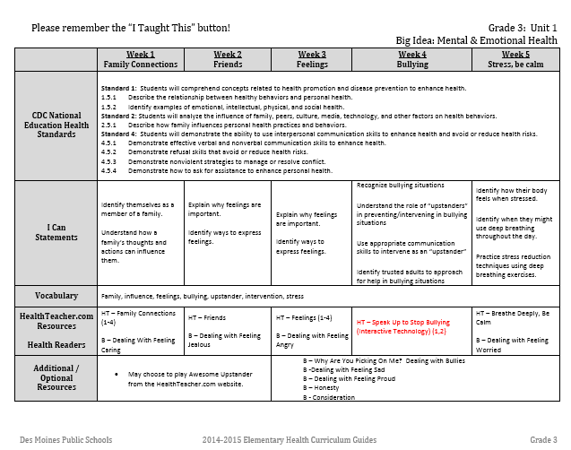
Health

Slide 161
Social Studies Guides Unit Calendar/Guides
elementary.dmschools.org
Grade level dropdown menu> “Curriculum Guides” Page

Slide 162
Health
Additional “New” lessons available in HealthTeacher.com – they are marked with (Interactive Technology)
Now organized in a format identical to other curricular areas

Slide 163
Health
Family Health & Sexuality Units
Counselor
Nurse
Young Women’s Resource Center – contact information is on the curriculum guides.
More resources than time!
1- HealthTeacher.com lessons
2- Integrate the health readers as time allows

Slide 164
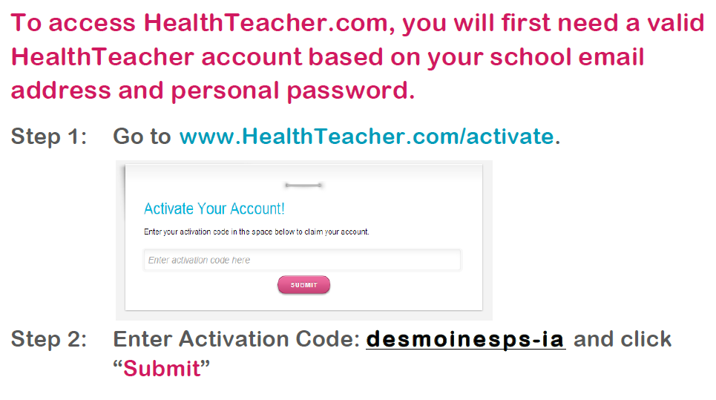
HealthTeacher.Com

Slide 165
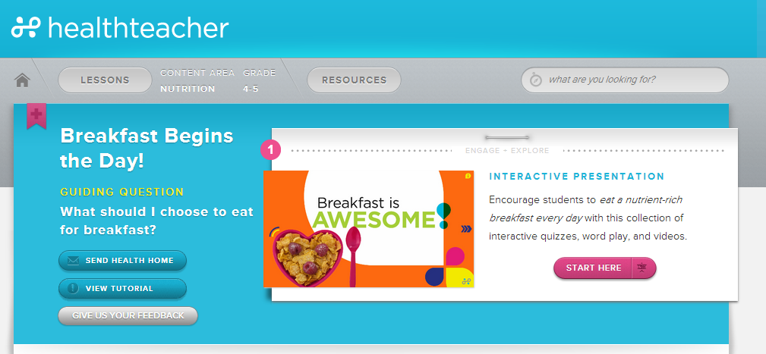
4th Grade Classroom Example
Breakfast Begins the Day (Interactive Technology)

Slide 166
*1st Grade Classroom Example*
Interactive Lesson on HealthTeacher.com
Background information
Slide notes
Notes:
Esther

Slide 167
Exploration: Collaborative Planning
(Use the Health Collaborative Planning document or other structured document for planning in your teams.)

Slide 168
Exit Survey
Before you leave, please visit the following link to take a survey regarding your PD experiences this afternoon:
https://www.surveymonkey.com/s/elementarysummerpd
From the dropdown menu at the top, choose:
“Content Teaching: Science, Social Studies, Health”

