Slide 1
Elementary Teaching + Learning
March 10, 2015

Slide 2
Agenda
Facilitating a Growth Mindset
Chapter 62 + MTSS: Redefining Intervention
English Language Learner Services
Organizational Updates Q + A

Slide 3
Facilitating a Growth Mindset
Outcome: Reflect on the connections between our integrated structures for growth and identify ways to facilitate a growth mindset across our work.

Slide 4
Integrated Structures for Growth
School Leader Development
Marzano’s Leadership Framework
Student Development
Standards-Reference Grading
Teacher Development
Marzano’s Instructional Framework

Slide 5
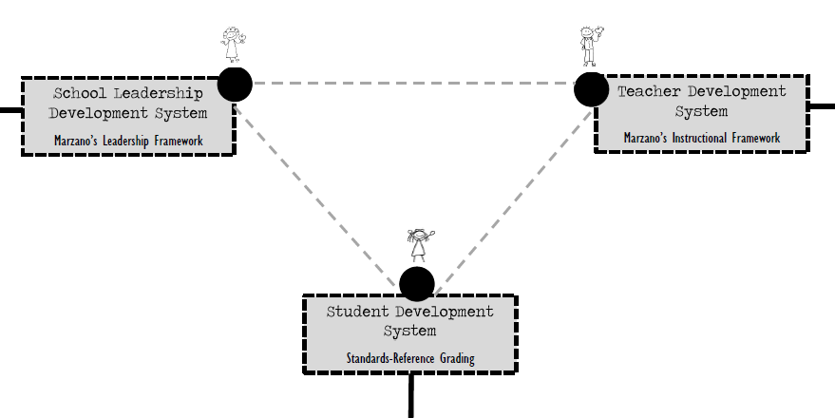
Connect. The. Dots.
How do these systems work together?
Notes:
5 minutes

Slide 6
Mindset Teacher Students Coach Teachers Principal Teachers

Slide 7
Carol Dweck-Mindset
“Mindset change is not about picking up a few pointers here and there. It's about seeing things in a new way. When people...change to a growth mindset, they change from a judge-and-be-judged framework to a learn-and-help-learn framework. Their commitment is to growth, and growth take plenty of time, effort, and mutual support.”
Carol S. Dweck, Mindset: The New Psychology of Success

Slide 8
Growth vs. Fixed Mindset

Slide 9
Growth Mindset
What are the implications for the adults in our system?
Notes:
Stop at 2:55

Slide 10
Connect. The. Dots.
How do these systems work together?

Slide 11
Mindset Matters
“How people think about change influences how they approach it. This is true for coaches and teachers. A coach’s mindset influences the coach’s ability to support teachers. Coaches with a mindset of appreciation, inquiry, and assets will have safe and constructive relationships with their colleagues.”
(Killion, J., Harrison, C., Bryan, C., & Clifton, H. 2012. Coaching Matters.)

Slide 12
Mindset Matters
“When a coach’s mindset is limited by judgment and focused on the gap between the ideal and current practice, the coach will have a more difficult time acknowledging teachers’ small successes, may not value progress over time, and may not have the patience and perseverance to help teachers become independent with the new practices. These coaches may be more directive, neglect to listen to individual needs or concerns, and fail to provide appropriate support.” (Killion, J., Harrison, C., Bryan, C., & Clifton, H. 2012. Coaching Matters.)

Slide 13
Developing a Growth Mindset
Edutopia: Developing a Growth Mindset in Teachers and Staff, Keith Heggart, 2015. What does this look like with staff? (pg.3)

Slide 14
Discussion Questions
How do leaders and coaches create the type of culture that supports growth + development?
How will leaders and coaches address factors of school culture that contribute to, as well as threaten, growth + development?
How can we, as leaders, set the stage for successful coaching?
Notes:
Do More/Do Less Activity

Slide 15
Elementary SRG
Three Year Implementation Plan
Notes:
20 minutes

Slide 17
Year 1: 2015-2016
Desired Result: Establish levels of rigor in accordance with the Iowa Common Core Standards and align instructional practices.

Slide 18
Year 1: 2015-2016
Highlights:
Curriculum scales will be added to our district curriculum guides for grades 4-5.
Tiered-assessment item banks will be developed to support CFA creation for grades 4-5.
Teacher training will focus on alignment of rigor and Marzano’s design question #1.
Principal work will focus on developing a communication and capacity building plan.
We will convert to quarterly reporting and will utilize IC as our district data collection system.

Slide 19
Year 2: 2016-2017
Desired Result: Utilize SRG to effectively communicate with all stakeholders what students know and are able to do in a consistent and valuable manner.

Slide 20
Year 2: 2016-2017
Desired Result: Utilize SRG to effectively communicate with all stakeholders what students know and are able to do in a consistent and valuable manner.

Slide 21
Year 2: 2016-2017
Highlights:
Student profiles/curriculum scales will be provided for all subjects K-5.
Teacher training will be focused on effective assessment and SRG practices.
Infinite Campus gradebooks and report cards will convert to a standards-referenced grading system utilizing a 4-point scale.
Work to utilize SRG as our vehicle for support of exceptional learners will begin.

Slide 22
Year 3: 2017-2018
Desired Result: Utilize SRG to effectively support our exceptional learners and provide the foundation for a strong MTSS System.

Slide 23
Between Now… and June
Questions for reflection:
Where is our (leaders + teachers) current level of awareness in regards to the philosophy and guiding practices of SRG?
What steps can we take to support awareness and understanding of the SRG guiding practices?
What school-specific factors will need to be considered as we prepare for implementation?

Slide 24
Between Now… and June
Resources for Review:

Slide 25
MTSS: (Re)Defining Intervention
Outcomes: Understand Chapter 62 requirements, define effective intervention characteristics, and review the 2015-2016 literacy assessment plan.

Slide 26
Chapter 62 Requirements for Intervention

Slide 27
Official guidance for §279.68 from the Iowa Department Education
12 279.68(2)(f) IAC 281—62.6(5) IAC281—62.10(2) Report the following to the Department of Education:
specific reading interventions and supports implemented by the district
data on universal screening and progress monitoring
Use FAST as Universal Screener.
Document interventions through TIER.

Slide 28
Official guidance for §279.68 from the Iowa Department Education
5 279.68(2)(a) IAC 281—62.6(1) Provide intensive reading instruction, including a minimum of 90 minutes a day of scientific, research- based reading instruction, to any student who exhibits a substantial deficiency in reading.
This instruction may also include but is not limited to the following strategies:
Small group instruction
Reduced teacher- student ratios
More frequent progress monitoring
Tutoring or mentoring
Extended school day, week, or year
Summer reading programs

Slide 29
Iowa Department of Education: Q & A
How much more time beyond the 90 minutes do I need to provide to a student?
It depends on the intervention being used and what the guidelines for implementation regarding the specific intervention entail.
Notes:
It is important to implement the evidence-based intervention with fidelity, or in the manner the designer intended. The intensity and duration of intervention should be adjusted as needed to ensure participating students are gaining the desired improvement.

Slide 30
Official guidance for §279.68 from the Iowa Department Education
279.68(2)(d) IAC 281—62.6(3) Provide a reading curriculum for students with substantial deficiencies in reading that does all of the following:
Assists students in developing skills to read at grade level
Provides skill development in phonemic awareness, phonics, fluency, vocabulary, and comprehension
Is implemented by certified instructional staff with appropriate training and professional development
Is implemented during regular school hours
Provide interventions to students with substantial deficiencies in reading.
Interventions must be research-based.
Interventions must occur during school hours.

Slide 31
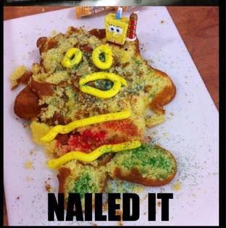
MTSS Cake: Intervention Layer
How do we put our ingredients together using the tools we have?
Notes:
Chapter 62 does not give us many ingredients for the intervention layer of the cake.
What ingredients are we bringing to intervention?
Today work to add an ingredient to our MTSS pantry- An understanding of what effective intervention is and some characteristics of effective intervention.

Slide 32
(RE)Defining Intervention

Slide 33
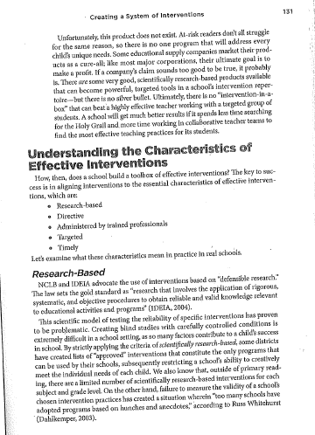
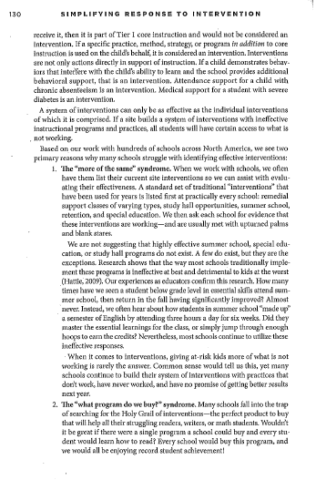
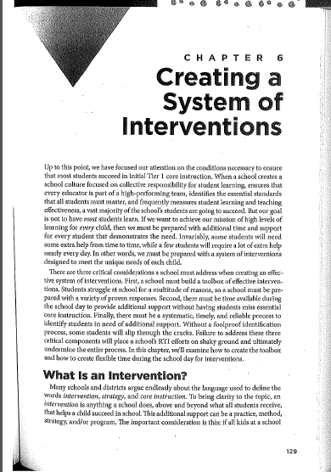
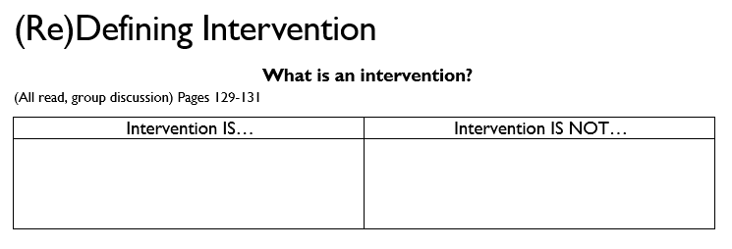
Creating a System of Interventions Buffum, Mattos, & Weber
“What is an Intervention?
Read pages 129-131
Complete in groups:
Notes:
5 minutes

Slide 34
Creating a System of Interventions Buffum, Mattos, & Weber
Jigsaw “Understanding the Characteristics of Effective Intervention”
Read pages 131-139
Research-Based
Directive
Administered by trained professionals
Targeted
Timely
Complete “Notes” for your section
Share notes with your group
*Leave “Current Reality/Desired Reality” boxes open
Notes:
*Directive: you have to record in Iowa TIER when a student receives an intervention which will help determine effectiveness - if they aren't there to receive the instruction, it is makes it hard to impact learning
10 minutes to read
15 minutes to discuss
(25 minutes)

Slide 35
Creating a System of Interventions Buffum, Mattos, & Weber
School Team Discussions:
Read Guiding Question(s) for each characteristic
Discuss “Current Reality” versus “Desired Reality” at your school based on your notes for each
Notes:
*Directive: you have to record in Iowa TIER when a student receives an intervention which will help determine effectiveness - if they aren't there to receive the instruction, it is makes it hard to impact learning
10 minutes to read
15 minutes to discuss
(25 minutes)

Slide 36
Next Steps

Slide 37
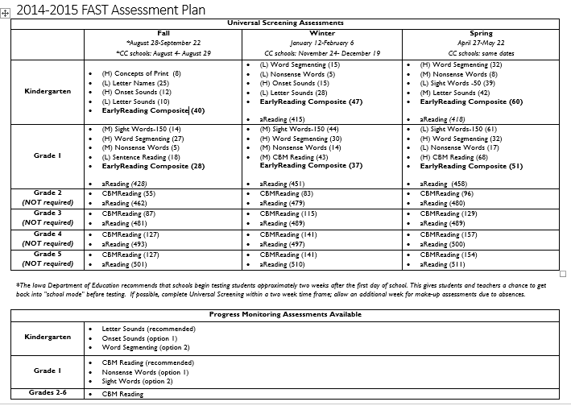
Fast Assessment Info Sheet
Notes:
Pink Paper
Subtests for K-1 with H, M, L to indicate weighting
In parenthesis is benchmark score for each subtest
Composite benchmark score
Testing window dates for traditional and continuous calendar schools
Progress monitoring probes (what is recommended- by default will come up in TIER when assigning PM & other options) by grade level

Slide 38
Resources
ELEMENTARY.DMSCHOOLS.ORG
Links to DE Guidance documents
TIER guidance document that supports navigating TIER reports, assessment, & training
Link to A&A account login page
Documents to support analyzing the data
Documents to support family communication about FAST Assessments
All training materials used previously
And MORE!
Notes:
Links to DE Guidance documents
TIER guidance document that helps your navigate TIER
Link to sign in for TIER
Documents to support analyzing the data
Documents to support family communication about FAST Assessments
All training materials used previously
90 minutes

Slide 39
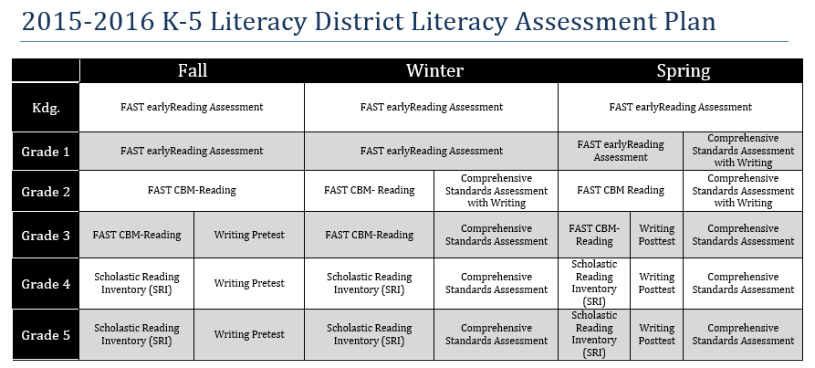
2015-2016 Literacy Assessment Plan
Notes:
No midyear CSA

Slide 40
2015-2016 Literacy Assessment Plan
Notes:
CBM instead of BRI

Slide 41
2015-2016 Literacy Assessment Plan
Notes:
CBM instead of SRI

Slide 42
Beyond a Strong Core
How to implement MTSS with English Learners

Slide 43
Review of our Learning
ELL instruction is considered core instruction with language support.
Content alignment and teacher collaboration = increased academic knowledge for English learners
Strengths-based approach to serving English learners

Slide 44
Distinguishing between LD and language acquisition
“My English learners are not making progress. I think it’s time to start the problem-solving process.”
Notes:
2

Slide 45
Notes:
4

Slide 46
LD or Language Acquisition?
Identify for ELL services
✓
When do we begin intervention
with English learners??
Identify for
SpEd services
✓
Tier 1
Core Instruction
Tier 2
Intervention
Tier 3
Intervention
Tier 4

Slide 47
MTSS (Multiple Systems of Support)
English learners’ response to education and interventions is related to:
teacher effectiveness across the tiers
the educator’s ability to adapt and change instruction for non-responders
the fidelity of implementation of high quality instruction for ELLs
(O’Connor & Klingner, 2010)

Slide 48
LD in English Learners
Approximately 10-15% of all students have a learning disability (LD)
About 7% of English learners in the U.S. are believed to have a disability (NCES, 2009; Bedore & Gilliam, 2011).
About 50% of those English learners identified, are believed to have a Learning Disability (LD)
Disproportionate representation is two-fold.
Both under and over representation in special education services.

Slide 49
Language Acquisition or Learning Disability?
Determining whether or not an English learner has a learning disability is a process of elimination
Many factors must be considered and ruled out as possible reasons for a child’s struggles.
There are multiple possible explanations for every behavior.
There are no tests that can definitely tell us whether a student has LD.

Slide 50
Confounding data for English learners
Literacy development Indicators
Fluency
Accuracy
Comprehension
Reading level
Language development Indicators

Slide 51
Where do we start?
First – use hypothesis driven-model to evaluate learning experience and potential (opportunity to learn).
Second – determine if the English learner is discrepant from their “true peers”.

Slide 52
Step 1 - Hypothesis-Driven Model
Begin the evaluation process by exploring the hypothesis that the causes of the student’s learning difficulties are due to external factors.
Conduct the assessment with the notion that there is nothing wrong with the individual and that systemic, ecological, or environmental factors are the primary reason for the observed learning problems.
Maintain this hypothesis until data suggests otherwise and when all plausible factors are ruled out (Watkins, 2003. Minnesota DOE; Council for Exceptional Children/Klingner webinar, 2011)

Slide 53
Step 1 - Questions
Is the student receiving instruction that is appropriate to their needs and targeted to their language level?
Is the student receiving high-quality instruction in the core?
Is the classroom environment conducive to learning?
Are multiple forms of assessments used in the classroom?
Is the student receiving adequate amount of ELL instruction, appropriate to their language proficiency level?

Slide 54
Step 2 – Determine if student is discrepant
Are most of the student’s true peers succeeding?
What is the input from the ELL teacher(s)?
What is a true peer? EL students with comparable backgrounds (as much as possible).
Native language
Age/grade level
Time in the U.S.
Immigrant experiences (refugee or immigrant)
Academic history - in both family language and English language

Slide 55
Projected Language Acquisition Progress Lines
50th percentile on grade-level with native English peers
Language development levels

Slide 56
Projected Language Acquisition Progress Lines
50th percentile on grade-level with native English peers
Language development levels
Discrepancy
From true peers

Slide 57
Step 2 – Sources of Information
ELL portfolio
Analyze previous language and education experiences
Cumulative file
determine home language and history
Teachers
Input from both ELL and grade level teachers
Family
English language proficiency of caregivers in the home
Have family members expressed concerns of language use in first language?
To what extent has the family been included in the process of identifying challenges to learning?

Slide 58
Case Scenarios – LD or Language?
Given a student case scenario
Consider language background factors
Consider academic data
Following the guiding questions, determine the first action steps your school should take to improve learning opportunities for this student.
Identify the data on the student fact sheet that informs your decision.

Slide 59
Case Scenario A - decision
Student A is an English Learner in the 4th grade. She has an ELDA level of 2. She has attended the same DMPS elementary school since Kindergarten. One of her parents speaks English fluently, and her second parent is partially fluent in English. Both English and the family’s native language are spoken in the home.
The language proficiency development of this student has not moved at the same rate of progress as her true peers. She had an ELDA level of 1 in Kindergarten, First grade, and Second grade. She moved up to an ELDA level of 2 in the Third grade. Her lexile level of reading has not moved above the classification of “Below Basic” at any time in her elementary years.
She has at least 45-60 minutes of ELL support every day since First grade. She has failed to make academic progress in both her ELL classroom and the grade-level classroom.
Her parents have expressed concerns about her ability to read or process question in either English or her first language. They have states that she seems confused if she is given more than three instructions at a time. She is also very forgetful and disorganized at home. They struggle to work with her on school work at home. She often refuses to work on reading or activities sent home from the teacher. Student A often says she is too tired or all the work sent home is just too confusing.
Notes:
Model this scenario as a group. The text is provided in the hand-outs but repeated on this slide so we can identify key indicators.

Slide 60
Case Scenario A- decision
Decision – Does need intervention.
ELDA level is not progressing at same rate as true peers.
Academic performance in both ELL classroom and grade-level classroom does not match progress as true peers.
Parents have concerns in both languages.
Not making progress despite receiving recommended level of ELL support daily.

Slide 61
Case Scenario B - decision
Decision – Does not need intervention.
Your ideas/Evidence …

Slide 62
Case Scenario C - decision
Decision – Need more time to evaluate. Likely does not need intervention.
Your ideas/evidence…

Slide 63
Organizational Updates
Summer PD: 2015
Healthy U

