Slide 1
District PLC Meeting Elementary
January 15, 2014
2:30 – 3:45pm
Notes:
Welcome to the third District PLC Meeting. So glad to have you here today! ☺

Slide 2
Agenda
2:30pm Welcome, Reminders, and Logistics
2:35pm Mathematical Practice Standard #1
“I am excited for all teachers to be focusing on problem solving.”
“I am excited about the ideas shared by others in collaboration.”
“I am excited about the practice standards.”
“What are good strategies for me to use to expand their thinking?”
“I would like more problem solving strategies for struggling math students.”
3:10pm Science
3:35pm Survey Feedback and Exit Slip
3:45pm Dismissal
Notes:
Let’s briefly review our agenda for today.
We are going to start off by sharing some successes you have had in your classroom over the last month.
We appreciate your feedback from the last session. We have taken that feedback into consideration when planning this session.

Slide 3
Reminders and Logistics
Notes:
Just a few reminders and meeting logistics

Slide 4
The Purpose of the District PLCs
Support the implementation of our common district initiatives
Provide teachers with an opportunity to share ideas and collaborate with colleagues from around the district
Notes:
Being the start of the school year – last session was very information, but I wanted to remind you the our purpose is to support the implementation of the common district initiatives. And to provide all of you an opportunity to share and collaborate with colleagues around the district.

Slide 5
Questions?
We want to make an effort to deliver deep, meaningful professional development to you each and every session.
Time is limited and we want to make good use of the 75 minutes.
Today – If you have questions about what is presented – please write them on a notecard. If you would like a personal response – please write down your name and school.
Notes:
Today – we have a very tight schedule – please have the group refrain from asking whole group questions. This will allow us to move forward quicker and not get caught anywhere. If they have questions – ask them not to address the whole group but rather write it on a notecard.

Slide 6
Norms
Be on time – every time
Be prepared – bring back requested materials
Be present
No side conversations
Avoid using your computer or cell phone
Avoid working on other tasks – stay focused on the topic at hand
Be respectful of your peers and the facilitator
Participate!
Notes:
A quick reminder of our norms (Stay positive)

Slide 7
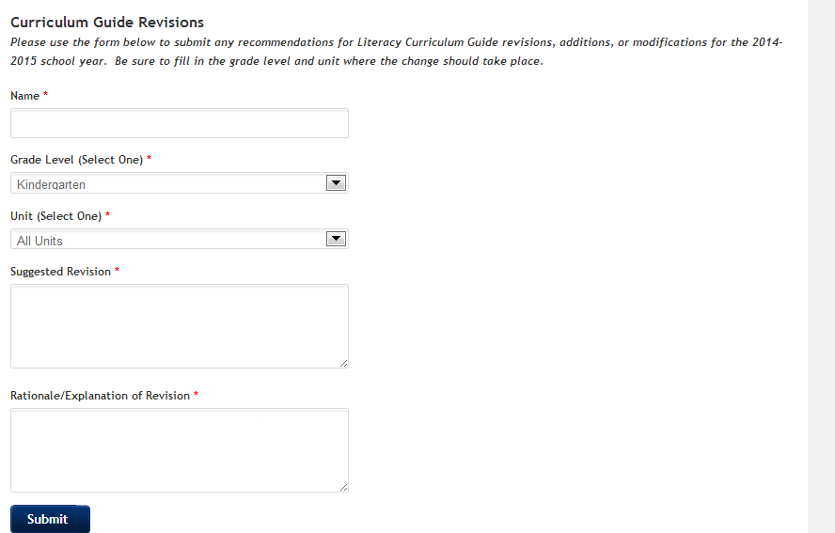
Literacy Curriculum Guide Revision Survey
Fill out the survey on the homepage to submit suggested revisions:
www.elementaryliteracy.dmschools.org
Notes:
We are currently going through the process of revising the literacy curriculum guides for next year. Liz is not anticipating any major revisions, but we would love to get some feedback before any changes are made. Please visit the elementary literacy website and take a minute to fill out the survey on the homepage if you have encountered something in the guides that you believe should be changed.

Slide 8
mathematical practice standard #1: Make sense of problems and persevere in solving them
December 3rd we…
Practiced solving a problem collaboratively for our current grade level unit.
Watched a video of elementary students working through the problem-solving process and discussed with an elbow partner how this was similar or different from the problem solving in your classroom.
Read an article about Practice Standard #1 and collaborated with a teacher from another school around your Aha’s and questions.
Were provided with teacher action steps and probing questions to ask our students during the problem solving process.
Notes:
Today we are going to continue our work discussing mathematical practice standard number 1.
Last time we….

Slide 9
Building a Problem-Solving Disposition
Many students become easily frustrated with solving math problems.
Am I able to do this?
What if I get stuck?
What if it takes me too long to get the answer?
What if my idea doesn’t work?
What if my answer is wrong?
Believing it is possible to solve a problem, recognizing that confusion is part of the process, and discovering that persistence pays off are components of the positive problem-solving disposition.
Math Practice Standard #1:
Make sense of problems and persevere in solving them.
Notes:
This slide is a repeat from last time – just want to review the importance of problem solving and perseverance to set up the rest of the presentation.
Many of us have had the word “IDK” written on a piece of homework or an assessment following a word problem.
That is because problem solving is hard!
Many students become easily frustrated with solving math problems.
They ask themselves:
Am I able to do this?
What if I get stuck?
What if it takes me too long to get the answer?
What if my idea doesn’t work?
What if my answer is wrong?
CLICK
Believing it is possible to solve a problem, recognizing that confusion is part of the process, and discovering that persistence pays off and are components of the positive problem-solving disposition.
That leads us to Math Practice Standard #1Click
Make sense of problems and persevere in solving them.
Click

Slide 10
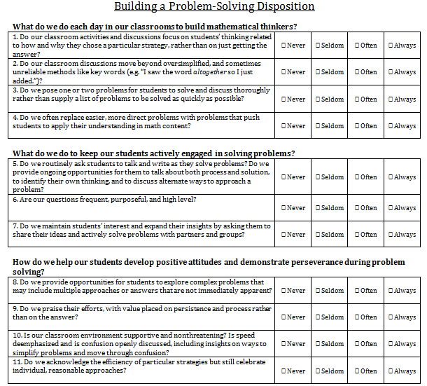
How Do We Get There?
Math Practice Standard #1 provides us with a clear vision of the knowledge and skills that makes our students effective problem solvers…
But how do we help our students develop these important practices?
Think about your own classroom as you read the following questions. You may already be able to answer “yes” to many of them! (4 min)
Notes:
Math Practice Standard #1 does a nice job of providing us with a great vision of the knowledge and skills that makes are students effective problems solvers – but that does not mean it tells us how to get there.
So how do we help our students develop these important practices?
ClickOn the first page of you handout you have a self – assessment of where you are at with your problem solving in you classroom.
This is to be completed individually – you do not need to share this with anyone else – so be as honest as you can. You may be able to answer yes or always to some or many of the questions, but there may be some that you answer never to. There is no right answer here. It is nice to have a baseline to know where we are so we know where we can grow to.
If you are not a math teacher – think about how you use problem solving in your content area and self-assess based on your content.
You are only going to have 4 minutes to fill this out. You may not finish it completely – but it will at least give you a starting point.
Do not give them any longer than 4 minutes – Look for most of the room to be finished and then move on even if it is less than 4 minutes.

Slide 11
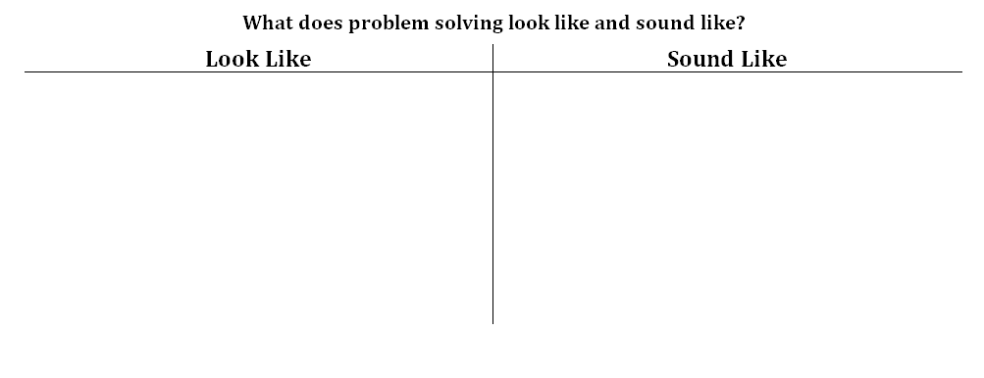
How Do We Get There?
Based on your self-assessment and background knowledge – what does problem solving in a classroom look like and sound like? Turn to a partner to make a short list. (4 minutes)
Notes:
After the self-assessment you have a pretty good baseline for where you are at with implementing problem solving into your classroom.
The self assessment also provided lots of great words for us to get a feeling for what problem solving in the classroom looks like or sounds like.
What you are going to next is CLICK
Based on your self assessment and background knowledge – with an elbow partner fill in the T-Chart of what problem solving in the classroom looks like and sounds like. You will have four minutes to collaborate.
If you are finding it difficult to come up with verbiage for the t-chart use the self assessment. For example CLICK

Slide 12
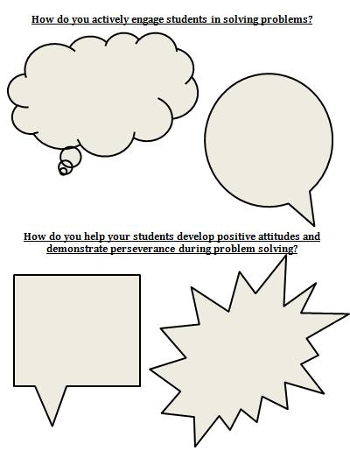
How Do We Get There?
The Purpose of the District PLC is to provide teachers with an opportunity to share ideas and collaborate with colleagues from around the district.
Activity – Share and gain ideas from others around problem solving in the classroom.
Find a teacher in the room that is not from your school.
Introduce yourself.
Share how you actively engage students in solving problems.
Share how you help your students demonstrate positive attitudes and demonstrate perseverance during problem solving.
You will fill out two bubbles.
3 minutes
Find another teacher in the room not from your school and repeat.
Notes:
Again, to state the purpose of our PLC is to provide teachers with an opportunity to share ideas and collaborate with colleagues around the district.
So we are now going to do an activity that will allow you to talk with 2 other teachers, at your grade level, that do not teach in your building.
On the back of the first page in your handout you will see some boxes. What you will do is get up and find a teacher you do not know. You will introduce yourself and then fill in a box on the top and a box on the bottom.
You will
Share how you actively engage students in solving problems.
Share how you help students demonstrate positive attitudes and perseverance during problem solving.
So with your first partner you will fill out two bubbles. You will have about 3 minutes to collaborate with this teacher. Then I will give the cue and you will find another partner and trade ideas again.
You may not have the perfect ideas and that is okay. This is a brainstorming session.
Again, if you do not teach math – go ahead and think about how you have your students persevere through difficult tasks.
Questions?
Okay – get up, find a partner – you will have about 3 minutes.

Slide 13
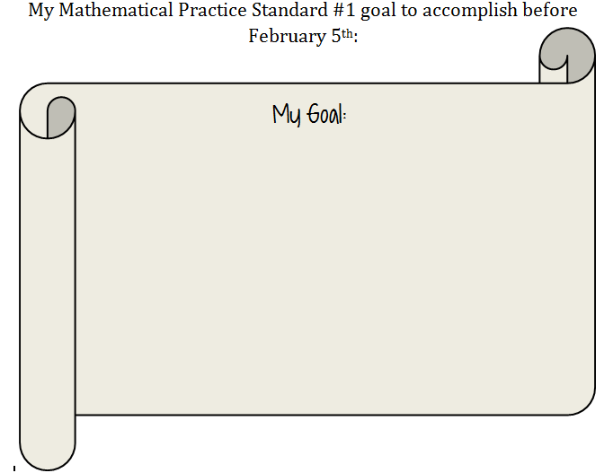
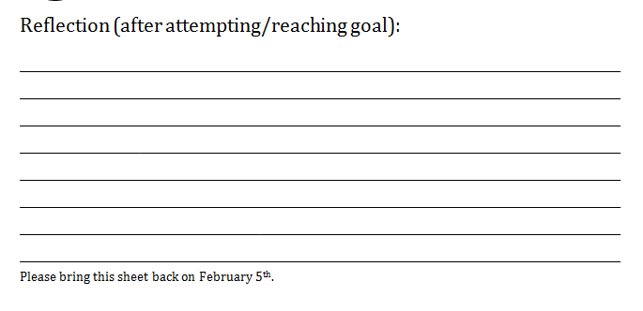
Summing It Up
Teaching problem solving is more than assigning problems to our students. It is a balance of guided experiences in which we support the development of our students’ thinking skills, as well as investigate experiences in which our students develop skills through trial-and error experiences.
Today we…
Took a self-assessment about problem solving in our individual classrooms.
Made a list with a partner of what problem solving looks like and sounds like.
Collaborated with two teachers outside of my school on how they engage their students in solving problems.
Notes:
To sum up today:
Teaching problem solving is more than assigning problems to our students. It is a balance of guided experiences in which we support the development of our students’ thinking skills, as well as investigate experiences in which our students develop skills through trial-and error experiences.
Today we… CLICK CLICK CLICK
CLICK
The last part of our math work today is to write a personal goal for yourself based on the last two sessions together. Your goal in relation to helping students understand the problem and persevere in solving them.
I will give you a few minutes to do this.
CLICK
Then before next time you will fill out the reflection piece and bring that back on February 5th. Ask yourself, how did it go? What questions do you have.

Slide 14
Elementary Math: Feedback from December 3rd
Feedback: Why are we no longer being trained in CGI and instead focusing on the Math Practice Standards?
Based on the requirements of the Iowa Core – we are moving forward with professional development with the Mathematical Practice Standards which correlates well with the practices of CGI.
Our district supports all who have been trained and continue to implement the practices of CGI.
In the past, our district was awarded a grant to help train teachers in CGI. Unfortunately, the funding is no longer available.
1,000 elementary teachers in DMPS have various levels of understanding of CGI ranging from zero to deep implementation.
If you are interested in beginning or continuing training in CGI – please check the AEA summer course offerings.
Notes:
Before starting this slide – please remind them if they have further questions to WRITE THEM ON A POSTCARD AND NOT ADDRESS THE WHOLE GROUP. ;)
THIS IS A TOUCHY SUBJECT. Just go through the points quickly.
Tell them (nicely) you are not going to spend a lot of time on this but if they would like more information to write it on their exit slip.
Just briefly go over each point.
There was a lot of positive feedback and good questions around the new math materials upgrade.
On December 17th, a committee of 17 district representatives from Des Moines Public Schools voted in favor of the materials upgrade purchase of the Houghton Mifflin Go Math (©2015) comprehensive mathematics program.
Go Math will support the teaching and learning of the Iowa Common Core Standards.
This proposal will go to the Des Moines Public School Board in early 2014.
On the back page of your handout you will see more information on the materials upgrade, why it was chosen, and the next steps.
More information will be coming soon.

Slide 15
Elementary Math: Feedback from December 3rd
Feedback: I am excited about the math materials upgrade!
On December 17th, a committee of 17 district representatives from Des Moines Public Schools voted in favor of the materials upgrade purchase of the Houghton Mifflin Go Math (©2015) comprehensive mathematics program.
Go Math will support the teaching and learning of the Iowa Common Core Standards.
This proposal will go to the Des Moines Public School Board in early 2014.
Notes:
Before starting this slide – please remind them if they have further questions to WRITE THEM ON A POSTCARD AND NOT ADDRESS THE WHOLE GROUP. ;)
Tell them (nicely) you are not going to spend a lot of time on this but if they would like more information to write it on their exit slip.
Just briefly go over each point.
There was a lot of positive feedback and good questions around the new math materials upgrade.
On December 17th, a committee of 17 district representatives from Des Moines Public Schools voted in favor of the materials upgrade purchase of the Houghton Mifflin Go Math (©2015) comprehensive mathematics program.
Go Math will support the teaching and learning of the Iowa Common Core Standards.
This proposal will go to the Des Moines Public School Board in early 2014.
On the back page of your handout you will see more information on the materials upgrade, why it was chosen, and the next steps.
More information will be coming soon.

Slide 16
Elementary Math: Feedback from December 3rd
Feedback: I liked the video! I am excited to use the “Find 3 Ways Graphic Organizer”.
Notes:
We also had great feedback around the video we viewed last time. You are able to find the graphic organizer here if you are interested in using it in your classroom.

Slide 17
Kindergarten Science Unit 4 Land and Water

Slide 18
Unit Outline
6 weeks in length to correspond with literacy unit 4 (120 minutes/week)
I Can Statements (student outcomes for the unit)
I can recognize that rocks and soils have different physical properties.
I can sort objects based on their observable characteristics.
I can explain how soil and rocks are used in my daily life.

Slide 19
Resources
Foss Kit: Pebbles, Sand and Silt
Recommended Investigations: Investigation 1, Investigation 2, Investigation 3 (parts 3 & 4 optional), Investigation 4
Lots of other online resources listed on curriculum guide
DMPS science website at http://science.dmschools.org
Contact Kim O’Donnell if you need any support kimberly.odonnell@dmschools.org

Slide 20
Other Ideas for Teaching Land and Water
Sample Kindergarten Rock Unit: http://www.kindergartenkindergarten.com/2012/04/rock-and-roll.html
Make Borax Crystals http://britton.disted.camosun.bc.ca/snow/boraxsnowflake.html
Invite a geologist to talk to your class.

Slide 21
Collaboration Time!
Form small groups (3-4) and discuss how you plan to teach Pebbles, Sand and Silt to your students, and integrate science concepts with literacy and math.
Add your lesson ideas to the Land and Water page on the elementary science wiki! (you’ll need to become a member to add to the page if you are not already.) www.dmpsscience.wikispaces.com

Slide 22
Survey Feedback & Exit Slip

Slide 23
Survey Feedback
Please take a minute complete the following surveys to provide feedback for the Curriculum Team:
TCI social studies survey: http://socialstudies.dmschools.org/elementary.html
Literacy Curriculum Guide survey: www.elementaryliteracy.dmschools.org

Slide 24
Exit Slip
Use a notecard on your table to complete one of the following sentence starters:
I am excited about…
Something I find challenging…
I would like more information about…
I really enjoyed…

