Slide 2
How to DOWNLOAD SMARTNOTEBOOK 14

Slide 3
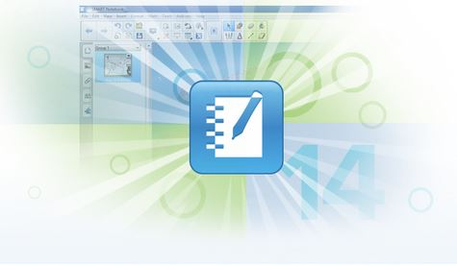
SMART Notebook 14
SMART Notebook is available immediately for download on your teacher station.
It is currently housed in the district’s “Software Center”.
If you have questions about how to download the software, contact the customer service desk, X8161, or follow the link to Technology Resources.
Notes:
The software is immediately available.
You can get help from either the customer service desk, or technology resources documents. (Link Provided in PPT)
https://sharepoint.dmps.k12.ia.us/sites/divisions/tech/TechnologyResources/Equipment/Imaging%20Process_InstallingSoftware.aspx

Slide 4
SMART Notebook 14
Click on your “Start” Icon
Type “Software Center” into the search bar
Click on Software Center
Notes:
Here is a brief walk through of how to download Smart Notebook 14:
Click your “Start” Icon
Type “Software Center” into the search bar
Click on Software Center

Slide 5
SMART Notebook 14
Click on the “Find additional applications from the Application Catalog” link.
Notes:
The Software Center window will open.
Click on “Find additional applications from the Application Catalog”

Slide 6
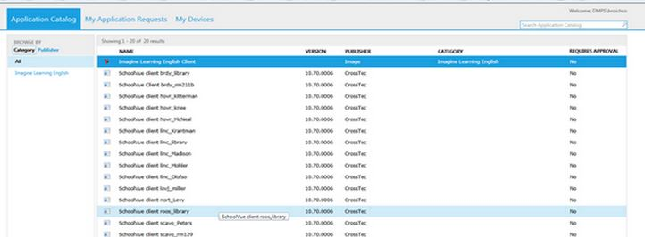
SMART Notebook 14
Find SMART Notebook software and click
Notes:
A new window will open.
SMART Notebook will now be listed as one of the options of additional software. Simply click on the software and it will download automatically.
This will take approximately ______ minutes to download, so please plan accordingly.

Slide 7
SMART Notebook 14
The SMART Notebook software has the ability to enhance the interactive projector.
You must have the SMART Notebook software in order to run the interactive lessons provided with the Go Math materials next year.
Notes:
The software enhances the projector. You projector can run and be interactive with your computer/laptop without the software. It is essentially a REALLY BIG MOUSE.
The SMART Software will allow us to use and create interactively engaging content to add to our already great teaching practices.
You must have the software to run the interactive lesson next year.

Slide 8
SMART Notebook 14
Please feel free to explore and create with the SMART Notebook 14 software.
We will be providing some very basic templates for you on the Elementary Literacy website between now and the end of the year.
Notes:
Even without the interactive projectors in place you can begin to become familiar with the software and it’s capabilities between now and the end of the school year. You will need to rely on your mouse and keyboard as a way to interact at this time.
We will be providing some basic templates between now and the end of the school year on the Elementary Literacy site. Feel free to download them and change them to meet your needs as you see fit.

