Slide 1
For Go Math Training – You will need a copy of Chapter One (print or digital)
Go to the elementary website
Hover over PD
Click Summer PD 2014
Under Go Math! Training (Day 1) click: Go Math Chapter One Teacher Editions
Click your grade level
Notes:
A quick reminder of our norms (Stay positive)

Slide 2
Go Math! Training Grade Two
6.18.14
Dean Avenue Conference Center

Slide 3
Agenda
1. Welcome & Agenda Overview
2. Go Math Organization and Curriculum Guides
3. Critical Success Factors for the Implementation of Go Math
4. Framework for Teaching Go Math (+Tech Integration)
5. Critical Success Factors for the Implementation of Go Math
Go Math Pacing and Assessment
Available Resources + Centers
8. Satisfaction Survey
9. Dismissal
Notes:
Let’s

Slide 4
Norms
Active Listening:
Self-monitor use of electronics
Follow along, take notes, etc… on your computer during the presentation today
Raise hand for individual assistance (so we can see you!)
Avoid working on other tasks – stay focused on the topic at hand
Work with a partner or small group

Slide 5
New Website
elementary.dmschools.org

Slide 6
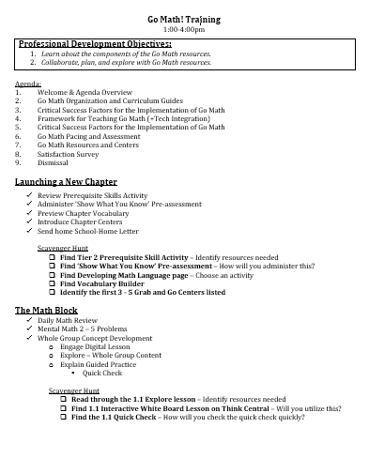
Scavenger Hunt
Notes:
A quick reminder of our norms (Stay positive)

Slide 7
Go math!
2015 Covers look different than the 2012 Covers
2

Slide 8
Go math: Chapter organization

Slide 9
Chapter Organization
Notes:
First page – Table of Content –
Lists Critical Area
Domains
All standards for the unit
This is really the overview for the whole chapter – teachers can see what they will be covering

Slide 10
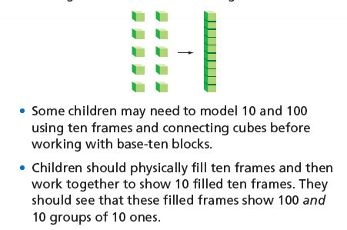
Go Math: Organization
Notes:
The next page is a professional development page for teachers.
We have identified that many teachers would like more support in the area of math content knowledge. This page will be worth spending time in planning and data teaming.
CLICK
It breaks down the concepts in the chapter and outlines what may be helpful in teaching students in various ways.
CLICK
It also outlines the mathematical practice standards.
Click
And provides PD videos to which teachers will be able to watch some of these strategies in action in a classroom.

Slide 11
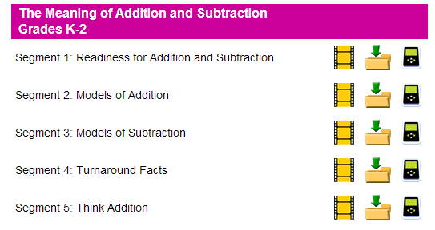
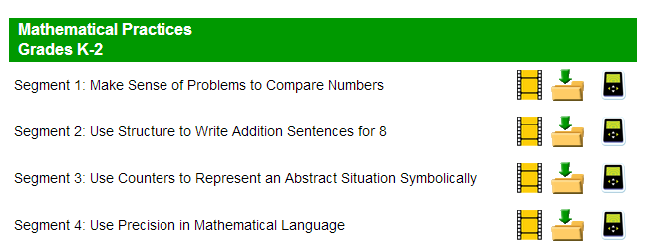
Go Math: Content Development
Notes:
The next page is a professional development page for teachers.
We have identified that many teachers would like more support in the area of math content knowledge. This page will be worth spending time in planning and data teaming.
CLICK
It breaks down the concepts in the chapter and outlines what may be helpful in teaching students in various ways.
CLICK
It also outlines the mathematical practice standards.
Click
And provides PD videos to which teachers will be able to watch some of these strategies in action in a classroom.

Slide 12
2012 or 2015?
2012
Resources on Think Central (including Teacher Editions)
Interactive White Board Lessons
2015
Teacher Edition on Website
Teacher Edition on Table (even more updates)
Notes:
A quick reminder of our norms (Stay positive)

Slide 13
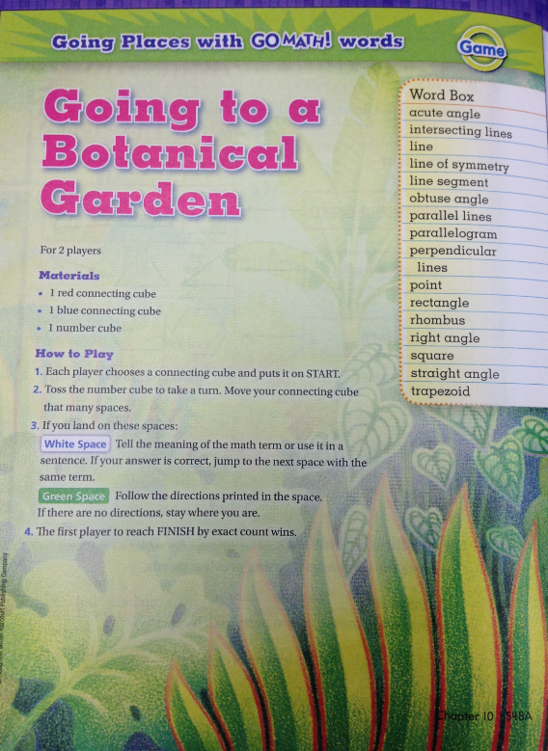
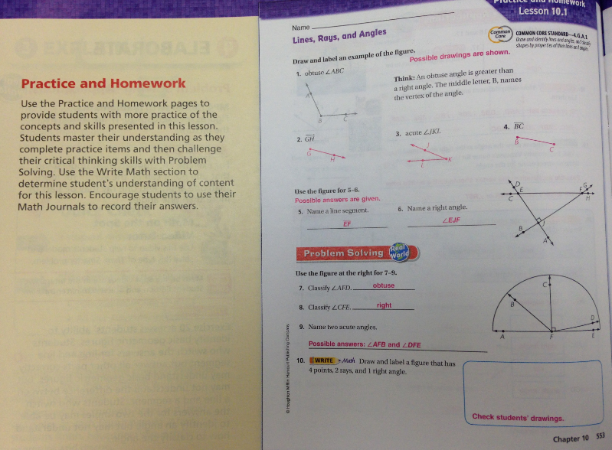
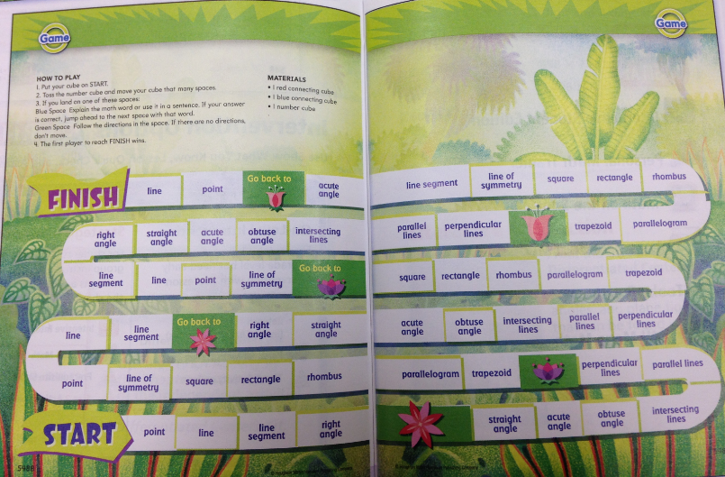
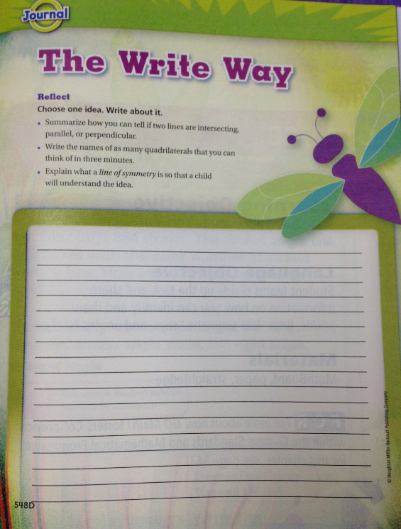
Go Math: Organization
New to 2015 – Not in the current Chapter One
Usage will be optional
Vocabulary Game
Vocabulary Writing Prompt
Lesson Practice and
Homework
Notes:
These next two pages are important and again will be utilized.
The first page gives the teacher two activities for students to review the prerequisite skills for the chapter.
The second page is similar to the page that we have currently have on our curriculum guides which outlines what the students learned in the previous grade level in relation to this concept – and will learn in the next grade level.

Slide 14
Go math: curriculum guide format

Slide 15
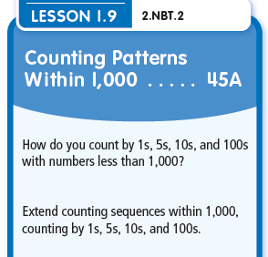
Go Math: Curriculum Guide
Notes:
So let’s take a look at what the new curriculum guide format will look like.
You should have a copy of this guide.
At the top of every grade you will see the grade level, the chapter number and the name of the chapter.
Then you see the chapter essential question to which is in CLICK the TE.
This first page does look very similar to our current guides – the difference is that the learner objectives have changed to match the objectives of the lesson.
CLICK
For example in lesson 1.9 the standard covered is CLICK NBT.2. And we have altered the I Can statement to match the objective of the lesson.

Slide 16
Go Math: Curriculum Guide
Notes:
You will also notice that the Before and After will be altered to match the Coherence page in the TE.

Slide 17
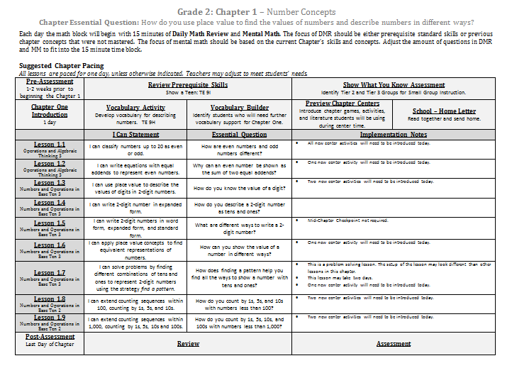
Go Math: Curriculum Guide
Notes:
The second page of the curriculum guide will walk teachers through the chapter and the expected outcomes.

Slide 18
Go Math: Curriculum Guide
Notes:
The next part of the guide outlines what the outcomes of each lesson are.
For example – the I Can Statement is the learning objective of the lesson. This language is a little more mature and probably more suited for the teacher.
The second is the Essential Question of the lesson which is found under the ENGAGE section and also in the Student Edition. This is in Student friendly language. I have shown this presentation to some of our math coaches and a couple coaches said the essential question is a great writing to learn prompt every day.
The last section are the implementation notes for teachers – just things to consider when planning for instruction.

Slide 19
Go Math: Curriculum Guide
Notes:
Then the third page lists out the resources and centers that will be needed to teach the chapter. It lists out the technology, the hands-on resources, and the centers mentioned in the TE. I do plan to do some hyperlinking to these resources once they are available.
The last section is additional resources we have used in the past to teach these standards. They will be hyperlinked similar to how they are this year for easy access.
CLICK
You will notice that there are a lot of technology components offered on this page and we know you have a lot of questions in concern with the technology. Many people are working on this and we will provide you with answers to your common questions soon in reference to the technology.

Slide 20
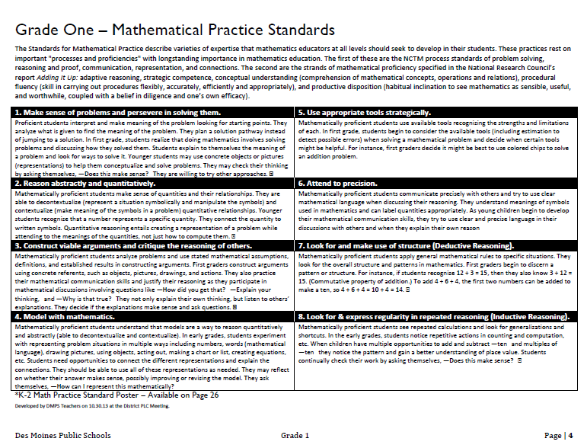
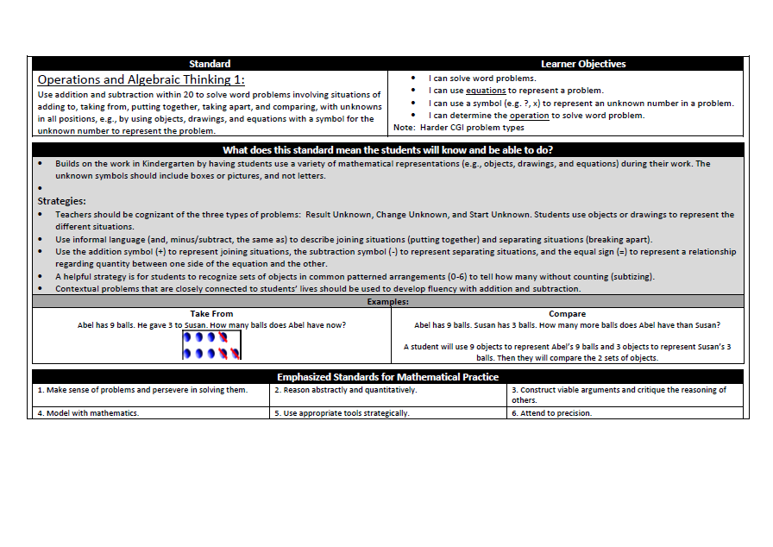
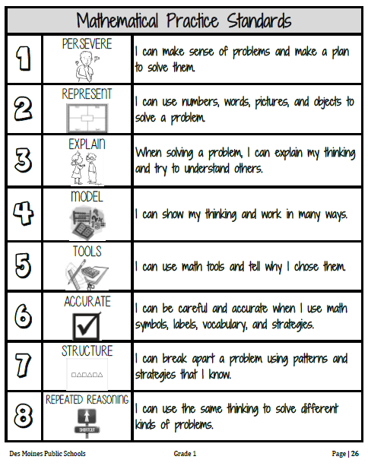
Go Math: Curriculum Guide
Notes:
The pages that are noticeably gone are these standards pages which explains in depth what each standard means.
My plan is to make a book of these for teachers – that just has all the standards for the grade level in one place – that way teachers and coaches can still utilize them in data teaming and planning.
So therefore you will notice our curriculum guides are considerably shorter – only three pages in length.

Slide 21
Go Math: Curriculum Guide
Suggested Chapter Pacing
All lessons are paced for one day, unless otherwise indicated. Teachers may adjust to meet students’ needs.
Year One of implementation will be a learning process.
In planning – Check Chapters before and after and prior grade levels and next.
Example: What strategies that are taught in 2nd grade may not make sense without looking at the strategies that were taught in 1st grade.
Notes:
The next part discusses Chapter Pacing.
This is still in the very early stages of planning – as we need the new editions to really make decisions on pacing and assessments.
What we do know is what Go Math suggests…
They suggest 1 lesson per day, 1 day for introducing the chapter, 2 days for assessment – which depending on the number of lessons in a chapter equals out to anywhere from 8 – 16 days per chapter.
Go Math include an average of 140 days of instruction which would end our school year in the beginning of April.
That means that we have 40 days remaining to add to chapters for differentiation and to meet the needs of all of our students.
This will allow teachers to stretch a lesson over two day or bring in additional resources if needed.
A couple of weeks ago the curriculum guide writing team worked to block out chapter pacing and the assessment calendar. The conversations revolved around which concepts were a bit bigger and needed more instructional time.
In order to complete this work – we need to 2015 TE Chapters which we have been told will be delivered mid-April and then the team will resume their work and make modifications based on the new editions.
More information to come on pacing, assessments, and how this work affects Data Teams. I foresee being able to share more on this in May.

Slide 22
Go math: critical success factors

Slide 23
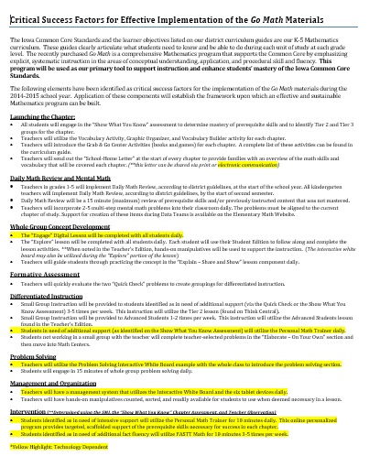
Go Math: Critical Success Factors
Notes:
Overview slide…

Slide 24
Go Math: Critical Success Factors
The following elements have been identified as critical success factors for the implementation of the Go Math materials during the 2014-2015 school year.
Notes:
Overview slide…

Slide 25
Go Math: Critical Success Factors
Launching the Chapter
Show What You Know Pre-Assessment
Vocabulary Activity
Vocabulary Builder
Grab and Go Centers
School-Home Letter
Notes:
All students will complete the show what you know prior to the start of the chapter to identify Tier 2 and 3 students. This will be the pre-assessment for the chapter.
The introduction of the chapter will include two activities surrounding the vocabulary in the chapter.
This is also an opportunity to introduce the centers that will be used for the chapter.
As well as review the school-home letter which can be accessed electronically.

Slide 26
Go Math: Critical Success Factors
Launching the Chapter
Daily Math Review + Mental Math
Show What You Know Pre-Assessment
Grade 1 – 5: beginning of school year
Vocabulary Activity
Grade K: start of second semester
Vocabulary Builder
15 minutes maximum
Grab and Go Centers
2-5 multi-step mental math problems daily
School-Home Letter

Slide 27
Go Math: Critical Success Factors
Launching the Chapter
Daily Math Review + Mental Math
Whole Group Concept Development
Show What You Know Pre-Assessment
Grade 1 – 5: beginning of school year
“Engage” Digital Lesson
Daily
Vocabulary Activity
Grade K: start of second semester
“Explore” Lesson Daily
Vocabulary Builder
Hands-on Manipulatives
15 minutes maximum
Grab and Go Centers
Guided Practice: “Explain” - Share and Show
2-5 multi-step mental math problems daily
School-Home Letter

Slide 28
Go Math: Critical Success Factors
Launching the Chapter
Daily Math Review + Mental Math
Whole Group Concept Development
Formative Assessment
Show What You Know Pre-Assessment
Grade 1 – 5: beginning of school year
“Engage” Digital Lesson
Daily
Quick Check: Create Groupings
Vocabulary Activity
Grade K: start of second semester
“Explore” Lesson Daily
Vocabulary Builder
Hands-on Manipulatives
15 minutes maximum
Grab and Go Centers
Guided Practice: “Explain” - Share and Show
2-5 multi-step mental math problems daily
School-Home Letter

Slide 29
Go Math: Critical Success Factors
Launching the Chapter
Daily Math Review + Mental Math
Whole Group Concept Development
Formative Assessment
Differentiated Instruction
Small Group Instruction 3-5x week for students in need of additional support.
Small Group Instruction 1-2x week for Advanced Students.
Students Needing Additional Support: Personal Math Trainer daily
Students not in small group will complete “On Your Own” and Math Centers.

Slide 30
Go Math: Critical Success Factors
Launching the Chapter
Daily Math Review + Mental Math
Whole Group Concept Development
Formative Assessment
Differentiated Instruction
Problem
Solving
Small Group Instruction 3-5x week for students in need of additional support.
Utilize Problem Solving Interactive White Board example
15 minutes minimum daily
Small Group Instruction 1-2x week for Advanced Students.
Students Needing Additional Support: Personal Math Tutor daily
Students not in small group will complete “On Your Own” and Math Centers.

Slide 31
Go Math: Critical Success Factors
Launching the Chapter
Daily Math Review + Mental Math
Whole Group Concept Development
Formative Assessment
Differentiated Instruction
Problem
Solving
Management + Organization
Small Group Instruction 3-5x week for students in need of additional support.
Utilize Problem Solving Interactive White Board example
Plan for differentiated instruction using Think Central Resources.
15 minutes minimum daily
Management system for use of technology.
Small Group Instruction 1-2x week for Advanced Students.
Organization of manipulatives
Students Needing Additional Support: Personal Math Tutor daily
Students not in small group will complete “On Your Own” and Math Centers.

Slide 32
Go Math: Critical Success Factors
Launching the Chapter
Daily Math Review + Mental Math
Whole Group Concept Development
Formative Assessment
Differentiated Instruction
Problem
Solving
Management + Organization
Intervention
Small Group Instruction 3-5x week for students in need of additional support.
Utilize Problem Solving Interactive White Board example
Plan for differentiated instruction using Think Central Resources.
Tier 3
Fastt Math
15 minutes minimum daily
Management system for use of technology.
Small Group Instruction 1-2x week for Advanced Students.
Organization of manipulatives
Students Needing Additional Support: Personal Math Tutor daily
Students not in small group will complete “On Your Own” and Math Centers.

Slide 33
Go Math: Critical Success Factors
Launching the Chapter
Daily Math Review + Mental Math
Whole Group Concept Development
Formative Assessment
Differentiated Instruction
Problem
Solving
Management + Organization
Intervention

Slide 34
Go math: Framework for teaching

Slide 35
Go Math: Framework for Teaching
Notes:
You have a document that looks like this in front of you. I am going to walk you through what does a math block look like in 2014 – 2015 in Des Moines Public Schools.
I know this is a document that a lot of teachers and leaders have been wanting for quite some time because they want to know how to structure our math time.
And then the question is raised – why do our math blocks across the district need to be consistent?
And the answer is that we have to maintain a level of consistency for our students in the district. We have 38 elementary schools and 1 and 4 students will be in a different math classroom at the end of the school year with a different teacher .

Slide 36
Go Math: Framework for Teaching
A Framework for Beginning our Implementation of the Go Math Materials
This instructional sequence to serve as a support for weekly planning when it feels as though “we can’t get it all in!”
Adjustments in regards to pacing and timing may be needed to meet the needs of students.
This should be considered a starting point as we work to become more efficient with the Go Math materials.
Notes:
Taking you through the introduction to the framework…
This instructional sequence to serve as a support for weekly planning when it feels as though “we can’t get it all in!”
Adjustments in regards to pacing and timing may be needed to meet the needs of students.
This should be considered a starting point as we work to become more efficient with the Go Math materials.
Remind them: 1. Next year is a learning year and the components may take longer than planned – we will become more efficient as the time goes on.
2. This is a starting point and therefore we will be taking feedback throughout the year to improve our structure.

Slide 37
Framework for teaching: Launching the chapter

Slide 38
Go Math
Launching a New Chapter:
Review Prerequisite Skills Activity
Administer ‘Show What You Know’ Pre-assessment
Preview Chapter Vocabulary
Introduce Chapter Centers
Send home School-Home Letter

Slide 39
Go Math
Launching a New Chapter:
Review Prerequisite Skills Activity (prior to the pre-assessment)
Notes:
So the start of the curriculum guide is what we discussed earlier.
Prior to the start of the chapter we start with reviewing the prerequisite skills with a whole group activity – as to not send them into the pre-assessment cold.
Then we do the Show What You Know pre-assessment which identifies our Tier 2 and Tier 3 students for the chapter.

Slide 40
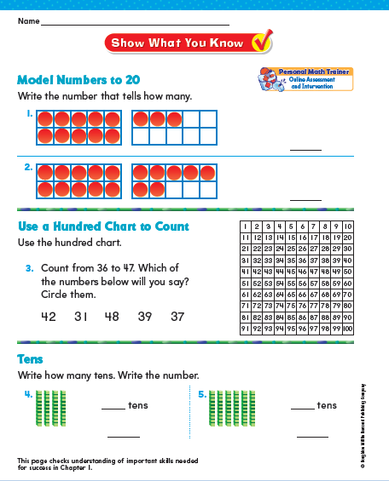
Go Math
Launching a New Chapter
Review Prerequisite Skills
Administer ‘Show What You Know’ Pre-assessment
Tier 2 + 3 Students for Chapter 1
Same group of students for the entire chapter.
Students who need additional assistance with chapter concepts.
Notes:
So the start of the curriculum guide is what we discussed earlier.
Prior to the start of the chapter we start with reviewing the prerequisite skills with a whole group activity – as to not send them into the pre-assessment cold.
Then we do the Show What You Know pre-assessment which identifies our Tier 2 and Tier 3 students for the chapter.

Slide 41
Intervention
What is Tier 1, Tier 2, Tier 3…
Tier 1 = The Core
Tier 2 = Small group intervention during 75 minute math block with a teacher (classroom or support)
Tier 3 = Additional small group intervention outside of math block (or within a 90 minute math block) provided by a teacher (classroom or support)
Can be SPED or general education student
Notes:
These are common questions from the last PLC – Common Questions will pop up in the PP several times.
Try to breeze through them quickly.
The last question bleeds into the next slide. So the purpose will remain the same, but the expectations will change slightly to fit within the 15 minute block of time… CLICK to go to the next slide.

Slide 42
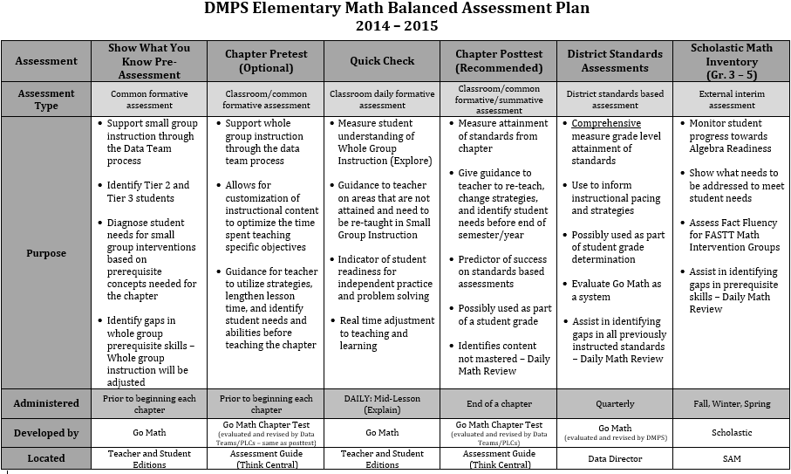
Go Math: Pre-Assessment

Slide 43
Go Math: Pre-Assessment
Show What You Know Pre-Assessment
Formative Assessment
Administered: Prior to beginning each chapter
Developed by: Go Math
Located: Teacher and Student Editions
Purpose:
Support small group instruction through the Data Teams process
Identify Tier 2 and Tier 3 students for the chapter
Diagnose student needs for small group interventions based on prerequisite concepts needed for the chapter
Identify gaps in whole group prerequisite skills – Whole group instruction will be adjusted

Slide 44
Go Math: Pre-Assessment
Show What You Know Pre-Assessment
How will I know if a student is Tier 2 or Tier 3?

Slide 45
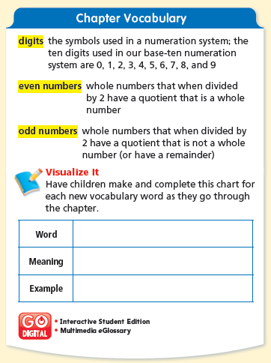
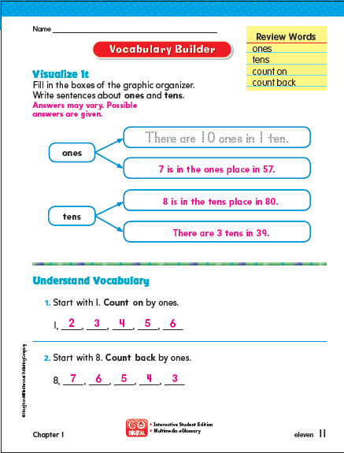
Go Math
Launching a New Chapter:
Review Prerequisite Skills Activity
Administer ‘Show What You Know’ Pre-assessment
Preview Chapter Vocabulary
Introduce Chapter Centers
Send home School-Home Letter
Do these activities the day before starting Lesson 1.1
Notes:
So the start of the curriculum guide is what we discussed earlier.
Prior to the start of the chapter we start with reviewing the prerequisite skills with a whole group activity – as to not send them into the pre-assessment cold.
Then we do the Show What You Know pre-assessment which identifies our Tier 2 and Tier 3 students for the chapter.

Slide 46
Go Math
Launching a New Chapter:
Review Prerequisite Skills Activity
Administer ‘Show What You Know’ Pre-assessment
Preview Chapter Vocabulary (Developing Math Language and Vocabulary Builder)
Introduce Chapter Centers
Send home School-Home Letter
Chapter One Scavenger Hunt:
Find Tier 2 Prerequisite Skill Activity – Identify resources needed
Find ‘Show What You Know’ Pre-assessment – How will you administer this?
Find Developing Math Language page – Choose an activity
Find Vocabulary Builder
Identify the first 3 - 5 Grab and Go Centers listed

Slide 47
Framework for teaching Go Math
Notes:
Give them some process time. But not too much on DMR as there are not that many changes. 2-3 minutes maximum.

Slide 48
Go Math
The Math Block: 75 – 90 minutes/day
Daily Math Review
Mental Math 2 – 5 Problems
Whole Group Concept Development
Engage Digital Lesson
Explore – Whole Group Content
Explain Guided Practice
Quick Check
Differentiated Instruction
Teacher Small Group
Independent/Center Work
Personal Math Trainer
Problem Solving
Interactive White Board

Slide 49
Daily Math Review + Mental Math
Math Block: 75 – 90 minutes/day
Daily Math Review
Mental Math 2 – 5 Problems
Daily Math Review +
Mental Math
(15 min maximum)
We will be providing DMR modification suggestions for teachers in order to adjust the time to fit 15 minutes without changing the purpose and integrity of DMR.
Does Daily Math Review have to be part of the math block of time?
No. Daily Math Review and Mental Math can be a stand alone – similar to this year.
Will the purpose and expectations of Daily Math Review be the same as this year?
The purpose remains the same – which is to review prerequisite skills or skills that were not mastered in a previous Chapter.
Notes:
Go through quickly…
Next year the elementary math block will be 75-90 minutes in length. This is a change from this year as the requirement was 60 – 90 minutes. Some teachers may struggle with this a little. Let them take a deep breath. ;)
CLICK
The first component of the Math Block is Daily Math Review and Mental Math.
Why are we keeping Daily Math Review if it is not part of Go Math?
Teachers really appreciate this time with their students because it allows for them to review concepts that students may have not mastered in previous chapters and/or prerequisite skills for what is to come in future chapters.
It is the answer to the question, “What do I do if my students did not get the concept in the last chapter, but I have to move on?”
The difference next year is that DMR will have a time limit of 15 minutes. Go Math has many components and so we will need to make sure that DMR is not lasting longer than the 15 minutes otherwise it will not be possible to complete the rest of the math block components.
CLICK
We have provided DMR modification suggestions for teachers in order to adjust the time to fit 15 minutes without changing the purpose and integrity of DMR.
It is also important to remember that DMR is not a time where teachers will be “teaching” new concepts or reviewing word problems.

Slide 50
Go Math: Common Questions
Notes:
What we have done is outline some modifications that can be made to DMR to fit within the 15 minute time frame.
This sheet should look familiar – we went over this in September.
CLICK
You will notice the change to the number of problems. In K-2 the amount of questions asked should be up to 2. And in 3-5 it should be up to 3. When in the past it has been 5. This will lower the amount of time required for the process
Click
For instance the students will not need as much time to work alone or in partners. The rest of the document is exactly the same. The process – circle, fix, key statement, reflect, etc… will remain the same. It is just the amount of questions and time spent that will change.

Slide 51
Daily Math Review + Mental Math
elementary.dmschools.org
Notes:
If you are looking to access this document.
You will go to the math website and under PD resources you will click on Go Math.
CLICK
This is where you will find all of the information for next year.
At the bottom of the page
CLICK
You will find DMR Expectations and Progression modified for next year.
That is where the document is available.

Slide 52
Go Math
The Math Block: 75 – 90 minutes/day
Daily Math Review
Mental Math 2 – 5 Problems
Whole Group Concept Development
Engage Digital Lesson
Explore – Whole Group Content
Explain Guided Practice
Quick Check
Differentiated Instruction
Teacher Small Group
Independent/Center Work
Personal Math Trainer
Problem Solving
Interactive White Board

Slide 53
Whole Group Concept Development (5)
Math Block: 75 – 90 minutes/day
Whole Group Concept Development
Engage Digital Lesson
Explore – Whole Group Content
Explain Guided Practice
Quick Check
Daily Math Review +
Mental Math
(15 min maximum)
Whole Group Concept Development
(20 min)
ENGAGE
EXPLORE
EXPLAIN
Notes:
The next component in the math block will be WHOLE GROUP CONCEPT DEVELOPMENT – 20 minutes.
Whole group concept development has three different components.
The first is… Engage
Click
The first part of whole group concept development is called ENGAGE. The engage lesson really introduces the lesson before the students open their student editions. This part of the lesson is digital. We have not had a chance to preview the new versions of these, but we have talked to their program coordinator and she says this is a very cool, important part of the lesson – in order to get the students interested and invested in the content.
CLICK
The next part of whole group concept development is called EXPLORE. This is the whole group instruction piece where they are really learning the concept of the day. A lot of times you will see the Hands On symbol which means the students are using hands-on manipulatives to learn the concept. That being said, the teacher could be using the iTools and having students use the iTools on tablets.
K-2 Listen and Draw
3-5 Unlock the Problem
CLICK
The last part of whole group concept development is the EXPLAIN section. This is a guided practice section where the students complete some questions similar to the concept learned in the EXPLORE section. They call this Share and Show.
So basically the students come to class and every day they will start of with an ENGAGE – digital lesson which will capture their interest in the content. Then they will move into the EXPLORE section which is really teacher-directed – learning the content – hands on. Then they will have the opportunity in the EXPLAIN section to do some guided practice on the type of problems that were taught in the EXPLORE section.

Slide 54
Whole Group Concept Development
Math Block: 75 – 90 minutes/day
Whole Group Concept Development
Engage Digital Lesson
Explore – Whole Group Content
Explain Guided Practice
Quick Check
Daily Math Review +
Mental Math
(15 min maximum)
Whole Group Concept Development
(20 min)
ENGAGE
INTRODUCTION
Notes:
The next component in the math block will be WHOLE GROUP CONCEPT DEVELOPMENT – 20 minutes.
Whole group concept development has three different components.
The first is… Engage
Click
The first part of whole group concept development is called ENGAGE. The engage lesson really introduces the lesson before the students open their student editions. This part of the lesson is digital. We have not had a chance to preview the new versions of these, but we have talked to their program coordinator and she says this is a very cool, important part of the lesson – in order to get the students interested and invested in the content.
CLICK
The next part of whole group concept development is called EXPLORE. This is the whole group instruction piece where they are really learning the concept of the day. A lot of times you will see the Hands On symbol which means the students are using hands-on manipulatives to learn the concept. That being said, the teacher could be using the iTools and having students use the iTools on tablets.
K-2 Listen and Draw
3-5 Unlock the Problem
CLICK
The last part of whole group concept development is the EXPLAIN section. This is a guided practice section where the students complete some questions similar to the concept learned in the EXPLORE section. They call this Share and Show.
So basically the students come to class and every day they will start of with an ENGAGE – digital lesson which will capture their interest in the content. Then they will move into the EXPLORE section which is really teacher-directed – learning the content – hands on. Then they will have the opportunity in the EXPLAIN section to do some guided practice on the type of problems that were taught in the EXPLORE section.

Slide 55
Whole Group Concept Development
Math Block: 75 – 90 minutes/day
Whole Group Concept Development
Engage Digital Lesson
Explore – Whole Group Content
Explain Guided Practice
Quick Check
What are the benefits to using a simple interactive video to begin the lesson?
How will you use the Engage Video to introduce the lesson?
Notes:
The next component in the math block will be WHOLE GROUP CONCEPT DEVELOPMENT – 20 minutes.
Whole group concept development has three different components.
The first is… Engage
Click
The first part of whole group concept development is called ENGAGE. The engage lesson really introduces the lesson before the students open their student editions. This part of the lesson is digital. We have not had a chance to preview the new versions of these, but we have talked to their program coordinator and she says this is a very cool, important part of the lesson – in order to get the students interested and invested in the content.
CLICK
The next part of whole group concept development is called EXPLORE. This is the whole group instruction piece where they are really learning the concept of the day. A lot of times you will see the Hands On symbol which means the students are using hands-on manipulatives to learn the concept. That being said, the teacher could be using the iTools and having students use the iTools on tablets.
K-2 Listen and Draw
3-5 Unlock the Problem
CLICK
The last part of whole group concept development is the EXPLAIN section. This is a guided practice section where the students complete some questions similar to the concept learned in the EXPLORE section. They call this Share and Show.
So basically the students come to class and every day they will start of with an ENGAGE – digital lesson which will capture their interest in the content. Then they will move into the EXPLORE section which is really teacher-directed – learning the content – hands on. Then they will have the opportunity in the EXPLAIN section to do some guided practice on the type of problems that were taught in the EXPLORE section.

Slide 56
Whole Group Concept Development
Math Block: 75 – 90 minutes/day
Whole Group Concept Development
Engage Digital Lesson
Explore – Whole Group Content
Explain Guided Practice
Quick Check
Daily Math Review +
Mental Math
(15 min maximum)
Whole Group Concept Development
(20 min)
ENGAGE
EXPLORE
WHOLE GROUP
Notes:
The next component in the math block will be WHOLE GROUP CONCEPT DEVELOPMENT – 20 minutes.
Whole group concept development has three different components.
The first is… Engage
Click
The first part of whole group concept development is called ENGAGE. The engage lesson really introduces the lesson before the students open their student editions. This part of the lesson is digital. We have not had a chance to preview the new versions of these, but we have talked to their program coordinator and she says this is a very cool, important part of the lesson – in order to get the students interested and invested in the content.
CLICK
The next part of whole group concept development is called EXPLORE. This is the whole group instruction piece where they are really learning the concept of the day. A lot of times you will see the Hands On symbol which means the students are using hands-on manipulatives to learn the concept. That being said, the teacher could be using the iTools and having students use the iTools on tablets.
K-2 Listen and Draw
3-5 Unlock the Problem
CLICK
The last part of whole group concept development is the EXPLAIN section. This is a guided practice section where the students complete some questions similar to the concept learned in the EXPLORE section. They call this Share and Show.
So basically the students come to class and every day they will start of with an ENGAGE – digital lesson which will capture their interest in the content. Then they will move into the EXPLORE section which is really teacher-directed – learning the content – hands on. Then they will have the opportunity in the EXPLAIN section to do some guided practice on the type of problems that were taught in the EXPLORE section.

Slide 57
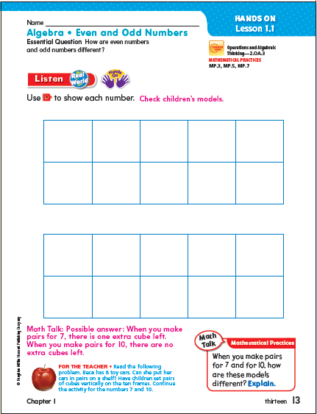
Whole Group Concept Development
Math Block: 75 – 90 minutes/day
Whole Group Concept Development
Engage Digital Lesson
Explore – Whole Group Content
Explain Guided Practice
Quick Check
Notes:
Do this with the teachers – bring connecting cubes.

Slide 58
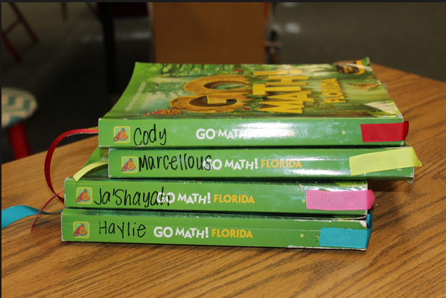
Whole Group Concept Development
Math Block: 75 – 90 minutes/day
Whole Group Concept Development
Engage Digital Lesson
Explore – Whole Group Content
Explain Guided Practice
Quick Check
Do students need to complete the student edition pages?
Ideas:
Interactive White Board
Perforated Pages
Hands-on Manipulatives
Notes:
Do this with the teachers – bring connecting cubes.

Slide 59
Whole Group Concept Development
Math Block: 75 – 90 minutes/day
Whole Group Concept Development
Engage Digital Lesson
Explore – Whole Group Content
Explain Guided Practice
Quick Check
Daily Math Review +
Mental Math
(15 min maximum)
Whole Group Concept Development
(20 min)
ENGAGE
EXPLORE
EXPLAIN
GUIDED PRACTICE + FORMATIVE ASSESSEMNT
Notes:
The next component in the math block will be WHOLE GROUP CONCEPT DEVELOPMENT – 20 minutes.
Whole group concept development has three different components.
The first is… Engage
Click
The first part of whole group concept development is called ENGAGE. The engage lesson really introduces the lesson before the students open their student editions. This part of the lesson is digital. We have not had a chance to preview the new versions of these, but we have talked to their program coordinator and she says this is a very cool, important part of the lesson – in order to get the students interested and invested in the content.
CLICK
The next part of whole group concept development is called EXPLORE. This is the whole group instruction piece where they are really learning the concept of the day. A lot of times you will see the Hands On symbol which means the students are using hands-on manipulatives to learn the concept. That being said, the teacher could be using the iTools and having students use the iTools on tablets.
K-2 Listen and Draw
3-5 Unlock the Problem
CLICK
The last part of whole group concept development is the EXPLAIN section. This is a guided practice section where the students complete some questions similar to the concept learned in the EXPLORE section. They call this Share and Show.
So basically the students come to class and every day they will start of with an ENGAGE – digital lesson which will capture their interest in the content. Then they will move into the EXPLORE section which is really teacher-directed – learning the content – hands on. Then they will have the opportunity in the EXPLAIN section to do some guided practice on the type of problems that were taught in the EXPLORE section.

Slide 60
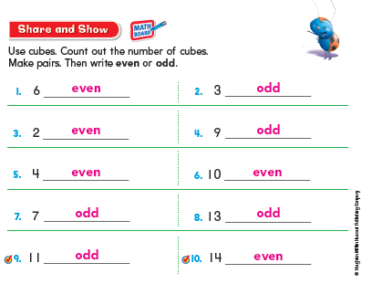
Whole Group Concept Development
Math Block: 75 – 90 minutes/day
Whole Group Concept Development
Engage Digital Lesson
Explore – Whole Group Content
Explain Guided Practice
Quick Check
Notes:
Do this with the teachers – bring connecting cubes.

Slide 61
Formative Assessment: Quick Check
Differentiated Instruction
(20-35 min)
FORMATIVE ASSESSMENT
Students needing additional support with lesson concept
Notes:
Do this with the teachers – bring connecting cubes.

Slide 62
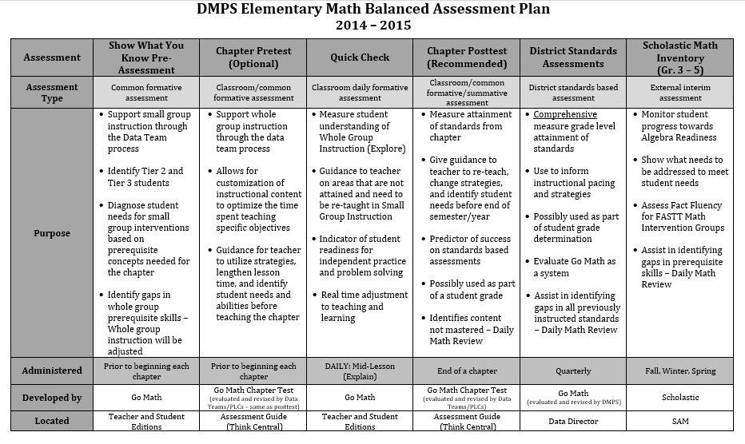
Formative Assessment: Quick Check

Slide 63
Formative Assessment: Quick Check
Quick Check
Formative Assessment
Purpose:
Measure student understanding of Whole Group Instruction (Explore)
Guidance to teacher on areas that are not attained and need to be re-taught in Small Group Instruction
Indicator of student readiness for independent practice and problem solving
Real time adjustment to teaching and learning
Administered: Mid-Lesson DAILY (Explain)
Developed by: Go Math
Located: Teacher and Student Editions

Slide 64
Formative Assessment
Show What You Know: 1 per Chapter
Quick Check: Daily
Quick Check Students
Tier 2 + 3 Students for Chapter 1
VS.
Students needing additional support with lesson concept
These students do not need intense support
Different students daily
Same group of students for the entire chapter.
Students who need additional assistance with Chapter Concepts
Could be SPED or Gen-ed
Different students each chapter
Notes:
Do this with the teachers – bring connecting cubes.

Slide 65
Go Math
The Math Block:
Daily Math Review
Mental Math 2 – 5 Problems
Whole Group Concept Development
Engage Digital Lesson
Explore – Whole Group Content
Explain Guided Practice
Quick Check
Chapter One Scavenger Hunt:
Read through the 1.1 Explore lesson – Identify resources needed
Find 1.1 Interactive White Board Lesson on Think Central – Will you utilize this?
Find the 1.1 Quick Check – How will you check the quick check quickly?

Slide 66
Go Math
The Math Block: 75 – 90 minutes/day
Daily Math Review
Mental Math 2 – 5 Problems
Whole Group Concept Development
Engage Digital Lesson
Explore – Whole Group Content
Explain Guided Practice
Quick Check
Differentiated Instruction
Teacher Small Group
Independent/Center Work
Personal Math Trainer
Problem Solving
Interactive White Board

Slide 67
Intervention
What is Tier 1, Tier 2, Tier 3…
Tier 1 = The Core
Tier 2 = Small group intervention during 75 minute math block with core teacher (or support)
Tier 3 = Additional small group intervention outside of math block (or within a 90 minute math block) provided by support staff (or core)
Can be SPED or general education student
*Differentiated Instruction Resources
Notes:
These are common questions from the last PLC – Common Questions will pop up in the PP several times.
Try to breeze through them quickly.
The last question bleeds into the next slide. So the purpose will remain the same, but the expectations will change slightly to fit within the 15 minute block of time… CLICK to go to the next slide.

Slide 68
Go Math: Differentiated Instruction
Small Group Intervention Resources…
Personal Math Trainer – Adaptive Intervention Program
Prerequisite skills and concepts
Tier 2 and 3 students identified through Show What You Know
September District PLC will focus on introducing Personal Math Trainer
May be available before the District PLC
Notes:
Setting them up for the next few slides…

Slide 69
Go Math: Personal Math Trainer
Personal Math Trainer
Students will have unlimited practices on key concepts supported by guided examples, step-by-step solutions, and video tutorials.
PMT analyzes each student’s personal strengths, weaknesses, preferences, and learning pace.
Generates reports for teachers so instruction can be tailored to meet the students’ needs.
PMT will automatically prescribe and create standards-based, personalized interventions for the students up to two grade levels below the current grade level.
Notes:
Taking you through the introduction to the framework…
This instructional sequence to serve as a support for weekly planning when it feels as though “we can’t get it all in!”
Adjustments in regards to pacing and timing may be needed to meet the needs of students.
This should be considered a starting point as we work to become more efficient with the Go Math materials.

Slide 70
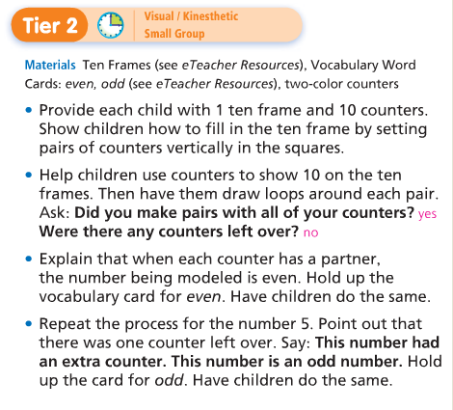
Go Math: Differentiated Instruction
Small Group Intervention Resources…
Tier 2 Activity available on Think Central
10 Minute lesson – same content – new way
Tier 2 and 3 students identified through Show What You Know
Students also identified through Quick Check
Currently available through 2012 Teacher’s Edition. Will be available on Think Central – as a link when Think Central is updated.
Notes:
Setting them up for the next few slides…

Slide 71
Go Math: Differentiated Instruction
How to access Tier 2 Lesson on 2012 Think Central:
1. Open the Teacher’s Edition
2. Find the current lesson of instruction. The page prior to the Engage will provide the Tier 2 lesson.
Notes:
Setting them up for the next few slides…

Slide 72
Go Math: Differentiated Instruction
Small Group Intervention Resources…
Strategic and Intensive Intervention Guides
Tier 2 and Tier 3 Interventions (available for both SPED and general ed)
Utilized for additional intervention
Concept/Skill Prerequisites
Notes:
Setting them up for the next few slides…

Slide 73
Go Math: Differentiated Instruction
The next few slides outline what the Differentiated Instruction component may look like in a classroom.
Thoughts to consider…
It will take 1 – 4 weeks to establish an effective small group instruction structure and routine.
Extra time has been built into chapter one at all grade levels
The small group instruction format will vary by school/classroom depending on the support staff available.
Interventions/Small Groups can be led by a classroom or support teachers.
Notes:
Setting them up for the next few slides…

Slide 74
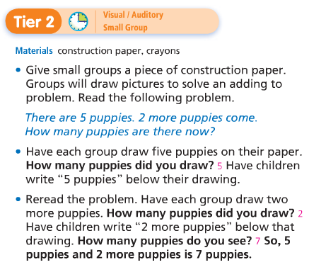
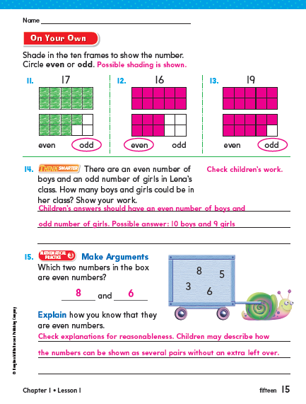
Go Math: CORE Differentiated Instruction
Students needing more support with a particular lesson
Tier 2 and Tier 3 students for the chapter (could be SPED or Gen Ed)
Differentiated Instruction
20 minutes
Small Group Instruction
3 – 5x per week
Independent/ Collaborative Work
10 minutes: Tier 2 Activity available on Think Central
Support Staff Push in/Pull Out During this Time
10 minutes: Guided Practice or Personal Math Trainer
Notes:
So we are in the differentiated instruction part of the lesson which is 20 minutes part of the math block. This part can be confusing – go slow and give them time to think and process.
Click
Next we are going to talk about the Differentiated Instruction (20 min) part of the Math Framework. This has several components so bear with me and we will have some process/question time.
CLICK
Most days we will split our classes into 2 groups of students:
Students needing additional support and proficient/advanced students
CLICK
Let’s focus on our students needing additional support first…
How did I decide on these six kids?
CLICK The first four are the ones I identified as Tier2/Tier3 kids on the Trimester Preassessment – remember those four red kids?
CLICK
The last two are the two I identified in my Quick Check as needing more support with this specific lesson concept – remember my two orange kids.
Those two kids will not stay the same each day because it is different lesson each day and a separate quick check. So some days you could only have 6 in your group, but there may be other days where this group is larger. The four Tier2/Tier3 students will most likely always be in this group. During this trimester.
Possible Question: What if the Tier2/Tier3 students passed the Quick Check?
That is going to be a teacher decision.
CLICK
So all of those students identified as needing additional support will complete a 10 minute Tier 2 activity with the teacher to which is available on Think Central. It is the same concept of the day – but taught in a different, more scaffolded way.
Remembering that this part of the math block is 20 minutes – the teacher leads the entire group through the Tier 2 activity and then the group splits apart. CLICK for the next 10 minutes.
CLICK
The four Tier2/Tier3 kids will move into Personal Math Trainer on a tablet. Personal Math Trainer is a program that will help the students to practice the concept of the day, but personalize to their learning level. These students will use this for the last 10 minutes of this block daily – More information on Personal Math Trainer will be shared in the Summer Training.
CLICK
The two other students will do the On Your Own section in their student editions with the guidance of their teacher as they were just needing a little additional assistance with the concept of the day.
Pause – let them process for a short time.
CLICK This small group instruction will occur 3-5x per week.
CLICK
The question always occurs – what is the rest of the class doing while those six kids are working with the teacher? And I know I only have 22 students represented up here and many of you have larger classes. ☺
These students are doing independent/collaborative work.
CLICK
All of these students will complete teacher selected problems in the On Your Own section in their SE.
Click
After they complete that section they will move into Math Centers which could include – Grab and Go Differentiated Centers Kit, Technology, Math Journaling, and/or Fastt Math.
CLICK
This is the time in the lesson where push-in/pull out support will come in. So there may actually be more than two groups going if teachers have the extra support available.
You do not have to answer these unless they come up…
POSSIBLE QUESTIONS:
If we have push-in support – will they replace the personal math trainer in working with the students?
Potentially. That is a decision based on student need.
What if I do not have enough devices for Personal Math Trainer? More than six Tier2/Tier3?
Prioritize the needs of your students.
Is Personal Math Trainer available for all students?
PMT is an adaptive intervention program available for students needing additional support and scaffolding.

Slide 75
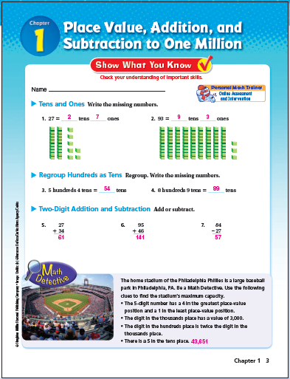
Formative Assessment
Show What You Know: 1 per Chapter
Quick Check: Daily
Quick Check Students
Tier 2 + 3 Students for Chapter 1
VS.
Students needing additional support with lesson concept
These students do not need intense support
Different students daily
Same group of students for the entire chapter.
Students who need additional assistance with Chapter Concepts
Could be SPED or Gen-ed
Different students each chapter
Notes:
Do this with the teachers – bring connecting cubes.

Slide 76
Go Math: Differentiated Instruction
Students needing more support with a particular lesson
Tier 2 and Tier 3 students for the chapter (could be SPED or Gen Ed)
Differentiated Instruction
20 minutes
20 minutes on Personal Math Trainer
(Adaptive Prerequisites)
10 minutes Guided Practice with Teacher
10 minutes On Your Own Skill Practice
Support Staff Push in / Pull Out During this Time
10 minutes Math Centers
10 minutes Advanced Learners Activity with Teacher
Small Group Instruction
(1-2x per week)
Notes:
I am going to soon give you some process time, as I know, it is a lot of information, but there is one more scenario to consider…
The Differentiated Instruction will look different at least 1 time per week.
It is important that we are also meeting with our advanced learners.
Let’s look at our students needing additional support.
Click
We have our group of four red students who were identified as tier 2 and tier 3 by the pre-assessment.
Click
And we have our group of two students who needed a little more assistance with the concept of the day as indicated by the quick check.
Click
Our tier 2 + 3 students will be spending the full 20 minutes on Personal Math Trainer which CLICK personalizes their learning at their individual level.
Click
Our orange students will spend CLICK the first 10 minutes of this part doing some guided practice with the teacher.
While the teacher is working with this small group – the advanced kids are doing the on your own section individually. (see animation on right side of the screen).
Click
During the last 10 minutes the orange students move into a center and the teacher is now doing a 10 minute advanced lesson with the advanced students that is available in the teacher edition.
Click
This is happening 1 – 2 times per week. Remember it does not HAVE to look like this – this is one way to structure this time.
Click
And the rest of the class is working independently or collaboratively on the On Your Own and the Math Centers.
Click
And again, this is the time that push in or pull out support is in the classroom.
Possible Questions:
When do proficient students have time with the teacher in small group? If I always pass my quick check, but I am not necessarily advanced – when do I get time with the teacher?
These students are getting core support and are indicating that they do not need additional teacher time. Their math needs are being met during core instruction. Since there is a quick check every day this will allow the students who need help with the content to receive help. This is flexible grouping.

Slide 77
Go Math: Special Education + Intervention
Special Education + Intervention
Daily Math Review +
Mental Math
(15 min maximum)
Whole Group Concept Development
(20 min)
Differentiated Instruction
(20 min)
Problem
Solving
(15 min)
Whole Group Concept Development
(20 min)
Problem
Solving
(15 min)
ENGAGE
Small Group Instruction
What if a Special Education student is out of the room during whole group?
SPED students will be in the classroom for Core Whole Group Instruction.
Education student is Can a SPED student miss Daily Math Review in order to receive SPED services?
Maybe. It depends on the students and their needs and ability levels.
EXPLORE
Independent / Collaborative
EXPLAIN
Personalized Learning
Core Whole Group Instruction
Notes:
There are many questions about Special Education and Intervention that have popped up in PLCs.
The most common was how does it fit into the framework.
What is considered whole group?
Click
The 20 minutes of Whole Group Concept Development and the 15 minutes of problem solving is Core Whole Group Instruction.
Click
So the question is – what if a special education student is out of the room during whole group?
Click
And the answer is that all SPED students will be in the classroom for Core Whole Group Instruction.
Click
Next Question – can a sped student miss DMR in order to receive SPED services?
Click
Maybe – it depends on the student and his or her ability level and needs. If you have a student who is a grade or two below grade level – reviewing the prerequisites in DMR may be beneficial – but if the student is many levels below – DMR may not be appropriate.

Slide 78
Go Math
Math Block: 75 – 90 minutes/day
Math Block: 75 – 90 minutes/day
Daily Math Review +
Mental Math
(15 min maximum)
Whole Group Concept Development
(20 min)
Differentiated Instruction
(20 min)
Differentiated Instruction
(20 min)
Differentiated Instruction
(35-40 min)
Problem
Solving
(15 min)
Math Intervention: 15-20 minutes/day (**only for students in need of intensive support)
Where do Special Education minutes fit into The Math Framework?
Students may receive in-class or pull out support during the 20 minutes of Differentiated Instruction time.
What might the classroom look like during the additional 15-20 minutes of Intervention? What are Tier 3 SPED students missing during intervention?
One option would be to add 15-20 minutes to the Differentiated Instruction time for Math Intervention. The teacher would be working in small groups and students would be in centers.
Notes:
The question then comes up
CLICK
Where do SPED minutes fit into the framework?
CLICK
SPED students may receive in class or pull out support during the 20 minutes of differentiated time.
CLICK
What might my classroom look like during the additional 15-20 minutes of Intervention? What are Tier 3 SPED students missing during intervention?
If a students IEP indicates they need additional math support outside of the core time where do we fit this in? One option would be to change the 75 minute math block to a 90 minute block and add the 15 – 20 extra minutes to the differentiated instruction component in the math block.
Click
Then the SPED student is receiving 35-40 minutes of support while the Core teacher is working with other small groups of students and students are also working in centers.
Again, this is one way it COULD look but it is dependent on the specific needs in each classroom. Principals have received this information and are working on a plan for a structure to support all the needs of the students.

Slide 79
Go Math
The Math Block:
Daily Math Review
Mental Math 2 – 5 Problems
Whole Group Concept Development
Engage Digital Lesson
Explore – Whole Group Content
Explain Guided Practice
Quick Check
Differentiated Instruction
Teacher Small Group
Independent/Center Work
Personal Math Trainer
Chapter One Scavenger Hunt:
Find the On Your Own for Lesson 1.1
Brainstorm ideas with a partner on how to structure your small group time in the math block

Slide 80
Go Math
The Math Block: 75 – 90 minutes/day
Daily Math Review
Mental Math 2 – 5 Problems
Whole Group Concept Development
Engage Digital Lesson
Explore – Whole Group Content
Explain Guided Practice
Quick Check
Differentiated Instruction
Teacher Small Group
Independent/Center Work
Personal Math Trainer
Problem Solving
Interactive White Board

Slide 81
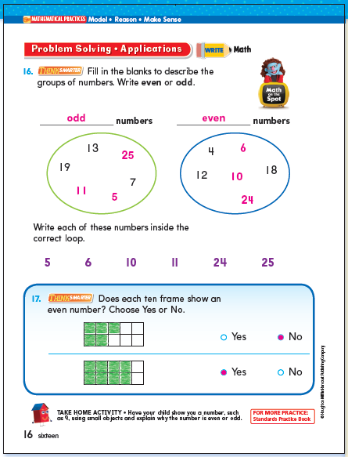
Go Math
Math Block: 75 – 90 minutes/day
Problem Solving
Interactive White Board
Daily Math Review +
Mental Math
(15 min maximum)
Whole Group Concept Development
(20 min)
Differentiated Instruction
(20 min)
Problem
Solving
(15 min)
Notes:
The last part of the math block is the problem solving section.
This section is timed at a 15 minute minimum. We recognize the importance of students solving problems in context and do not want to short change this section because it is at the end of a lesson.
Therefore, when teachers are planning lessons – they must plan for 15 minutes of problem solving daily and if they need to shorten other sections to do so – that is okay.
CLICK
The students have the problems in their SE and there are also videos available called Math On The Spot which are puppets leading students through how to solve certain problems.
There are interactive white board lessons available for this section as well.
We are not going to get into the interactive white board discussion at this time. Technology will be covered in the MAY PLC. We are just saying the interactive white board is available.

Slide 82
Go Math
The Math Block:
Daily Math Review
Mental Math 2 – 5 Problems
Whole Group Concept Development
Engage Digital Lesson
Explore – Whole Group Content
Explain Guided Practice
Quick Check
Differentiated Instruction
Teacher Small Group
Independent/Center Work
Personal Math Trainer
Problem Solving
Interactive White Board
Chapter One Scavenger Hunt:
Find the Problem Solving in Lesson 1.1
Find the Problem Solving section of the Interactive White Board Lesson for Lesson 1.1
Brainstorm ideas with a partner on how you will use the Interactive White Board for Problem Solving

Slide 83
Go Math
The Math Block: 75 – 90 minutes/day
Daily Math Review
Mental Math 2 – 5 Problems
Whole Group Concept Development
Engage Digital Lesson
Explore – Whole Group Content
Explain Guided Practice
Quick Check
Differentiated Instruction
Teacher Small Group
Independent/Center Work
Personal Math Trainer
Problem Solving
Interactive White Board

Slide 84
Go math: critical success factors

Slide 85
Go Math: Critical Success Factors
Notes:
Overview slide…

Slide 86
Go Math: Critical Success Factors
Launching the Chapter
Daily Math Review + Mental Math
Whole Group Concept Development
Formative Assessment
Show What You Know Pre-Assessment
Grade 1 – 5: beginning of school year
“Engage” Digital Lesson
Daily
Quick Check: Create Groupings
Vocabulary Activity
Grade K: start of second semester
“Explore” Lesson Daily
Vocabulary Builder
Hands-on Manipulatives
15 minutes maximum
Grab and Go Centers
Guided Practice: “Explain” - Share and Show
2-5 multi-step mental math problems daily
School-Home Letter

Slide 87
Go Math: Critical Success Factors
Launching the Chapter
Daily Math Review + Mental Math
Whole Group Concept Development
Formative Assessment
Differentiated Instruction
Problem
Solving
Management + Organization
Intervention
Small Group Instruction 3-5x week for students in need of additional support.
Utilize Problem Solving Interactive White Board example
Plan for differentiated instruction using Think Central Resources.
Tier 3
Fastt Math
15 minutes minimum daily
Management system for use of technology.
Small Group Instruction 1-2x week for Advanced Students.
Organization of manipulatives
Students Needing Additional Support: Personal Math Tutor daily
Students not in small group will complete “On Your Own” and Math Centers.

Slide 88
Math Assessment Plan What will PLC / Data Teams Look Like in 2014-2015?

Slide 89
How might the Data Team/PLC structure look different in 2014-2015?
Having conversations around what instruction will look like at the teacher and student level.
Focus on the use of Go Math
Engagement techniques within Go Math
Opportunities for collaborative practice using the new materials and technology.
Use of the Show What You Know assessment to differentiate instruction and plan for small group time.

Slide 90
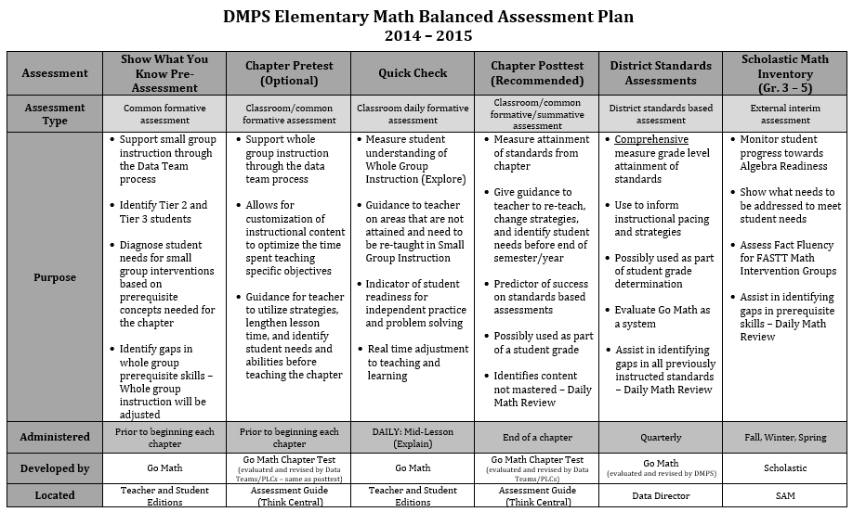
Elementary Math Assessment Plan

Slide 91
Elementary Math Assessment Plan
Show What You Know Pre-Assessment
Formative Assessment
Administered: Prior to beginning each chapter
Developed by: Go Math
Located: Teacher and Student Editions
Purpose:
Support small group instruction through the Data Teams process
Identify Tier 2 and Tier 3 students
Diagnose student needs for small group interventions based on prerequisite concepts needed for the chapter
Identify gaps in whole group prerequisite skills – Whole group instruction will be adjusted

Slide 92
Elementary Math Assessment Plan
Show What You Know Pre-Assessment
Formative Assessment

Slide 93
Elementary Math Assessment Plan

Slide 94
Elementary Math Assessment Plan
Quick Check
Formative Assessment
Purpose:
Measure student understanding of Whole Group Instruction (Explore)
Guidance to teacher on areas that are not attained and need to be re-taught in Small Group Instruction
Indicator of student readiness for independent practice and problem solving
Real time adjustment to teaching and learning
Administered: Mid-Lesson DAILY (Explain)
Developed by: Go Math
Located: Teacher and Student Editions

Slide 95
Elementary Math Assessment Plan

Slide 96
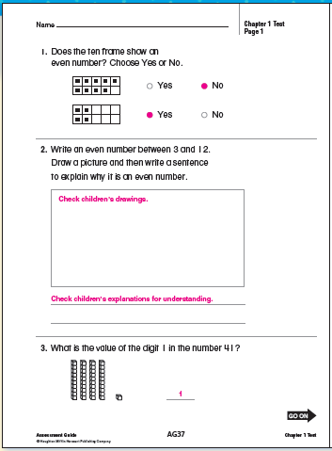
Elementary Math Assessment Plan
Chapter Posttest
(Recommended)
Formative / Summative Assessment
Purpose:
Measure attainment of standards from chapter
Give guidance to teacher to reteach, change strategies, and identify student needs before end of semester/year
Predictor of success on standards based assessments
Possibly used as part of a student grade
Identify content not mastered – Daily Math Review
Administered: End of a chapter
Developed by: Go Math
(Revised by Data Teams/PLC)
Located: Assessment Guide
(Think Central)

Slide 97
How Might PLC / Data Teams Look Different?
Posttest Data Team RECOMMENDED Structure
Assess your readiness level:
How frequent Math Data Teams meet
Use of the data to differentiate instruction

Slide 98
Elementary Math Assessment Plan

Slide 99
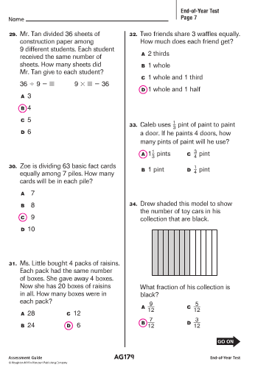
Elementary Math Assessment Plan
Quarterly District Standard Assessment
District Standards Based Assessment
Purpose:
Comprehensive measure grade level attainment of standards
Use to inform instructional pacing and strategies
Possibly used as part of student grade determination
Evaluate Go Math as a system
Assist in identifying gaps in all previously instructed standards – Daily Math Review
Administered: Quarterly
Developed by: Go Math
(Revised by DMPS District Team)
Located: Math Website (Available in August)

Slide 100
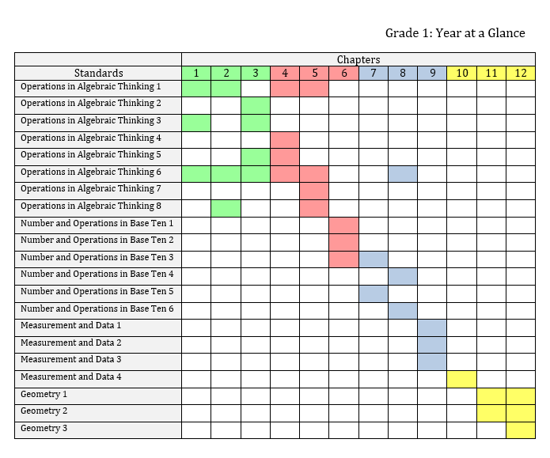
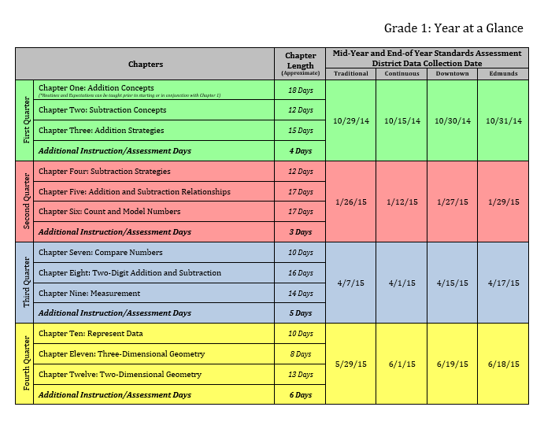
Math Data Teams
elementary.dmschools.org

Slide 101
Elementary Math Assessment Plan

Slide 102
Elementary Math Assessment Plan
Scholastic Math Inventory (SMI)
External Interim Assessment
Purpose:
Monitor student progress towards Algebra Readiness
Show what needs to be addressed to meet student needs
Assess Fact Fluency for FASTT Math Intervention Groups
Assist in identifying gaps in prerequisite skills – Daily Math Review
Administered: Fall, Winter, Spring
Developed by: Scholastic
Located: SAM

Slide 103
Elementary Math Assessment Plan

Slide 104
How Might PLC / Data Teams Look Different?
Pretest Data Team OPTIONAL Structure
Assess your readiness level:
How frequent Math Data Teams meet
Familiarity with Go Math materials in order to differentiate

Slide 105
Elementary Math Assessment Plan
Chapter Pretest
(Optional)
Common Formative Assessment
Purpose:
Support whole group instruction through the data team process
Allows for customization of instructional content to optimize the time spent teaching specific objectives
Administered: Prior to beginning a chapter
Developed by: Go Math
(evaluated and revised by Data Teams/PLCs)
Located: Assessment Guide (Think Central)

Slide 106
Elementary Math Assessment Plan

Slide 107
GO MATH RESOURCES

Slide 108
Go Math
AVAILABLE RESOURCES
Technology
Interactive White Board Lessons
Fastt Math
Engage Digital Lesson
Personal Math Trainer
Interactive Student Edition
iTools
Professional Development Videos
Strategic and Intensive Intervention Guides
Tier 2 Lessons on Think Central (through Teacher’s Edition)
Grab and Go Centers
Games
Literature
Activity
Activity Book
Bold – Access Daily Italic – Will be available through Think Central soon

Slide 109
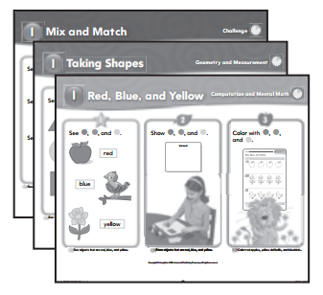
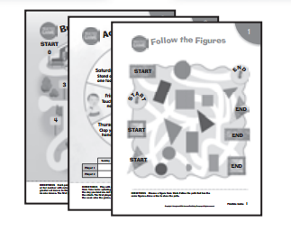
Go Math: Differentiated Instruction
Grab and Go Centers
Games (G): Practice skills and apply concepts with these ready-to-use interactive math adventures. Students can play these games in pairs or small groups.
Literature (L): Integrate math skills into real world situations and cross-curricular subject matter to engage student interest. Interactive questions focus on key concepts and support comprehension.
Activity Cards (A): Ready- made, easy-to-follow activities help students reinforce or extend concepts and skills.
*Includes cards for Challenge/Enrichment.

Slide 110
Go Math: Math Centers
Notes:
Setting them up for the next few slides…

Slide 111
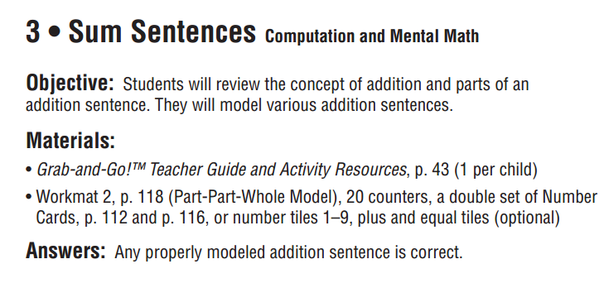
Go Math: Math Centers
Notes:
Setting them up for the next few slides…

Slide 112
Go Math: Math Centers
Notes:
Setting them up for the next few slides…

Slide 113
Go Math: Math Centers
“Good-to-Knows” about the Grab and Go Kits
Organizing a chapter at a time will make managing the components simpler. Some activities, games, and literature books may occur in future chapters.
Each activity card (blue, orange or purple) needs a student copy from the grab and go teacher book and sometimes other materials too. (Dice, counters, base ten blocks)
Some of the manipulatives required for the activity only come with paper/fold manipulatives so before you turn in old manipulatives – you may want to check on what you need for the centers and Tier 2 activities.
There is only 1 literature book and 1 copy of the game. You will probably need to make more copies of the game boards.
Notes:
Setting them up for the next few slides…

Slide 114
Go Math
AVAILABLE RESOURCES
Technology
Interactive White Board Lessons
Fastt Math
Engage Digital Lesson
Personal Math Trainer
Interactive Student Edition
iTools
Professional Development Videos
Strategic and Intensive Intervention Guides
Tier 2 Lessons on Think Central (through Teacher’s Edition)
Grab and Go Centers
Games
Literature
Activity
Activity Book
Bold – Access Daily Italic – Will be available through Think Central soon

Slide 115
Go Math: Think Central
Notes:
As an interventionist – there are many resources available to meet the students needs during intervention time. Depending on what the core teacher and the interventionist decide the interventionist can use any of the following resources in Tier 3 small group…
Click
Personal Math Trainer
Click
Strategic Intervention
Click
Intensive Intervention
Click
Tier 2 Activity available on Think Central
*More information on these resources in Summer Training
Possible Questions:
What if I have more Tier 3 students than I have devices?
Prioritize the needs of the students and other students can be working with the teacher and not on a device.
What will my other students be doing while I am doing this intervention?
That is completely up to the teacher.

Slide 116
Go Math: Think Central
Notes:
As an interventionist – there are many resources available to meet the students needs during intervention time. Depending on what the core teacher and the interventionist decide the interventionist can use any of the following resources in Tier 3 small group…
Click
Personal Math Trainer
Click
Strategic Intervention
Click
Intensive Intervention
Click
Tier 2 Activity available on Think Central
*More information on these resources in Summer Training
Possible Questions:
What if I have more Tier 3 students than I have devices?
Prioritize the needs of the students and other students can be working with the teacher and not on a device.
What will my other students be doing while I am doing this intervention?
That is completely up to the teacher.

Slide 117
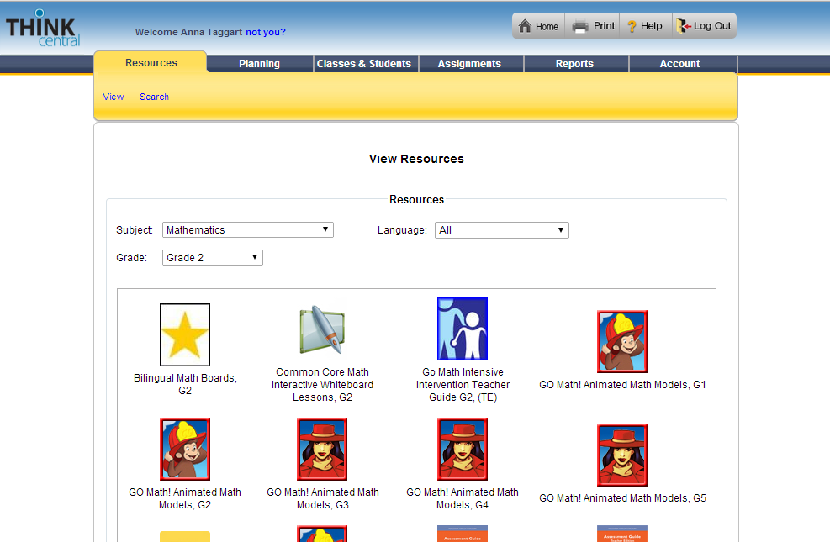
Go Math: Think Central
Notes:
As an interventionist – there are many resources available to meet the students needs during intervention time. Depending on what the core teacher and the interventionist decide the interventionist can use any of the following resources in Tier 3 small group…
Click
Personal Math Trainer
Click
Strategic Intervention
Click
Intensive Intervention
Click
Tier 2 Activity available on Think Central
*More information on these resources in Summer Training
Possible Questions:
What if I have more Tier 3 students than I have devices?
Prioritize the needs of the students and other students can be working with the teacher and not on a device.
What will my other students be doing while I am doing this intervention?
That is completely up to the teacher.

Slide 118
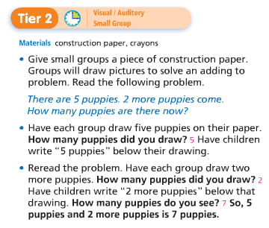
Go Math: Scavenger Hunt
Let’s find some resources…
Log on to Think Central
Under Resources – Click List
Select Grade Level, Math, and English
Find Resources
Interactive White Board Lessons – Problem Solving
Teacher Edition – Tier 2 Lesson
Grab & Go Activity Guide
Other Think Central Resources
Log on to the New Elementary Website
Find Curriculum Guide for Chapter One
Find Year at a Glace for Chapter One
Review Pacing
https://www.surveymonkey.com/s/elementarysummerpd
Notes:
As an interventionist – there are many resources available to meet the students needs during intervention time. Depending on what the core teacher and the interventionist decide the interventionist can use any of the following resources in Tier 3 small group…
Click
Personal Math Trainer
Click
Strategic Intervention
Click
Intensive Intervention
Click
Tier 2 Activity available on Think Central
*More information on these resources in Summer Training
Possible Questions:
What if I have more Tier 3 students than I have devices?
Prioritize the needs of the students and other students can be working with the teacher and not on a device.
What will my other students be doing while I am doing this intervention?
That is completely up to the teacher.

Slide 119
Collaborate, Plan, and explore Please complete the survey: https://www.surveymonkey.com/s/elementarysummerpd

