Slide 1
ELI Training 2015-2016

Slide 2
Outcomes
Understand Chapter 62 Requirements
SECTION 1 (Slides 3-12)
Understand the purpose of Universal Screening and Progress Monitoring
SECTION 2 (Slides 13- 26)
Become familiar with K-1 EarlyReading Universal Screening Measures
SECTION 3 (Slides 27- 36)
Become Familiar with 2-3 CBMReading Universal Screening Measure
SECTION 4 (Slides 37-74)
Login and Certify on Appropriate Assessments
SECTION 5 (Slides 75-90)

Slide 3
Early Literacy Implementation (ELI) What are the requirements?

Slide 4
K-3 Early Literacy Legislation Iowa Code §279.68
Section 279.68 of Iowa Code was passed during the 2012 legislative session, but it was not until the spring of 2013 that $8 million was appropriated to enact this law, which focuses on the following:
State-Approved Universal Screening & Progress Monitoring Assessments
Documented Interventions provided to students identified as at-risk of or having a substantial reading deficiency
Summer School & Retention starting in the summer of 2017
Notes:
1
26 page guidance document from DE available on their website and on our FAST PD page- I will highlight big ideas and need to knows
“ELI” Early Literacy Implementation/Code 279.68/Chapter 62

Slide 5
Big Ideas of Chapter 62
Universal screening in reading K-3
For students with a “substantial deficiency” in reading:
Progress monitoring (same requirement as for students who are “at risk”)
Intensive instruction, including 90 minutes a day of scientific, research-based reading instruction
Notice to parents:
The student has a substantial deficiency
Strategies they can use to help the child succeed
Student progress reports
Retention if the student is not proficient by the end of third grade, did not attend the summer program, and does not qualify for a good cause exemption
Notes:
3

Slide 6
DMPS Implementation
Universal screening in reading K-3 2014 K-1, 2015 2-3
For students with a “substantial deficiency” in reading:
Progress monitoring (same requirement as for students who are “at risk”)
Intensive instruction, including 90 minutes a day of scientific, research-based reading instruction
Notice to parents:
The student has a substantial deficiency
Strategies they can use to help the child succeed
Student progress reports
Retention if the student is not proficient by the end of third grade, did not attend the summer program, and does not qualify for a good cause exemption

Slide 7
DMPS Implementation
Universal screening in reading K-3 2014 K-1, 2015 2-3
For students with a “substantial deficiency” in reading:
Progress monitoring (same requirement as for students who are “at risk”) 2015
Intensive instruction, including 90 minutes a day of scientific, research-based reading instruction
Notice to parents:
The student has a substantial deficiency
Strategies they can use to help the child succeed
Student progress reports
Retention if the student is not proficient by the end of third grade, did not attend the summer program, and does not qualify for a good cause exemption

Slide 8
DMPS Implementation
Universal screening in reading K-3 2014 K-1, 2015 2-3
For students with a “substantial deficiency” in reading:
Progress monitoring (same requirement as for students who are “at risk”) 2015
Intensive instruction, including 90 minutes a day of scientific, research-based reading instruction Ongoing
Notice to parents:
The student has a substantial deficiency
Strategies they can use to help the child succeed
Student progress reports
Retention if the student is not proficient by the end of third grade, did not attend the summer program, and does not qualify for a good cause exemption

Slide 9
DMPS Implementation
Universal screening in reading K-3 2014 K-1, 2015 2-3
For students with a “substantial deficiency” in reading:
Progress monitoring (same requirement as for students who are “at risk” 2015
Intensive instruction, including 90 minutes a day of scientific, research-based reading instruction Ongoing
Notice to parents: 2015
The student has a substantial deficiency
Strategies they can use to help the child succeed
Student progress reports
Retention if the student is not proficient by the end of third grade, did not attend the summer program, and does not qualify for a good cause exemption

Slide 10
DMPS Implementation
Universal screening in reading K-3 2014 K-1, 2015 2-3
For students with a “substantial deficiency” in reading:
Progress monitoring (same requirement as for students who are “at risk”) 2015
Intensive instruction, including 90 minutes a day of scientific, research-based reading instruction Ongoing
Notice to parents: 2015
The student has a substantial deficiency
Strategies they can use to help the child succeed
Student progress reports
Retention if the student is not proficient by the end of third grade, did not attend the summer program, and does not qualify for a good cause exemption 2017, as required

Slide 11
Notice to Parents
Notice to parents will occur at conferences.
Parent(s) teacher, and students will create/revise a contract for reading support
More information and sample contracts coming…

Slide 12
2014 DMPS Implementation
Summer DE/AEA training for all principals plus one instructional coach or other representative
Number attended: 84
In school training provided by principal or instructional coach or other representative as Pre-Service PD in schools
All K-1 teachers and support staff
Materials printed and sent to schools based on number of teachers and interventionists (385 sets, appx.) *Materials were ordered and delivered for K-6*
Notes:
Stop to process (4 minutes)

Slide 13
Assessment Why Assess?

Slide 14
Assessment Measures
Screening
“So, how are you doing?”
Diagnostic
Further testing (specific blood tests, ultrasounds, etc)
Progress Monitoring
Follow up tests to determine response to treatment
Blood Pressure & Temperature
Educators as Physicians

Slide 15
Assessment Measures
Screening | Who has needs?
Diagnostic | What are the needs?
Monitoring Progress/Formative | Is our instruction working?
Outcome/Summative | How well did it work?

Slide 17
Universal Screening

Slide 18
Universal Screening
Universal Screening = ALL children
Brief and economical
Use measures valid for this purpose (FAST)
Provides overall indicator of performance
Strong predictor of target outcome (literacy success)
Used to PREDICT students likely to be successful vs. those who may not
Notes:
Review of Universal Screener

Slide 19
Universal Screening
K-1 subtests & 2-5 CBM Reading are indicators of overall literacy “health.”
Each K-1 subtest is weighted differently in the composite score based on research.
The screener does not give a detailed picture of what the individual needs of the students are (diagnostic assessments).
If less than 80% of students meet the benchmark of the universal screener, universal core should a focus for enhancement.

Slide 20
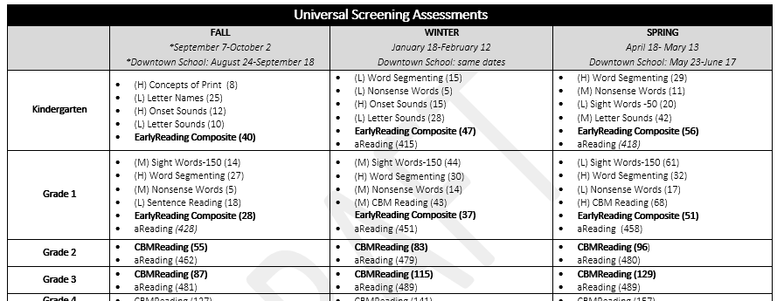
Universal Screening Measures
See FAST Assessment Plan 2015-2016 handout
Notes:
A few minutes to look at this. 10:30

Slide 21
Progress Monitoring

Slide 22
Formative Assessment: Embedded Classroom Assessment vs. Progress Monitoring
Embedded Classroom Assessments | Progress Monitoring
ALL students | Students identified as needing intervention
Informs instruction | Indicates whether intervention is working (yes/no)
Informal, seamless within instruction | Quick (1 minute), research-based (valid) tool
Specific to instruction | General outcome measure (goal = end of grade level expectation)

Slide 23
Formative Assessment: Embedded Classroom Assessment vs. Progress Monitoring
Embedded Classroom Assessments | Progress Monitoring
CFAs Exit Tickets WTL activities | FAST Progress Monitoring Probes Program Embedded Tools (System 44)

Slide 24
Principles of Effective Progress Monitoring
Set a goal and monitor at goal level
Monitor regularly (weekly)
Use a quick tool
Use a research-based (valid) tool
Collect additional data as needed
Use PM data to inform instructional decisions

Slide 25
Progress Monitoring with FAST
See FAST Assessment Plan 2015-2016 handout for Progress Monitoring Options for grade level

Slide 26
Progress Monitoring with FAST
OFF GRADE LEVEL Progress Monitoring measures can be used when necessary;
A grade level measure must be administered at least monthly.

Slide 27
Assessment Why FAST Assessments? (K-1 EarlyReading)

Slide 28
K-1 Early Reading

Slide 29
K-1 Early Reading
Research correlates these measures as strong indicators of overall literacy “health.”
Concepts of Print
Letter Names
Onset Sounds
Letter Sounds
Word Segmenting
Nonsense Words
Sight Words
NOT a list of skills to teach.
Used to predict students likely to be successful v. those may not.
Notes:
Why these measures? Research shows highest correlation to predicting overall literacy health.

Slide 30
K-1 Early Reading: Common Questions
Question: Word Segmenting
Some of my students who are already reading are having trouble with the segmenting subtest since they are already great at blending. Why use this subtest since it’s indicating that they are struggling even though they aren’t?

Slide 31
K-1 Early Reading: Common Questions
Explanation: Word Segmenting
Research shows that if they can blend it, they can segment it.
Test Prep: Be explicit about directions
Test Prep: Practice with sound boxes

Slide 32
K-1 Early Reading: Common Questions
Question: Nonsense Words
Why are we teaching students nonsense words? It’s confusing, especially for my ELL kids!

Slide 33
K-1 Early Reading: Common Questions
Explanation: Non-Sense Words
Reading nonsense words automatically is a strong indicator of overall literacy health, according to the research.
Rethink terminology: “Word Parts”
BAS KET = Basket
Short Vowel Focus
“Word Building” (Isabel Beck)
“Making Words” (Patricia Cunningham)
Subtests are indicators of overall literacy health
Notes:
Word wheel- changing first letter- really working with ONSET sounds even if it is sat, bat, cat, fat. Work from word lists like hit, hid, had, sad, sat, sit, it, at (those are short vowel strengthening!)

Slide 34
K-1 Early Reading: Common Questions
Question: Weighted Subtests
Some of my students scored really well on most of the subtests, but they are not even close to meeting the composite benchmark score. Why?

Slide 35
K-1 Early Reading: Common Questions
Explanation: Weighted Subtests
From Iowa DE 11.18.13
The earlyReading composite scores were developed to predict end of year broad reading achievement in kindergarten and first grade. The composite is generated based on weighted scores of several tests. The weighting of the individual scores in the composite was designed to optimize the prediction value of the composite. The actual formula is fairly complicated and not really important to know. It helps to know that scores that have a greater predictive value for the testing season get more weight.
It is possible for a student to be above benchmark on most tests yet be below the benchmark for the composite (or the reverse). This is not typical, but does happen sometimes, and is not considered to be a problem.
The composite is designed to be the best predictor for screening purposes. Of course, when interpreting individual student results, attend to the relative information from each test, as well as how close to the benchmark score the student is on each test.

Slide 36
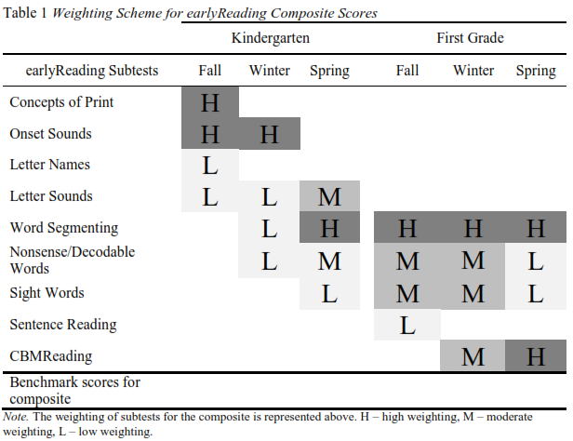
K-1 Early Reading: Common Questions
Explanation: Weighted Subtests
*see H, M, L marked next to each subtest on 2015-2016 FAST Assessment Plan

Slide 37
Assessment Why FAST Assessments? (2-3CBM Reading)

Slide 38
(Grades 2-3) CBM Reading

Slide 39
What’s FAST CBM-reading?
This video demonstrates a CBMReading administration using paper & pencil.
When using FAST, you will use a computer or other device to follow along, time, and record errors. Otherwise, the procedure is the same.
DATA from CBMReading = Fluency/Automaticity (WCPM) and Accuracy (% Correct)
Click link if video won’t play in ppt https://www.youtube.com/embed/fWnXhPKP-ho

Slide 40
What’s FAST CBM-reading?
Click link if video won’t play in ppt US with FAST

Slide 43
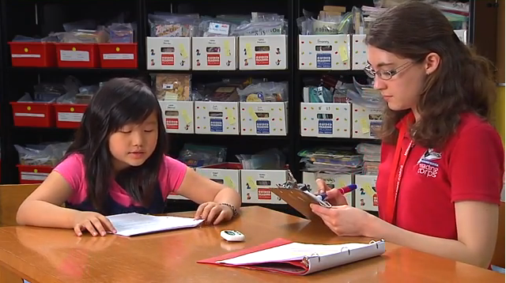
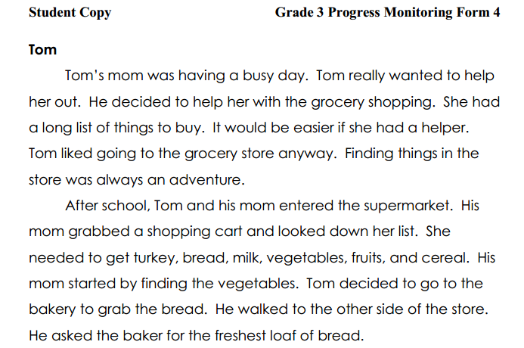
What is ?
CBMReading is Curriculum Based Measurement for reading
Screen/Benchmark 3 times a year (all students)
Read a 3 grade-level passages for one minute each
Words Read Correctly (WRC) per minute are computed
Reading errors are recorded
Frequent progress monitoring for students who are not proficient
64 words correct per minute. 8 errors. (89% accuracy)
Notes:
Introduce and explain CBMReading. An example of one passage, scored, is shown on the right.
Picture indicates that this is an individually administered measure.
64 words correct per minute with 8 errors (89% accuracy) is shown in the example. An important point to make about CBMReading is that it is not a measure that is solely concerned about rate of reading. Accuracy and qualitative features of students’ reading are also important components. Accuracy rate is one way in which we can better understand how well students are reading—and how well they are likely to understand what they are reading.

Slide 44
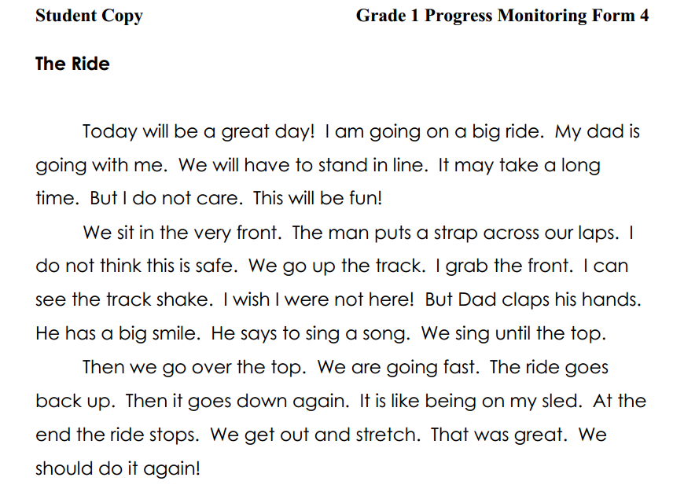
View a Sample Assessment
SAMPLE
Notes:
CBMReading covers Grades 1-6 for screening. There are three passages used per Benchmark Period, each read for 1 minute and scored accordingly. Here is a sample of CBMReading for Grade 1

Slide 45
Accuracy and Automaticity (fluency)

Slide 46
Theories & Evidence
Theoretic Foundation: Fluency & Automaticity
Assembly & Automation Theory
Comprehension enabled by automatic word identification
Information Processing Model
Improved automaticity frees up working memory
Freeing cognitive resources for more complex action
Phases of Skill Development (Instructional Hierarchy)
Accuracy | Fluency | Generalization | Adaption
Notes:
One of the major criticisms of CBM & promoting automaticity is that this approach ignores comprehension. However, it is likely that the development of “lower order” skills such as becoming accurate and fluent is necessary for more complex tasks (e.g. comprehending text).
As students become more proficient with basic skills, more cognitive resources become available for higher level (e.g. comprehension) tasks. This is why focusing on fluency and accuracy is only helpful to a point. Indeed, what we target for intervention should align with students’ skills.
Draw teachers’ attention to the figure at the bottom of slide. Note that these skills build on one another, such that mastery of lower order skills promotes the development of higher order skills (e.g. accuracy and fluency). You can provide examples of this order in other common skills as well (e.g. riding a bike, driving manual cars, sport specific skills). It is helpful to provide one example as a parallel to reading.
Note that these ideas are developed further in the next 4 slides.

Slide 47
Fluency
We use fluency because it represents the automation of procedural skills, which confers
Generalization of skills
Permanence of skills
Freeing of cognitive resources for more complex tasks
AND, rate-based assessments are more sensitive to growth over short periods

Slide 48
Back to …

Slide 49
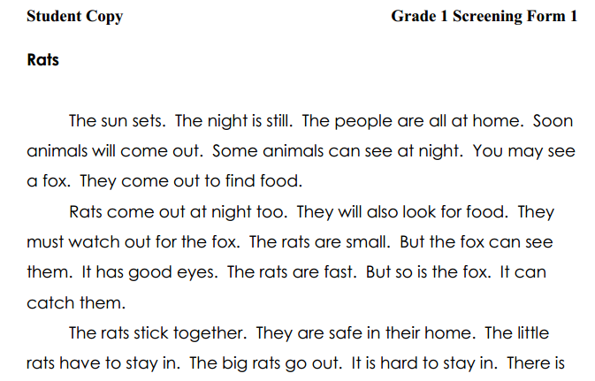
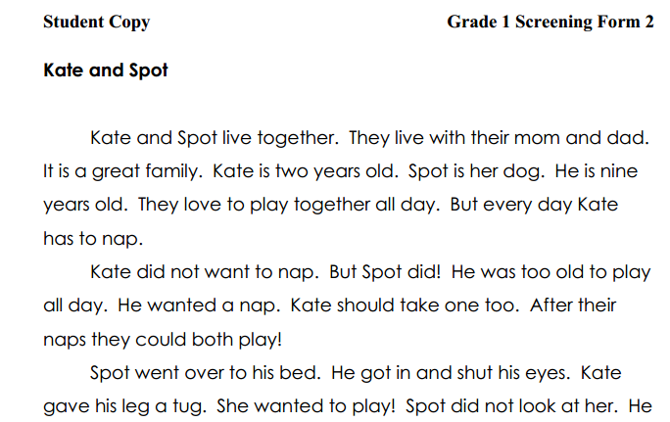
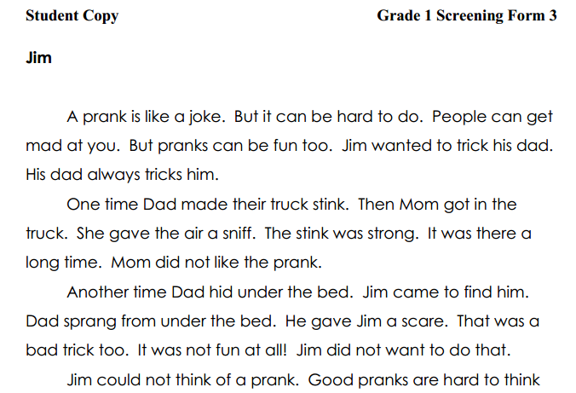
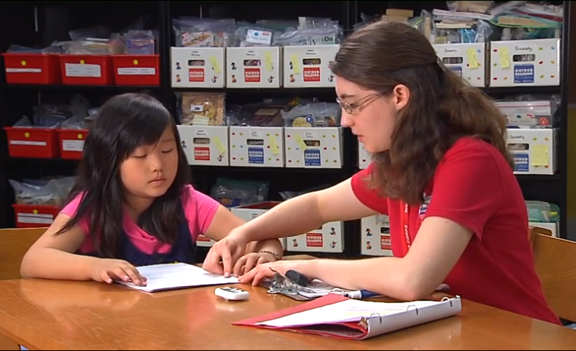
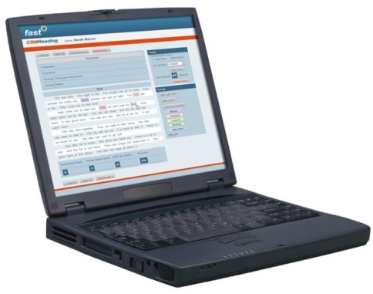
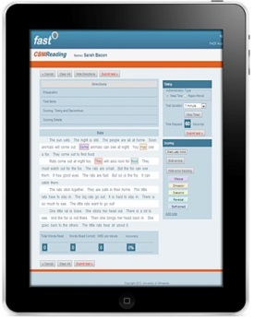
Paper copies for student to read aloud
(CBMReading shown in example. Process for most earlyReading assessments is similar in both English and Spanish.)
Browser-Based Scoring for CBMReading and earlyReading assessments:
Teacher provides student with materials to view/read.
Teacher gives standardized directions.
Student responds
or
Teacher scores “in real time” on computer or laptop
Teacher scores on computer device.
Notes:
The student is asked to read the passages for 1 minute each. The examiner may use a Mac or PC (tablet use in development) to score the assessment “in real time” while the student reads. This offers efficiency and helps increase accuracy of scoring. A paper-pencil option for scoring is also available.

Slide 50
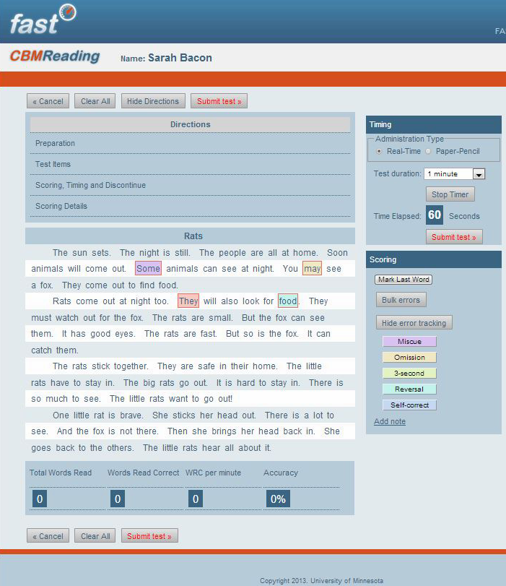
(CBMReading shown on iPad)
Administering CBMReading
Expand any section to obtain administration and scoring directions
Click “Start Timer”
As student reads , click any word to mark an error.
When “timer is up,” click last word + “Mark Last Word”
Click “Submit Test”
* Submit Test:
Auto-scores and saves the data.
The next assessment appears , or you may return to the main screen.
Notes:
Here is a closer view of the scoring platform for CBMReading. We will show this in greater depth later in this training. For now, note that the errors are marked and there is an optional method for coding error types. The assessment is automatically scored and a copy of the scored probe is stored digitally for later retrieval and review.
*****NOTE******
This screen shot shows the error tracking option, which *currently* is not a feature of Iowa TIER. One will need to point that out.

Slide 51
Administration & Scoring of

Slide 52
Quicksheet
Find the CBMReading Quicksheet (“Administration Review” Handout)
CBMR tab in your binder
Follow along as we review the directions for administration of CBMR

Slide 53
Administration & Scoring
Gather Materials
Teacher: Browser-based FAST application.
Student: Paper copy of student materials.
Prepare to assess
Navigate to CBMReading assessment.
Find student name and select pencil icon for CBMReading.
Notes:
DO this with the trainees.

Slide 54
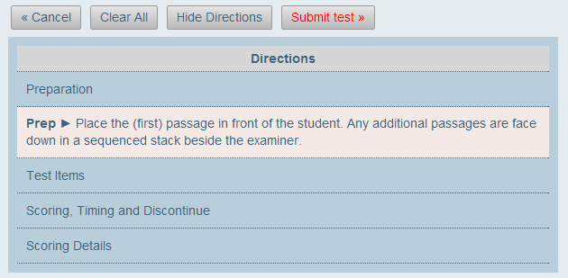
Administration & Scoring: Preparation
Click to review “Preparation”
Click to review “Test Items” and read directions verbatim to the student.
Notes:
If possible, you may have your trainees follow along on their computers.

Slide 55
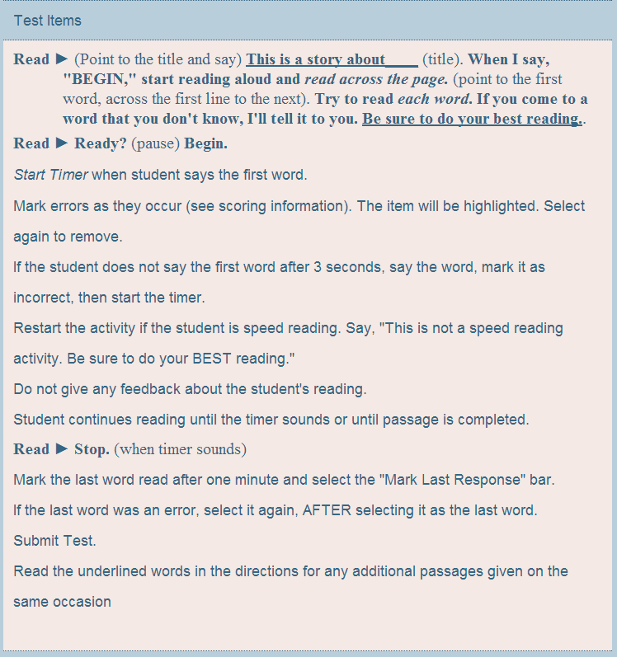
Administration & Scoring: Test Items
Read directions verbatim. Be ready to start timer.
Start timer at moment student says first word. (Wait up to 3 seconds.)
Any 3” delays, pauses, or struggles with a word: Say the word to the student and mark it as an error.
Speed readers: Pause timer quickly (e.g., within first sentence or so) address student and resume.
End of 1-minute: Mark last word. Prep for next passage.

Slide 56
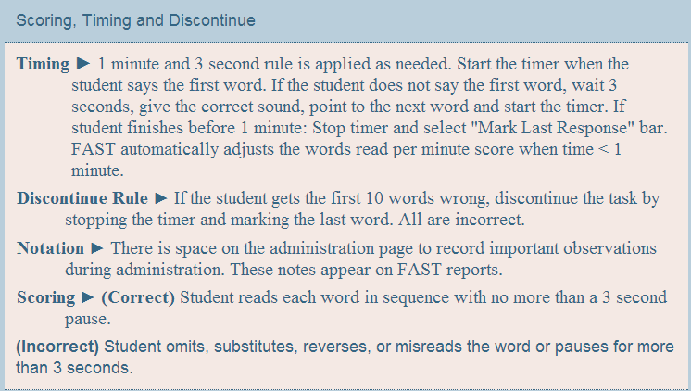
Administration & Scoring: Scoring
Review “Scoring, Timing & Discontinue” rules:
3-second pauses or struggles: Read the word to the student and mark the word incorrect. (Only when pause is 3-seconds.)
When to discontinue early: If student gets first 10 words incorrect
Incorrect word? Check the “Scoring Details” section for specifics.

Slide 57
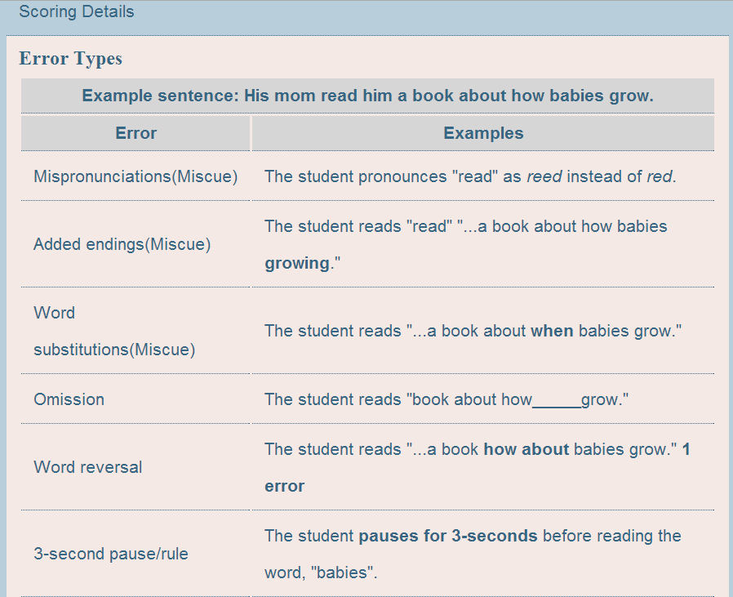
Administration & Scoring: Errors
Review “Scoring Details” rules:
Mispronunciations (Miscue)
Added endings (Miscue)
Substitutions (Miscue)
Omissions
Word Reversals (Word order)
3-second pause (or struggle without reading word)

Slide 58
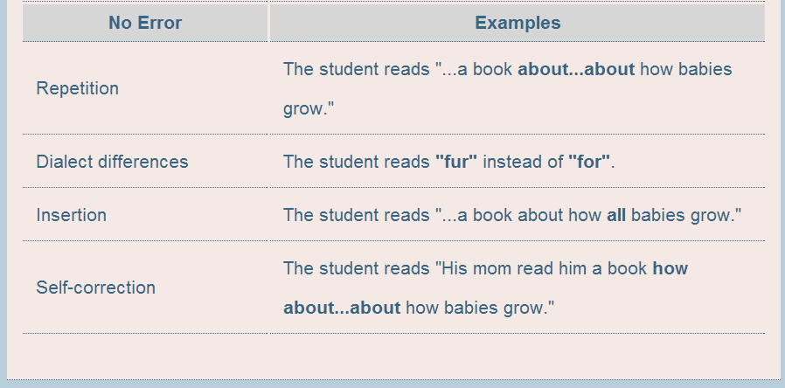
Administration & Scoring: Not Errors
Review “Scoring Details” rules:
Repetitions (are not errors)
Dialect Differences (Dialect or articulation differences are not errors)
Insertions (are not errors)
Self-Corrections (When within 3 seconds are not errors)

Slide 59
Administration & Scoring: Summary of Errors
ERRORS
NOT ERRORS
Mispronunciations, adding endings, substitutions (miscues)
Omissions
3-second pauses or struggles
Word reversals
Repetitions
Dialect differences
Insertions
Self-corrections (within 3 seconds)

Slide 60
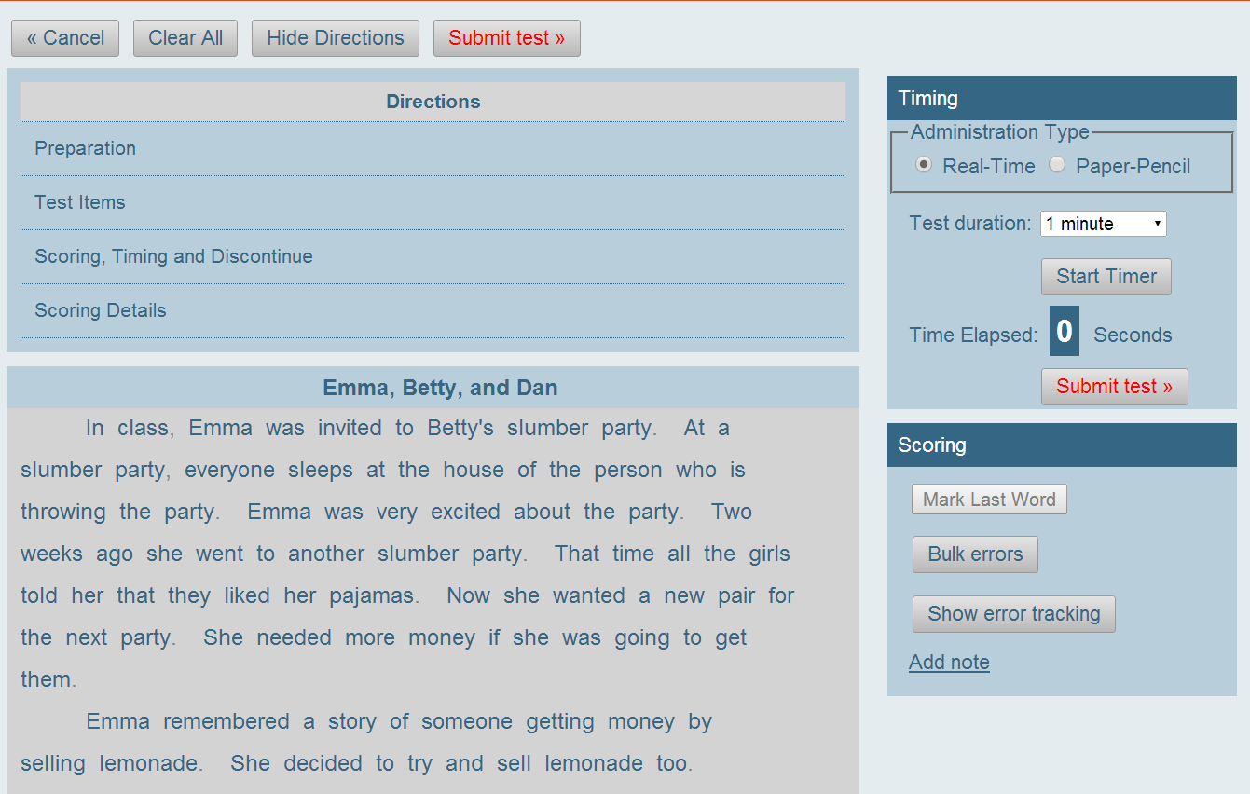
Administration & Scoring
Administering CBMReading via browser
Use “Real Time” (The default setting for any PC, Mac, iPad or Chromebook)
Use “1 minute” (The default setting for any PC, Mac, iPad or Chromebook)
Start Timer After you read directions verbatim and student says first word.
Click to mark errors Click again to de-select

Slide 61
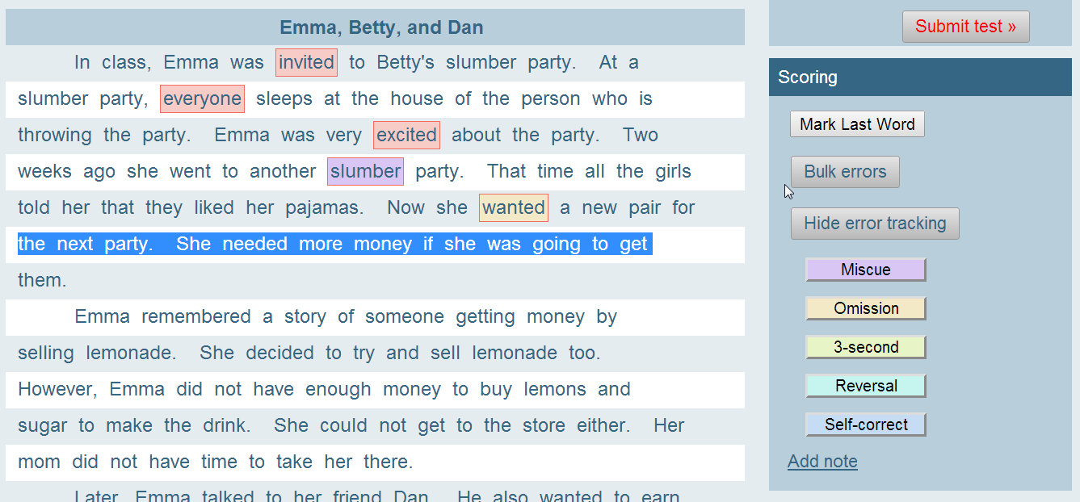
Administration & Scoring
Administering CBMReading via browser
Bulk Errors: Highlight a row (or portion of a row) if student skipped a group of words. Then click the “Bulk Errors” button to mark them all incorrect.

Slide 62
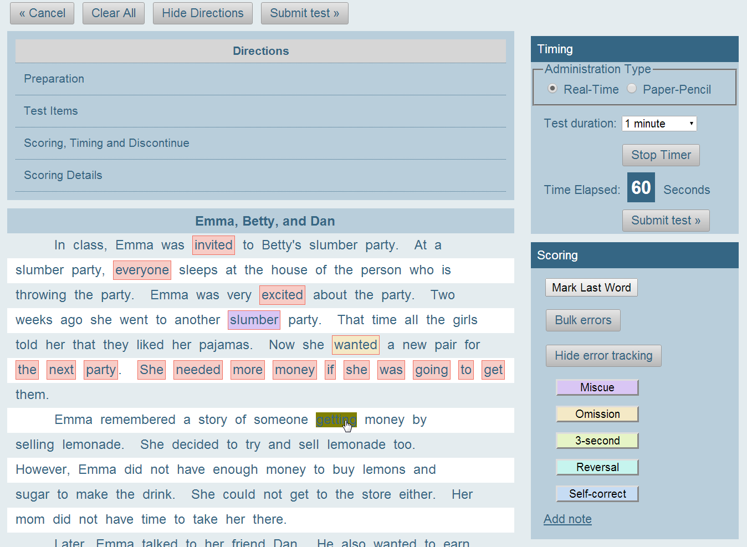
Administration & Scoring
Administering CBMReading via browser
Mark last word Click on the last word the student read when the “tone” is played at the end of time limit. Click it again to mark it as an error.
Submit test

Slide 63
CBM Reading Common Questions
Question: Fluency/Automaticity
I have kids that can read it (CBM) or produce it (Early Reading Measures), but just not fast enough to meet the benchmark score. Why does it matter if they are fast?

Slide 64
CBM Reading Common Questions
Explanation: Fluency/Automaticity
Fluency/Automaticity is a predictor of comprehension and overall reading health.
Automaticity Theory: The working brain only has so much attention to give to a task. Reading “the words” (or producing the letter sounds, etc.) must be automatic so attention can be paid to comprehending.

Slide 65
CBM Reading Common Questions
Automaticity Theory
When a truly automatic reader, students will look at a page and read the words on it in sequence, without unnatural hesitations. They will understand what those words mean on a subconscious level, and won't even have to think about or give too much attention to them to absorb their meanings.
-S. Jay Samuels

Slide 66
CBM Reading Common Questions
Click link if video won’t play in ppt Automaticity Video

Slide 67
CBM Reading Common Questions
Explanation: Fluency/Automaticity
Inform students of best practices for this assessment.
Test Prep: “Try to read each word. If you come to a word that you don’t know, I’ll tell it to you”
Try the words; keep going.
Test Prep: Type up familiar picture book as practice passage on one page.

Slide 68
CBM-Reading Directions
Standardized means a test is given the same way each time to each student.
This is important because it provides teachers with the most accurate reading results. To administer a standardized assessment:
Follow and read the directions exactly as they are listed.
Remember this is a time to test, not teach.
Students should not practice reading the passages ahead of time.
Errors should not be corrected during the assessment.

Slide 69
Administration & Scoring “Don’ts”
Administering a standardized assessment: The “Don’ts”
This is a test. Do not teach or correct student during test.
Follow and read the directions exactly as they are listed.
Teaching During Test
Modify Directions
Errors should not be corrected during assessment
Students should not practice or pre-read assessment
Don’t Correct Errors
No Student Practice
Notes:
Standardized directions require careful adherence to the administration and scoring directions and rules. Changing them can actually create problems. In some cases, it may even result in students receiving inappropriate programming.

Slide 70
Directions
CBM-Reading Directions
Prep ► Place the (first) passage in front of the student. Any additional passages are face down in a sequenced stack beside the examiner.
Read ► (Point to the title and say) This is a story about____ (title). When I say, "BEGIN," start reading aloud and read across the page. (point to the first word, across the first line to the next). Try to read each word. If you come to a word that you don't know, I'll tell it to you. Be sure to do your best reading.
Notes:
Word-for-Word From CBMReading Quick Sheet (handout)

Slide 71
CBM-Reading Directions
Read ► Ready? (pause) Begin.
Start Timer when student says the first word.
Mark errors as they occur (see scoring information). The item will be highlighted. Select again to remove.
If the student does not say the first word after 3 seconds, say the word, mark it as incorrect, then start the timer.
Restart the activity if the student is speed reading. Say, "This is not a speed reading activity. Be sure to do your BEST reading."
Do not give any feedback about the student's reading.
Student continues reading until the timer sounds or until passage is completed.
Notes:
Word-for-Word From CBMReading Quick Sheet (handout)

Slide 72
CBM-Reading Directions
Read ► Stop. (when timer sounds)
Mark the last word read after one minute and select the "Mark Last Response" bar.
If the last word was an error, select it again, AFTER selecting it as the last word.
Submit Test.
Read the underlined words in the directions for any additional passages given on the same occasion
Notes:
Word-for-Word From CBMReading Quick Sheet (handout)

Slide 73
CBM-Reading Directions
Timing ► 1 minute and 3 second rule is applied as needed. Start the timer when the student says the first word. If the student does not say the first word, wait 3 seconds, give the correct sound, point to the next word and start the timer. If student finishes before 1 minute: Stop timer and select "Mark Last Response" bar. FAST automatically adjusts the words read per minute score when time < 1 minute.
Discontinue Rule ► If the student gets the first 10 words wrong, discontinue the task by stopping the timer and marking the last word. All are incorrect.
Notation ► There is space on the administration page to record important observations during administration. These notes appear on FAST reports
Scoring ►
(Correct) Student reads each word in sequence with no more than a 3 second pause.
(Incorrect) Student omits, substitutes, reverses, or misreads the word or pauses for more than 3 seconds
Notes:
Word-for-Word From CBMReading Quick Sheet (handout)

Slide 74
CBM-Reading Directions
See Scoring Details for errors and examples
Notes:
Word-for-Word From CBMReading Quick Sheet (handout)

Slide 75
Resources & CERTIFICATION

Slide 76
Resources
ELEMENTARY.DMSCHOOLS.ORG> Resources> FAST Assessments Page
Links to DE Guidance documents
TIER guidance document that supports navigating TIER reports, assessment, & training
Link to A&A account login page
Documents to support analyzing the data
Documents to support family communication about FAST Assessments
All training materials used previously
And MORE!
Notes:
Links to DE Guidance documents
TIER guidance document that helps your navigate TIER
Link to sign in for TIER
Documents to support analyzing the data
Documents to support family communication about FAST Assessments
All training materials used previously

Slide 77
Iowa TIER Tour
Always Chrome or FireFox!
For additional navigation TIER Guidance:
http://elementary.dmschools.org/fast-assessments.html

Slide 78
Your Turn: A & A Account Set Up
No A & A Account?
Use instructions (handout) to set up your A & A account OR use videos on the following slides
DO NOT “Request roles”
Be sure to use your @dmschools.org email
All information for your “role” is pulled directly from Infinite Campus
**If the trouble-shooting guidance videos and documents on the next slide are not helping, contact Liz Griesel (Elizabeth.Griesel@dmschools.org) for additional support! ☺
Notes:
End 2:30

Slide 79
Your Turn: A & A Account Set Up
Video that details A & A Account Setup:
https://vimeo.com/iowatier/review/99264352/f283033346
Video that addresses common A & A Account Setup issues:
https://vimeo.com/iowatier/review/99264353/902dab3d7f
“Trouble-Shooting Access” DE Help Document
http://weebly-file/1/3/6/0/13604257/troubleshooting_access.docx
Notes:
End 2:30

Slide 80
Your Turn: Assessment Certification
Need certification on Early Reading Subtests or CBM-Reading?
Use Quick TIER Login to get to certifications page.
OR See the following slides for login walkthrough
Explore resources available on Elementary Curriculum Site> PD> FAST Page
Notes:
End 2:30

Slide 81
Log in to FAST
Notes:
In this next section, we will show you how to login to FAST, access the assessment, learn to administer and score CBMReading, and then practice within either the software or as small groups to ensure fidelity of administration and scoring.
Note to Trainer: If internet or software access is unavailable, the slide deck may be referenced as step-by-step directions for when the trainee returns to his/her school and can access their FAST accounts to practice independently.
In this case, use the practice activities available via paper-pencil. These are included in the Training Exercises packet.

Slide 82
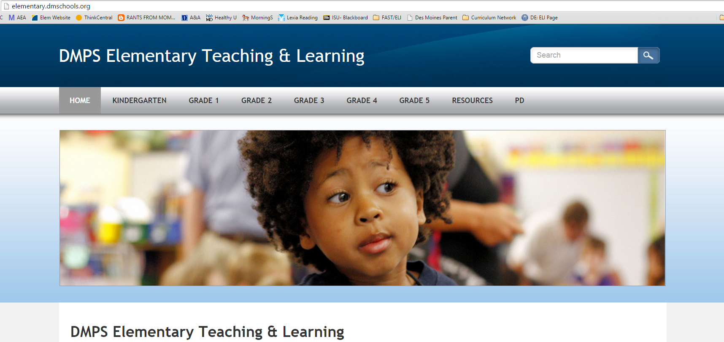
Your Turn: Assessment Certification
Navigate to www.elementary.dmschools.org
USE FIREFOX or CHROME only
Notes:
End 2:30

Slide 83
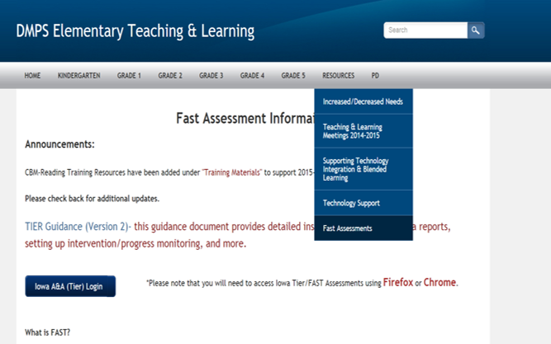
Your Turn: Assessment Certification
Under Resources heading, navigate to Fast Assessment page
Click “Iowa A&A (Tier)Login Button
Notes:
End 2:30

Slide 84
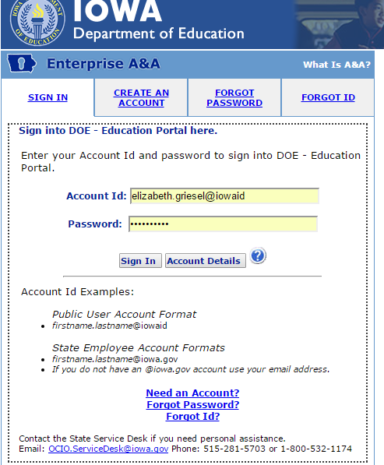
Your Turn: Assessment Certification
Enter your account id & password
Contact OCTO.ServiceDesk@iowa.gov for login assistance if needed
Click “Sign In”
Notes:
End 2:30

Slide 85
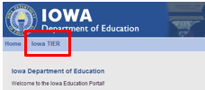
Your Turn: Assessment Certification
Click “Iowa TIER” from top menu
WAIT for TIER to load… (rolling clouds are good ☺)
Notes:
End 2:30

Slide 86
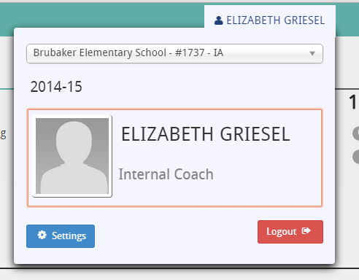
Your Turn: Assessment Certification
Use dropdown menu to make sure you have the correct school selected.
Notes:
End 2:30

Slide 87
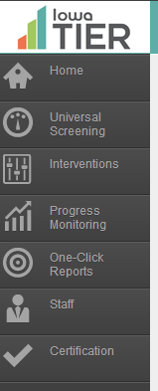
Your Turn: Assessment Certification
Use the ToolBar on the left to navigate to Certification,
Notes:
End 2:30

Slide 88
Navigate to the FAST Training
This reports your training status.
Select the appropriate check mark for your selection.
CLICK HERE

Slide 89
Navigate to the FAST Training
“Certification”
CLICK HERE
Click “?” to access HELP
This reports your training status.
Select the appropriate check mark for your selection.
CLICK HERE

Slide 90
School Specific Details
What will our assessment schedule for K-3 look like?
Who do I go to if I have trouble while administering the assessment?

